Slide 1
A study in 1 John

Slide 2
The Children of God
God's love is greater than the worlds love

Slide 3
See what kind of love the Father has given to us, that we should be called children of God; and so we are. The reason why the world does not know us is that it did not know him. Beloved, we are God's children now, and what we will be has not yet appeared;
1 John 3:1-3(ESV)

Slide 4
but we know that when he appears we shall be like him, because we shall see him as he is. And everyone who thus hopes in him purifies himself as he is pure.
1 John 3:1-3(ESV)

Slide 5
But God, being rich in mercy, because of the great love with which he loved us, even when we were dead in our trespasses, made us alive together with Christ—by grace you have been saved
Ephesians 2: 4-5(ESV)

Slide 6
...For I am sure that neither death nor life, nor angels nor rulers, nor things present nor things to come, nor powers, nor height nor depth, nor anything else in all creation, will be able to separate us from the love of God in Christ Jesus our Lord.
Romans 8:37-39(ESV)

Slide 7
In this is love, not that we have loved God but that he loved us and sent his Son to be the propitiation for our sins.
1 John 4:10(ESV)

Slide 8
But the steadfast love of the Lord is from everlasting to everlasting on those who fear him, and his righteousness to children's children
Psalms 103:17(ESV)

Slide 10
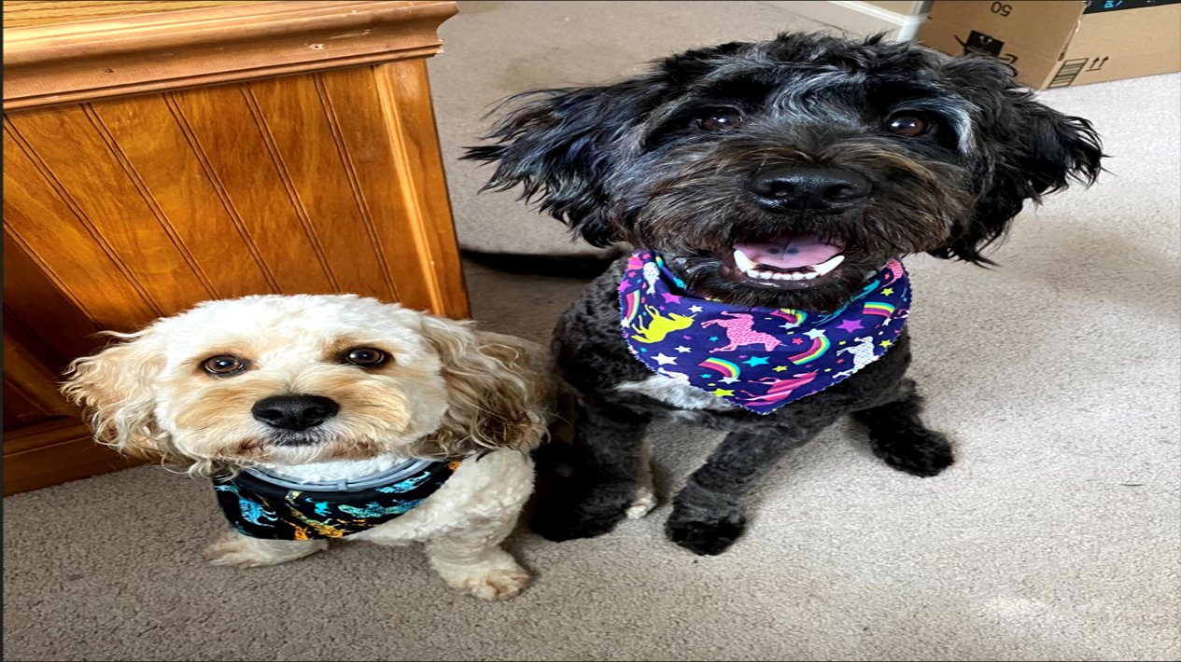

Slide 12
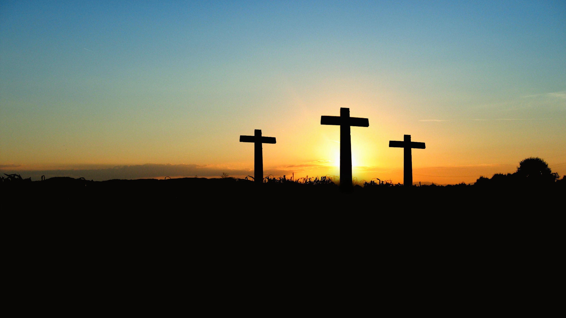

Slide 13
The kind of love that God has for us is so much more than the love we know and have

Slide 14
God loves us as his children and is openly inviting all to be adopted into his family where he will love you perfectly forever.

Slide 15
God's love is greater than the worlds love
The Children of God
The children of God are those who have truly accepted Jesus as their Lord

Slide 16
See what kind of love the Father has given to us, that we should be called children of God; and so we are. The reason why the world does not know us is that it did not know him.
1 John 3:1(ESV)

Slide 17
But to all who did receive him, who believed in his name, he gave the right to become children of God.
John 1:12(ESV)

Slide 18
For all who are led by the Spirit of God are sons of God. For you did not receive the spirit of slavery to fall back into fear, but you have received the Spirit of adoption as sons, by whom we cry, “Abba! Father!”
Romans 8:14-16(ESV)

Slide 19
The Spirit himself bears witness with our spirit that we are children of God.
Romans 8:14-16(ESV)

Slide 20
Because, if you confess with your mouth that Jesus is Lord and believe in your heart that God raised him from the dead, you will be saved. For with the heart one believes and is justified, and with the mouth one confesses and is saved.
Romans 10:9-10(ESV)

Slide 21
In him you also, when you heard the word of truth, the gospel of your salvation, and believed in him, were sealed with the promised Holy Spirit, who is the guarantee of our inheritance until we acquire possession of it to the praise of His glory.
Ephesians 1:13-14(ESV)

Slide 22
For in Christ Jesus you are all sons of God, through faith.
Galatians 3:26(ESV)

Slide 23
This means we need to check our heart to ensure we get this right, not all who claim to believe in Christ will be saved.

Slide 24
For such men are false apostles, deceitful workmen, disguising themselves as apostles of Christ. And no wonder, for even Satan disguises himself as an angel of light.
2 Corinthians 11:13-15(ESV)

Slide 25
So it is no surprise if his servants, also, disguise themselves as servants of righteousness. Their end will correspond to their deeds.
2 Corinthians 11:13-15(ESV)

Slide 26
But understand this, that in the last days there will come times of difficulty. For people will be lovers of self, lovers of money, proud, arrogant, abusive, disobedient to their parents, ungrateful, unholy, heartless, unappeasable, slanderous, without self-control,
2 Timothy 3:1-5(ESV)

Slide 27
brutal, not loving good, treacherous, reckless, swollen with conceit, lovers of pleasure rather than lovers of God, having the appearance of godliness, but denying its power. Avoid such people.
2 Timothy 3:1-5(ESV)

Slide 28
Not everyone who says to me, ‘Lord, Lord,’ will enter the kingdom of heaven, but the one who does the will of my Father who is in heaven.
Matthew 7:21-23(ESV)

Slide 29
On that day many will say to me, ‘Lord, Lord, did we not prophesy in your name, and cast out demons in your name, and do many mighty works in your name?’ And then will I declare to them, ‘I never knew you; depart from me, you workers of lawlessness.’
Matthew 7:21-23(ESV)

Slide 30
But even if we or an angel from heaven should preach to you a gospel contrary to the one we preached to you, let him be accursed.
Galatians 1:8(ESV)

Slide 31
Do not add to his word, lest he rebuke you and you be found a liar.
Proverbs 30:6(ESV)

Slide 32
God's love is greater than the worlds love
The children of God are those who have truly accepted Jesus as their Lord
The Children of God
The children of God will become like Jesus when he returns

Slide 33
Beloved, we are God's children now, and what we will be has not yet appeared; but we know that when he appears we shall be like him, because we shall see him as he is.
1 John 3:2(ESV)

Slide 34
But our citizenship is in heaven. And we eagerly await a Savior from there, the Lord Jesus Christ, who, by the power that enables him to bring everything under his control, will transform our lowly bodies so that they will be like his glorious body.
Philippians 3:20-21(ESV)

Slide 35
Just as we have borne the image of the man of dust, we shall also bear the image of the man of heaven.
1Corinthians 4:17(ESV)

Slide 36
These great rewards all point back to Gods great love towards his children.

Slide 37
God's love is greater than the worlds love
The children of God are those who have truly accepted Jesus as their Lord
The children of God will become like Jesus when he returns
The Children of God
As children of God, we are called to be pure as Christ is pure

Slide 38
And everyone who thus hopes in him purifies himself as he is pure.
1John 3:3(ESV)

Slide 39
Therefore be imitators of God, as beloved children. And walk in love, as Christ loved us and gave himself up for us, a fragrant offering and sacrifice to God.
Ephesians 5:1-3(ESV)

Slide 40
But sexual immorality and all impurity or covetousness must not even be named among you, as is proper among saints.
Ephesians 5:1-3(ESV)

Slide 41
Let us walk properly as in the daytime, not in orgies and drunkenness, not in sexual immorality and sensuality, not in quarreling and jealousy. But put on the Lord Jesus Christ, and make no provision for the flesh, to gratify its desires.
Romans 13:13-14(ESV)

Slide 42
So, whether you eat or drink, or whatever you do, do all to the glory of God.
1 Corinthians 10:31(ESV)

Slide 43
We are called to die to ourselves and live every aspect of our lives for Christ and the good news is God gave us the ability to persevere!

Slide 44
God's love is greater than the worlds love
The children of God are those who have truly accepted Jesus as their Lord
The children of God will become like Jesus when he returns
As children of God, we are called to be pure as Christ is pure
The Children of God
We need God and his word to accomplish these things

Slide 45
No temptation has overtaken you that is not common to man. God is faithful, and he will not let you be tempted beyond your ability, but with the temptation he will also provide the way of escape, that you may be able to endure it.
1 Corinthians 10:13(ESV)

Slide 46
So faith comes from hearing, and hearing through the word of Christ.
Romans 10:17(ESV)

Slide 47
Your word is a lamp to my feet and a light to my path.
Psalms 119:105(ESV)

Slide 48
But he answered, “It is written, “‘Man shall not live by bread alone, but by every word that comes from the mouth of God.’”
Matthew 4:4(ESV)

Slide 49
Scripture is the only true infallible word of God that we have. Our Father gave us an entire book that has instructions and letters of love and prophecy about the future etc. so let's live by it as Jesus told us to.

Slide 50
God's love is greater than the worlds love
The children of God are those who have truly accepted Jesus as their Lord
The children of God will become like Jesus when he returns
As children of God, we are called to be pure as Christ is pure
We need God and his word to accomplish these things

Slide 51
A study in 1 John

