Slide 1
The Story of Jesus

Slide 2
Oh how I love your law!
It is my meditation all the day. Your commandment makes me wiser than my enemies, for it is ever with me.
I have more understanding than all my teachers, for your testimonies are my meditation. I understand more than the age, for I keep your precepts.
Psalm 119:97-100

Slide 3
I hold back my feet from every evil way,
in order to keep your word.
I do not turn aside from your rules,
for you have taught me.
How sweet are your words to my taste,
sweeter than honey to my mouth!
Through your precepts I get understanding;
therefore I hate every false way.
Psalm 119:101-104

Slide 4
The Story of Jesus
THE STORY SO FAR
John the Baptist prepares the way for the ministry of Jesus by preaching in the wilderness, 1:1-8
Jesus comes to John for baptism, 1:9-11
Jesus is tempted by Satan, 1:12, 13

Slide 5
The Story of Jesus
THE STORY SO FAR
Jesus begins his ministry by preaching the gospel of the Kingdom of God, 1:14, 15
Jesus calls four fishermen to become fishers of men, 1:16-20
Jesus heals many. 2-3
Jesus is Lord of the Sabbath. 3

Slide 6
22 And the scribes who came down from Jerusalem were saying, “He is possessed by Beelzebul,” and “by the prince of demons he casts out the demons.” 23 And he called them to him and said to them in parables, “How can Satan cast out Satan? 24 If a kingdom is divided against itself, that kingdom cannot stand. 25 And if a house is divided against itself, that house will not be able to stand. 26 And if Satan has risen up against himself and is divided, he cannot stand, but is coming to an end.
Mark 3:22-26

Slide 7
27 But no one can enter a strong man's house and plunder his goods, unless he first binds the strong man. Then indeed he may plunder his house. 28 “Truly, I say to you, all sins will be forgiven the children of man, and whatever blasphemies they utter, 29 but whoever blasphemes against the Holy Spirit never has forgiveness, but is guilty of an eternal sin”— 30 for they were saying, “He has an unclean spirit.”
Mark 3:27-30

Slide 8
10 for he had healed many, so that all who had diseases pressed around him to touch him. 11 And whenever the unclean spirits saw him, they fell down before him and cried out, “You are the Son of God.”
Mark 3:10-11

Slide 9
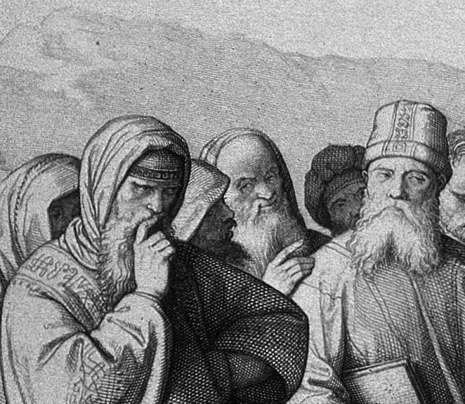
The Story of Jesus
The Scribes were high ranking officials. Their opinion carried a lot of weight. They accused Jesus of being possessed by Satan.

Slide 10
The Story of Jesus
Jesus addresses their argument directly as unreasonable and illogical.

Slide 11
The Story of Jesus
A house divided against itself.
Something will give way.

Slide 12
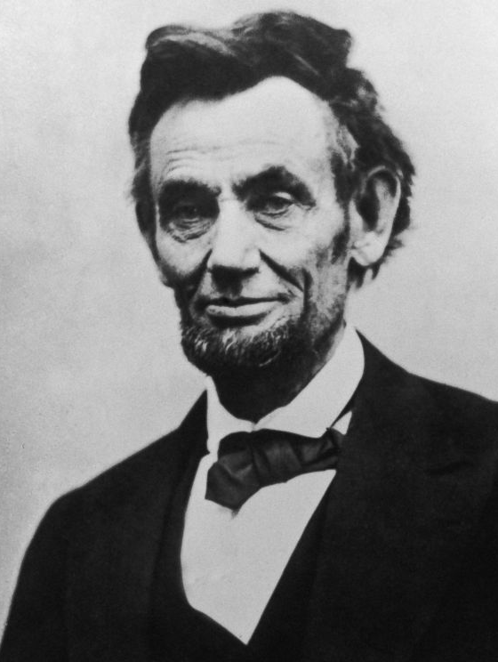
The Story of Jesus
A house divided against itself cannot stand. I believe this government cannot endure, permanently half slave and half free. I do not expect the Union to be dissolved -- I do not expect the house to fall -- but I do expect it will cease to be divided. It will become all one thing or all the other.

Slide 13
27 But no one can enter a strong man's house and plunder his goods, unless he first binds the strong man. Then indeed he may plunder his house.
Mark 3:27

Slide 14
Jesus answered, This voice has come for your sake, not mine. Now is the judgment of this world; now will the ruler of this world be cast out.
John 12:30-31

Slide 15
And having disarmed the powers and authorities, he made a public spectacle of them, triumphing over them by the cross.
Colossians 2:15

Slide 16
The Story of Jesus
Parables: Stories Jesus uses to teach some and confuse others.
The Lamp, New Cloth/Old Garment, The Sower, The Mustard Seed, The Good Samaritan, Prodigal Son

Slide 17
The Story of Jesus
The key to parables is often to find Jesus in the parable before you find yourself.

Slide 18
Jesus came to crush the devil.

Slide 19
The one who does what is sinful is of the devil, because the devil has been sinning from the beginning. The reason the Son of God appeared was to destroy the devil’s work.
1 John 3:8

Slide 20
12 The Spirit immediately drove him out into the wilderness. 13 And he was in the wilderness forty days, being tempted by Satan. And he was with the wild animals, and the angels were ministering to him.
Mark 1:12-13

Slide 21
24 If a kingdom is divided against itself, that kingdom cannot stand. 25 And if a house is divided against itself, that house will not be able to stand. 26 And if Satan has risen up against himself and is divided, he cannot stand, but is coming to an end.
Mark 3:24-26

Slide 22
“The time is fulfilled, and the kingdom of God is at hand; repent and believe in the gospel.”
Mark 1:15

Slide 23
The Story of Jesus
The battle with Satan isn’t over in Mark 1 or Mark 3 (Jesus will end up sacrificing his life to establish the kingdom fully), but a decisive blow has already been dealt.

Slide 24
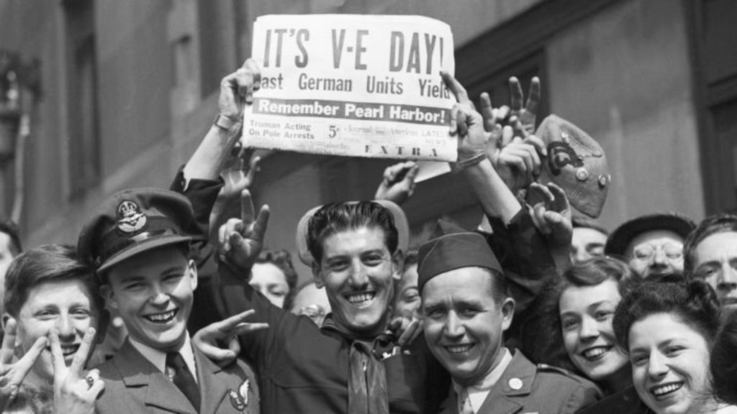
The Story of Jesus
“In God’s War with Satan's evils, D-Day, occurred with the death and resurrection of Christ. Ultimate victory is now assured; yet the fight rages on until V-E day, the glorious return of Christ.” – Ken Blue

Slide 25
Jesus came to crush the devil.
Jesus can forgive your sin.

Slide 26
The Story of Jesus
Because we’re bound by our sin, we have no way of binding this strong man ourselves.

Slide 27
And you were dead (Νεκρός nekrósin) in the trespasses and sins 2 in which you once walked, following the course of this world, following the prince of the power of the air, the spirit that is now at work in the sons of disobedience— 3 among whom we all once lived in the passions of our flesh, carrying out the desires of the body and the mind, and were by nature children of wrath, like the rest of mankind.
Ephesians 2: 1-4

Slide 28
4 But God, being rich in mercy, because of the great love with which he loved us, even when we were dead in our trespasses, made us alive together with Christ—by grace you have been saved— and raised us up with him and seated us with him in the heavenly places in Christ Jesus, so that in the coming ages he might show the immeasurable riches of his grace in kindness toward us in Christ Jesus.
Ephesians 2:4-7

Slide 29
The Story of Jesus
Jesus has bound the strong man and given us life with and in Him.

Slide 30
5 And when Jesus saw their faith, he said to the paralytic, “Son, your sins are forgiven.”
Mark 2:5

Slide 31
The Story of Jesus
Jesus has bound the strong man so that we would no longer bear the weight of our sin, but be forgiven.

Slide 32
Jesus came to crush the devil.
Jesus can forgive your sin.
Jesus Gives Life Where
Adam Brought Death

Slide 33
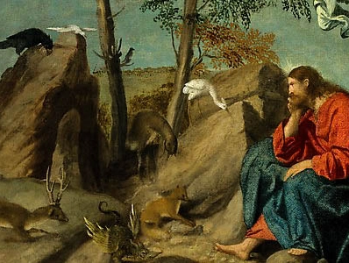
The Story of Jesus
The relationship between the binding of the strong man and Jesus’s temptation shows us that Jesus is the new Adam who brings life in place of death.

Slide 34
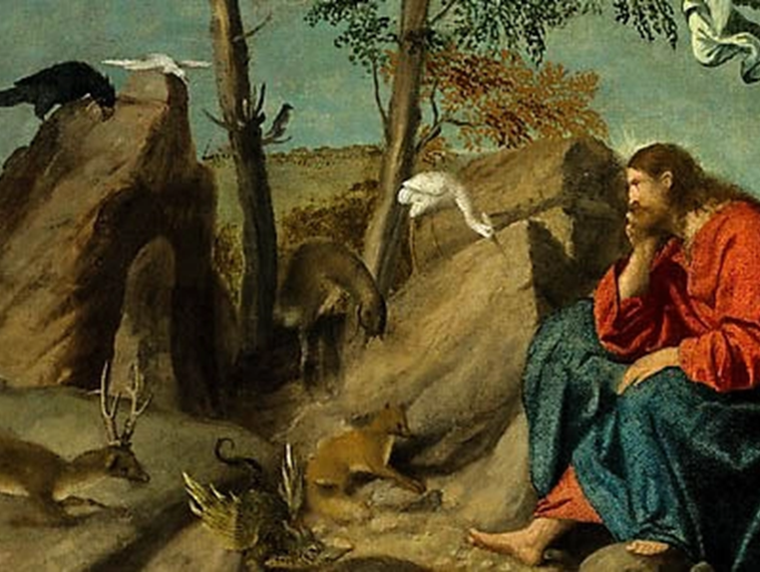
The Spirit immediately drove him out into the wilderness. And he was in the wilderness forty days, being tempted by Satan. And he was with the wild animals, and the angels were ministering to him.
Mark 1:12-13

Slide 35
Righteousness shall be the belt of his waist, and faithfulness the belt of his loins. The wolf shall dwell with the lamb, and the leopard shall lie down with the young goat, and the calf and the lion and the fattened calf together; and a little child shall lead them.
Isaiah 11:5-6

Slide 36
And he seized the dragon, that ancient serpent, who is the devil and Satan, and bound him for a thousand years
Revelation 20:2

Slide 37
The Story of Jesus
Jesus bound the strong man through obedience to God’s will. And only this fully obedient Savior has the authority to grant you life and forgive your sins.

Slide 38
The Story of Jesus
All my life I live to follow
You alone as you change my desires
Liberated by the blood of Jesus
I’ve found life in the sweetness of freedom

Slide 39
The Story of Jesus
Blasphemy of
the Holy Spirt

Slide 40
The Story of Jesus
“If forgiveness is withheld for eternity, guilt is sealed for eternity. God is never neutral to sin. Ge either forgives it or He punishes it. Not to be forgiven by God is to forever suffer His wrath forever.”
(Piper, Beyond Forgiveness)

Slide 41
The Story of Jesus
First of all, what is blaspheming? To speak against or to slander; i.e. exactly what the pharisees are doing.

Slide 42
Truly, I say to you, all sins will be forgiven the children of man, and whatever blasphemies they utter, but whoever blasphemes against the Holy Spirit never has forgiveness, but is guilty of an eternal sin”
Mark 3:28-29

Slide 43
Therefore I tell you, every sin and blasphemy will be forgiven people, but the blasphemy against the Spirit will not be forgiven. And whoever speaks a word against the Son of Man will be forgiven, but whoever speaks against the Holy Spirit will not be forgiven, either in this age or in the age to come.
Matthew 12:31-32

Slide 44
The Story of Jesus
Blasphemy against the SON is forgivable, because the avenue for forgiveness is repentance.

Slide 45
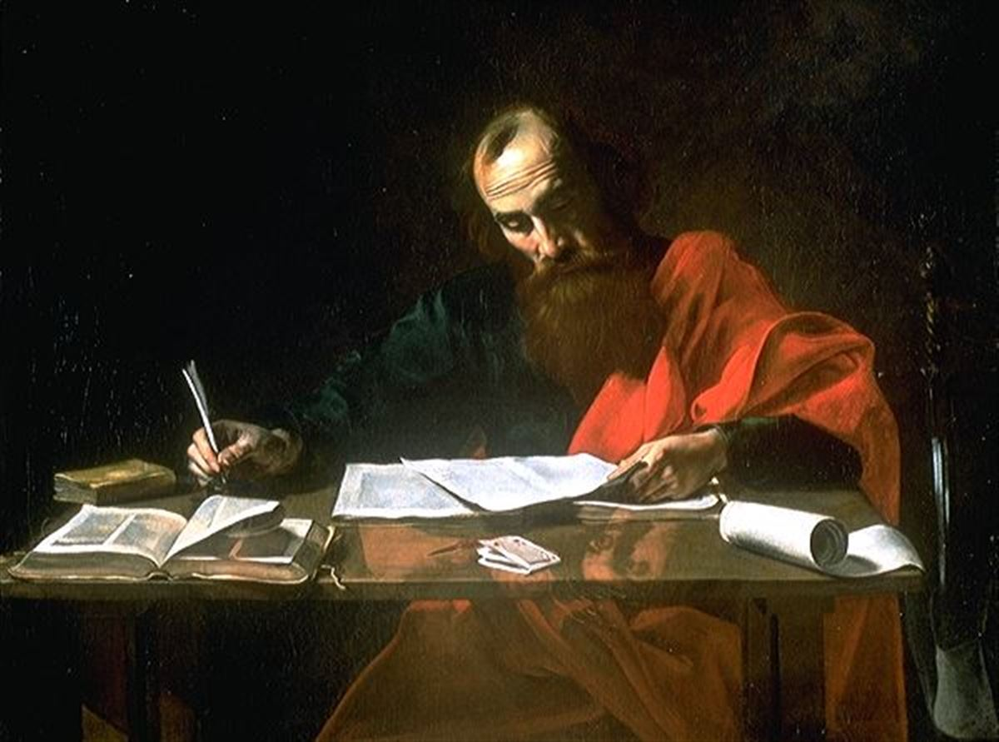
(Paul) though formerly I was a blasphemer, persecutor, and insolent opponent. But I received mercy because I had acted ignorantly in unbelief, 14 and the grace of our Lord overflowed for me with the faith and love that are in Christ Jesus.
1 Tim. 1:13-14

Slide 46
The Story of Jesus
Blasphemy against the SPIRIT is unforgivable, because the avenue to forgiveness is rejected.

Slide 47
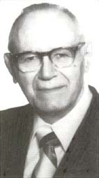
The Story of Jesus
“ By means of their own criminal and completely inexcusable callousness, (the pharisees) are dooming themselves. Their sin is unpardonable because they are unwilling to tread the path that leads to pardon. For the thief, the adulterer, the murderer, there is hope. The message of the Gospel may cause him to cry out ‘be merciful to me, O God, for I am a sinner’!
-W. Hendriksen

Slide 48
Jesus came to crush the devil.
Jesus can forgive your sin.
Jesus Gives Life Where Adam Brought Death
We must avoid labeling anyone as guilty of the unforgivable sin.

Slide 49
Jesus came to crush the devil.
Jesus can forgive your sin.
Jesus Gives Life Where Adam Brought Death
Avoid labeling the unforgivable sin.
The unforgivable sin is primarily a sin of the heart, not of the lips

Slide 50
9 because, if you confess with your mouth that Jesus is Lord and believe in your heart that God raised him from the dead, you will be saved. 10 For with the heart one believes and is justified, and with the mouth one confesses and is saved.
Romans 10:9-10

Slide 51
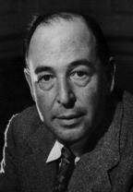
The Story of Jesus
“You must picture me alone in that room in Magdalen, night after night, feeling, whenever my mind lifted even for a second from my work, the steady, unrelenting approach of Him whom I so earnestly desired not to meet. That which I greatly feared had at last come upon me. In the Trinity Term of 1929 I gave in, and admitted that God was God, and knelt and prayed: perhaps, that night, the most dejected and reluctant convert in all England. I did not then see what is now the most shining and obvious thing; the Divine humility which will accept a convert even on such terms.”

Slide 52
The Story of Jesus
The Prodigal Son at least walked home on his own feet. But who can duly adore that Love which will open the high gates to a prodigal who is brought in kicking, struggling, resentful, and darting his eyes in every direction for a chance of escape? The words “compelle intrare,” compel them to come in, have been so abused be wicked men that we shudder at them; but, properly understood, they plumb the depth of the Divine mercy. The hardness of God is kinder than the softness of men, and His compulsion is our liberation.”

Slide 53
7 Key Conclusions about Blasphemy of the Holy Spirit
It is a sin of full knowledge
2. It is a verbal act that attributes the works of the Holy Spirit to Satan.
3. It is an ongoing disposition of the heart that resists the conviction of the Holy Spirit.

Slide 54
7 Key Conclusions about Blasphemy of the Holy Spirit
4. It is a willful rejection of God’s grace in Jesus.
5. It is rooted in unbelief.
6. It is a sin that a true Christian cannot commit.
7. It is a sin that not committed by one who is concerned that they may have committed it.

Slide 55
The Story of Jesus

Slide 56
NEED PRAYER?
text cccpray
to 97000
97000
cccpray
Crosby Community Church: Thank you for reaching out…

