Slide 1
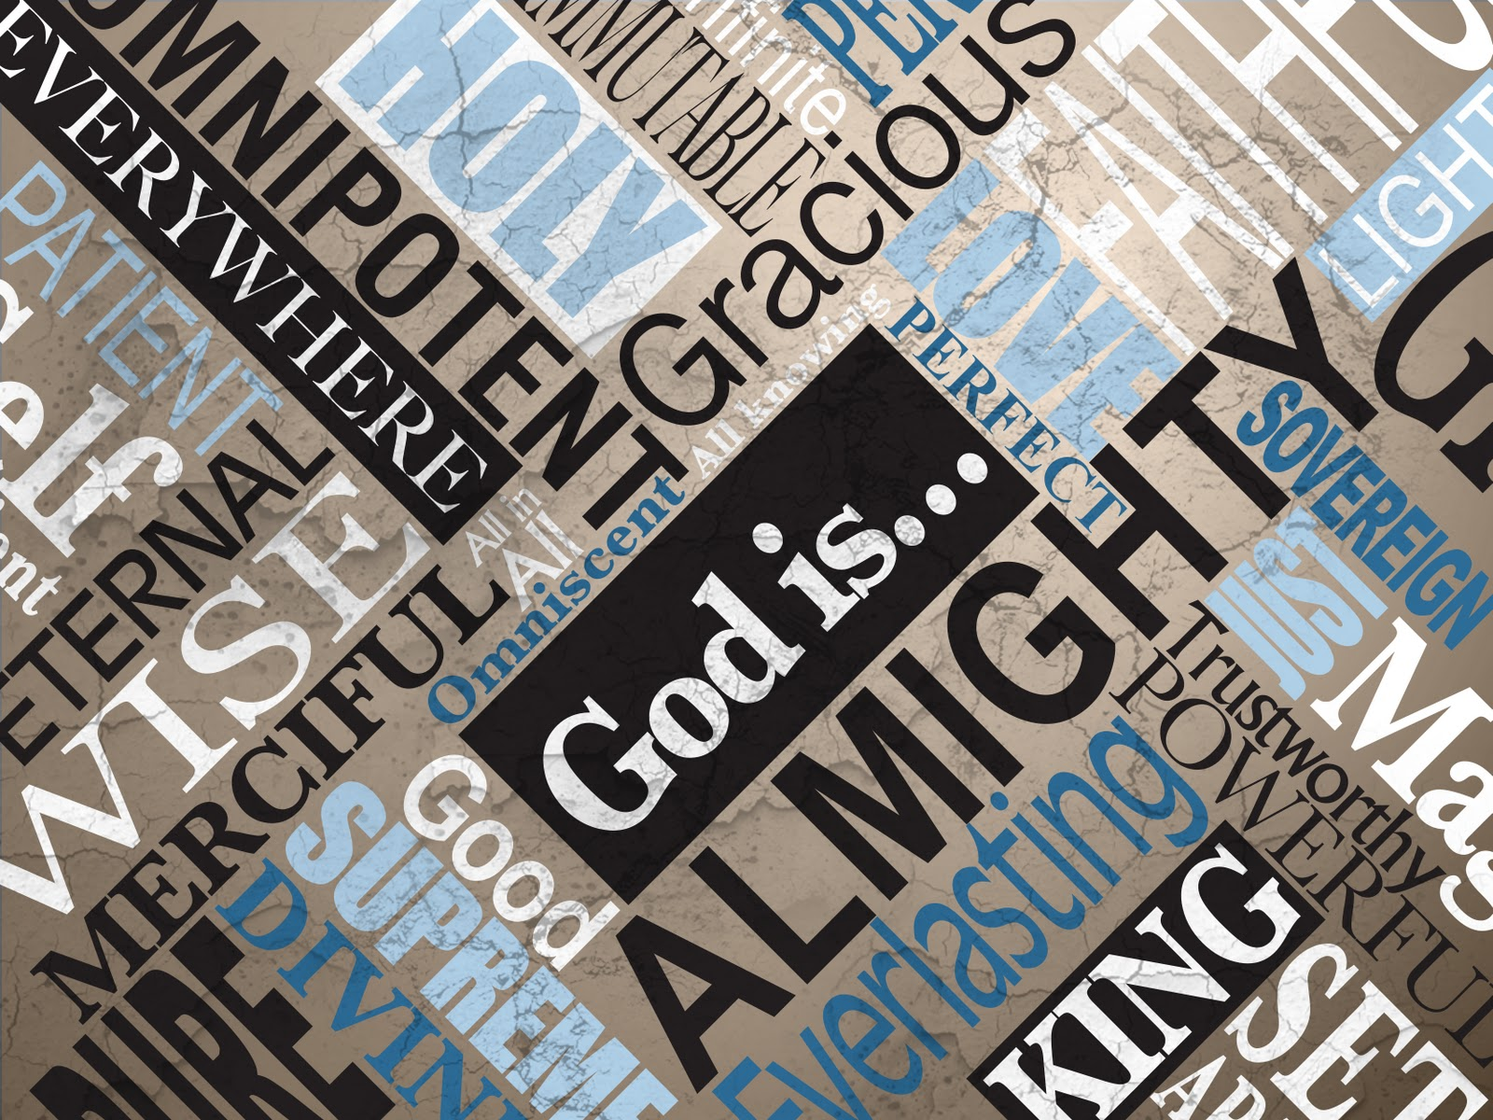

Slide 2
We will find that the more we discover about God, the more we will be in awe of Him.

Slide 3
God is... AWESOME!

Slide 4
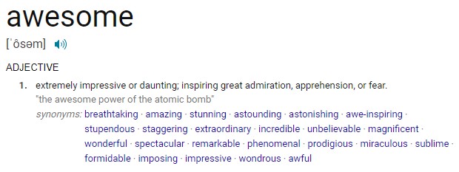

Slide 5
Who does God say He is?

Slide 6
Then Moses said to God, “If I come to the people of Israel and say to them, ‘The God of your fathers has sent me to you,’ and they ask me, ‘What is his name?’ what shall I say to them?”
Exodus 3:13-15

Slide 7
God said to Moses, “I Am Who I Am.”
Exodus 3:13-15

Slide 8
And he said, “Say this to the people of Israel,
‘I Am has sent me to you.’ ”
Exodus 3:13-15

Slide 9
God also said to Moses, “Say this to the people of Israel, ‘The Lord, the God of your fathers, the God of Abraham, the God of Isaac, and the God of Jacob, has sent me to you.’ This is my name forever, and thus I Am to be remembered throughout all generations.
Exodus 3:13-15

Slide 10
“I AM WHO I AM”: “YHWH” or “YAWEH”
Translated in English bibles: “LORD”
Short form: “YAH”
Hallelu-jah: “praise YAHWEH”

Slide 11
Jesus answered, “I tell you the truth, before Abraham was even born, I Am!” At that point they picked up stones to throw at him. But Jesus was hidden from them and left the Temple.
John 8:58-59 NLT

Slide 12
Who does God say He is?
God’s name is…“I AM”

Slide 13
In the beginning God created the heavens and the earth.
Genesis 1:1

Slide 14
Even Gentiles, who do not have God’s written law, show that they know his law when they instinctively obey it, even without having heard it.
Romans 2:14-15 NLT

Slide 15
They demonstrate that God’s law is written in their hearts, for their own conscience and thoughts either accuse them or tell them they are doing right.
Romans 2:14-15 NLT

Slide 16
They know the truth about God because he has made it obvious to them. For ever since the world was created, people have seen the earth and sky.
Romans 1:19-20 NLT

Slide 17
Through everything God made, they can clearly see his invisible qualities—his eternal power and divine nature. So they have no excuse for not knowing God.
Romans 1:19-20 NLT

Slide 18
The heavens proclaim the glory of God. The skies display his craftsmanship. Day after day they continue to speak; night after night they make him known.
Psalm 19:1-4

Slide 19
They speak without a sound or word; their voice is never heard. Yet their message has gone throughout the earth, and their words to all the world.
Psalm 19:1-4

Slide 20
Jesus Christ is the same yesterday, today, and forever.
Hebrews 13:8

Slide 21
“For I am the Lord, I do not change…
Malachi 3:6

Slide 22
Of old You laid the foundation of the earth, And the heavens are the work of Your hands.
They will perish, but You will endure; Yes, they will all grow old like a garment; Like a cloak You will change them, And they will be changed.
Psalm 102:25-27

Slide 23
But You are the same, And Your years will have no end.
Psalm 102:25-27

Slide 24
Who does God say He is?
God’s name is… I AM
God is more than we can comprehend

Slide 25
To whom then will you liken God? Or what likeness will you compare to Him?
Isaiah 40:18

Slide 26
“For as the heavens are higher than the earth, So are My ways higher than your ways, And My thoughts than your thoughts.
Isaiah 55:9

Slide 27
O LORD, there is none like You, nor is there any God besides You, according to all that we have heard with our ears.
1 Chronicles 17:20

Slide 28
Inasmuch as there is none like You, O Lord (You are great, and Your name is great in might), Who would not fear You, O King of the nations? For this is Your rightful due. For among all the wise men of the nations, And in all their kingdoms, There is none like You.
Jeremiah 10:6-7

Slide 29
But Jesus looked at them and said to them, “With men this is impossible, but with God all things are possible.”
Matthew 19:26

Slide 30
For with God nothing will be impossible.”
Matthew 19:26

Slide 32
Great is the Lord, and greatly to be praised; And His greatness is unsearchable. One generation shall praise Your works to another, And shall declare Your mighty acts.
I will meditate on the glorious splendor of Your majesty, And on Your wondrous works.
Psalm 145:3-5

Slide 33
Who does God say He is?
God’s name is… I AM
God is more than we can comprehend
God makes Himself small for you

Slide 34
Then He said, “Go out, and stand on the mountain before the Lord.” And behold, the Lord passed by, and a great and strong wind tore into the mountains and broke the rocks in pieces before the Lord, but the Lord was not in the wind;
1 Kings 19:11-12

Slide 35
and after the wind an earthquake, but the Lord was not in the earthquake; and after the earthquake a fire, but the Lord was not in the fire; and after the fire a still small voice
1 Kings 19:11-12

Slide 36
In the year that King Uzziah died, I saw the Lord sitting on a throne, high and lifted up, and the train of His robe filled the temple. Above it stood seraphim; each one had six wings: with two he covered his face, with two he covered his feet, and with two he flew
Isaiah 6:1-5

Slide 37
And one cried to another and said: “Holy, holy, holy is the Lord of hosts; The whole earth is full of His glory!” And the posts of the door were shaken by the voice of him who cried out, and the house was filled with smoke.
Isaiah 6:1-5

Slide 38
So I said: “Woe is me, for I am undone! Because I am a man of unclean lips, And I dwell in the midst of a people of unclean lips; For my eyes have seen the King, The Lord of Hosts.”
Isaiah 6:1-5

Slide 39
There are times when you need the God who is more than you can comprehend, but how do you approach Him???

Slide 40
…and after the fire a still small voice.
1 Kings 19:12

Slide 41
God didn’t just reveal who He is.
He came to us.
He came in the least intimidating way imaginable.
He came as a baby in a manger.

Slide 42
God loves you!
God wants to be approachable, so He sent Jesus to make this possible through the cross

Slide 43
So then, since we have a great High Priest who has entered heaven, Jesus the Son of God, let us hold firmly to what we believe.
This High Priest of ours understands our weaknesses, for he faced all of the same testings we do, yet he did not sin.
Hebrews 4:14-16

Slide 44
So let us come boldly to the throne of our gracious God.
There we will receive his mercy, and we will find grace to help us when we need it most.
Hebrews 4:14-16

Slide 45
O LORD, you have examined my heart and know everything about me. You know when I sit down or stand up. You know my thoughts even when I’m far away.
Psalm 139

Slide 46
You see me when I travel and when I rest at home. You know everything I do. You know what I am going to say even before I say it, LORD .
Psalm 139

Slide 47
How precious are your thoughts about me, O God. They cannot be numbered! I can’t even count them; they outnumber the grains of sand! And when I wake up, you are still with me!
Psalm 139

Slide 48
You go before me and follow me. You place your hand of blessing on my head.
Such knowledge is too wonderful for me, too great for me to understand!
Psalm 139

Slide 49
And those who know Your name will put their trust in You;
For You, Lord, have not forsaken those who seek You.
Psalm 9:10

Slide 50
Who does God say He is?
God’s name is “I AM” - I exist
God is more than we can comprehend
God makes Himself small for you

