Slide 1
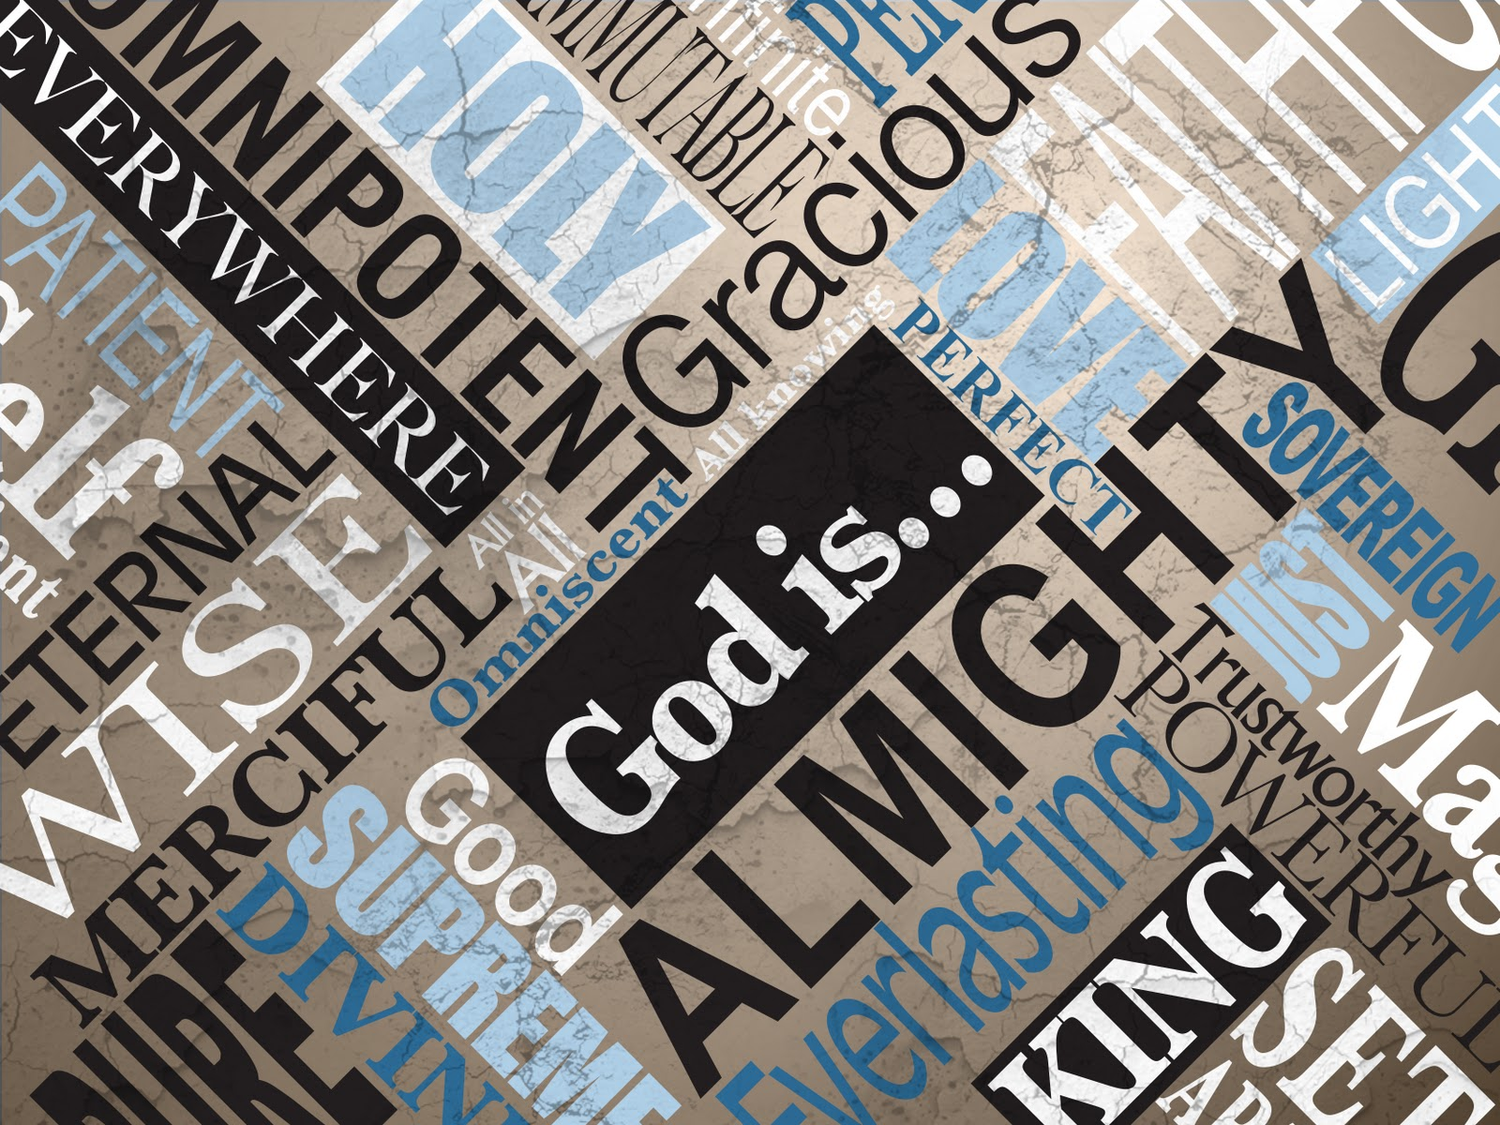

Slide 2
“There is a God we want, and there is a God who is—and they are not the same God.
The turning point of our lives is when we stop seeking the God we want and start seeking the God who is.”

Slide 3
Anytime you focus on just one attribute of God, you will come away with a distorted view of who God is.
God is the totality of all His attributes.

Slide 4
The Lord is king! Let the nations tremble! He sits on his throne between the cherubim. Let the whole earth quake! The Lord sits in majesty in Jerusalem, exalted above all the nations. Let them praise your great and awesome name. Your name is holy!
Psalm 99 (NLT)

Slide 5
Mighty King, lover of justice, you have established fairness. You have acted with justice and righteousness throughout Israel. Exalt the Lord our God! Bow low before his feet, for he is holy!
Psalm 99 (NLT)

Slide 6
Moses and Aaron were among his priests; Samuel also called on his name. They cried to the Lord for help, and he answered them. He spoke to Israel from the pillar of cloud, and they followed the laws and decrees he gave them.
Psalm 99 (NLT)

Slide 7
O Lord our God, you answered them. You were a forgiving God to them, but you punished them when they went wrong. Exalt the Lord our God, and worship at his holy mountain in Jerusalem, for the Lord our God is holy!
Psalm 99 (NLT)

Slide 8
God is… HOLY
The primary meaning of holy is the idea of being “separate”, or “otherness”

Slide 9
God is so far above and beyond us that He seems almost totally foreign to us.
To be holy is to be “other,” to be different in a special way.

Slide 10
And Moses said to Aaron, “This is what the Lord spoke, saying: ‘By those who come near Me I must be regarded as holy; And before all the people I must be glorified.’ ” So Aaron held his peace.
Leviticus 10:3 (NKJV)

Slide 11
Who among the gods is like you, Lord? Who is like you— majestic in holiness, awesome in glory, working wonders?
Exodus 15:11 (NIV)

Slide 12
“There is no one holy like the Lord; there is no one besides you; there is no Rock like our God.
1 Samuel 2:2 (NIV)

Slide 13
Who will not fear you, Lord, and bring glory to your name? For you alone are holy. …
Revelation 15:4 (NIV)

Slide 14
… For I am God, and not a man— the Holy One among you. ..
Hosea 11:9 (NIV)

Slide 15
The Lord is in his holy temple; let all the earth be silent before him.
Habakkuk 2:20 (NIV)

Slide 16
We must never forget that God is God!

Slide 17
In this manner, therefore, pray: Our Father in heaven, Hallowed be Your name.
Matthew 6:9 (NKJV)

Slide 18
Pray like this: Our Father in heaven, may your name be kept holy.
Matthew 6:9 (NKJV)

Slide 19
Satan has been successful at taking the very name of God that we are to keep holy and has us using it as one of the most common, even vulgar words in our society

Slide 20
“You shall not take the name of the Lord your God in vain, for the Lord will not hold him guiltless who takes His name in vain.
Exodus 20:7 (NKJV)

Slide 21
That the world has little respect for God is vividly seen by the way the world regards His name. No honor. No reverence. No awe before Him.
Sproul, R. C. (1993)

Slide 22
Recognizing God’s holiness changes everything

Slide 23
In the year that King Uzziah died, I saw the Lord, high and exalted, seated on a throne; and the train of his robe filled the temple.
Isaiah 6 (NIV)

Slide 24
Recognizing God’s holiness changes everything
God emphasizes His holiness above all other traits

Slide 25
Above him were seraphim, each with six wings: With two wings they covered their faces, with two they covered their feet, and with two they were flying. And they were calling to one another: “Holy, holy, holy is the Lord Almighty; the whole earth is full of his glory.”
Isaiah 6 (NIV)

Slide 26
Each of the four living creatures had six wings and was covered with eyes all around, even under its wings. Day and night they never stop saying: “ ‘Holy, holy, holy is the Lord God Almighty,’ who was, and is, and is to come.”
Revelation 4:8 (NIV)

Slide 27
The fear of the Lord is the beginning of knowledge,…
Proverbs 1:7 (NKJV)

Slide 28
One thing I have desired of the Lord, That will I seek: That I may dwell in the house of the Lord All the days of my life, To behold the beauty of the Lord, And to inquire in His temple.
Psalm 27:4 (NKJV)

Slide 29
Recognizing God’s holiness changes everything
God emphasizes His holiness above other traits
Recognizing who God is helps us understand who we are

Slide 30
At the sound of their voices the doorposts and thresholds shook and the temple was filled with smoke. “Woe to me!” I cried.
Isaiah 6 (NIV)

Slide 31
For the first time in his life Isaiah really understood who God was. At the same instant, for the first time Isaiah really understood who Isaiah was.
Sproul, R. C. (1993)

Slide 32
Now all the people witnessed the thunderings, the lightning flashes, the sound of the trumpet, and the mountain smoking; and when the people saw it, they trembled and stood afar off.
Exodus 20:18–21 (NKJV)

Slide 33
Then they said to Moses, “You speak with us, and we will hear; but let not God speak with us, lest we die.” And Moses said to the people,
“Do not fear; for God has come to test you, and that His fear may be before you, so that you may not sin.”
Exodus 20:18–21 (NKJV)

Slide 34
When Simon Peter saw this, he fell at Jesus’ knees and said, “Go away from me, Lord; I am a sinful man!”
Luke 5:1–11 (NIV)

Slide 35
Then Jesus said to Simon, “Don’t be afraid; from now on you will fish for people.” So they pulled their boats up on shore, left everything and followed him.
Luke 5:1–11 (NIV)

Slide 36
He said to his disciples, “Why are you so afraid? Do you still have no faith?”
They were terrified and asked each other, “Who is this? Even the wind and the waves obey him!”
Mark 4:35–41 (NIV)

Slide 37
When I saw him, I fell at his feet as though dead. Then he placed his right hand on me and said: “Do not be afraid. I am the First and the Last.
Revelation 1:17 (NIV)

Slide 38
So I said: “Woe is me, for I am undone! Because I am a man of unclean lips, And I dwell in the midst of a people of unclean lips; For my eyes have seen the King, The Lord of hosts.”
Isaiah 6:5 (NKJV)

Slide 39
Recognizing God’s holiness changes everything
God emphasizes His holiness above other traits
Recognizing who God is helps us understand who we are
We must be cleansed to be in God’s presence

Slide 40
Then one of the seraphim flew to me with a live coal in his hand, which he had taken with tongs from the altar. With it he touched my mouth and said, “See, this has touched your lips; your guilt is taken away and your sin atoned for.”
Isaiah 6 (NKJV)

Slide 41
… the blood of Jesus, his Son, cleanses us from all sin.
1 John 1:7 (NLT)

Slide 42
It is the blood of the cross applied to your
life that makes it even possible to stand before God

Slide 43
Then I saw a great white throne and Him who sat on it, from whose face the earth and the heaven fled away. And there was found no place for them.
Revelation 20:11 (NKJV)

Slide 44
Recognizing God’s holiness changes everything
God emphasizes His holiness above other traits
Recognizing who God is helps us understand who we are
We must be cleansed to be in God’s presence
When we really understand who God is we will want to serve Him

Slide 45
Then I heard the voice of the Lord saying, “Whom shall I send? And who will go for us?” And I said, “Here am I. Send me!”
Isaiah 6 (NKJV)

Slide 46
Recognizing God’s holiness changes everything
God emphasizes His holiness above all other traits
Recognizing who God is helps us understand who we are
We must be cleansed to be in God’s presence
When we really understand who God is we will want to serve Him

Slide 47
“Again, the Kingdom of Heaven is like a merchant on the lookout for choice pearls. When he discovered a pearl of great value, he sold everything he owned and bought it!
Matthew 13:45–46 (NLT)

Slide 48
Knowing, therefore, the terror of the Lord, we persuade men; but we are well known to God, and I also trust are well known in your consciences.
2 Corinthians 5:11 (NKJV)

Slide 49
When I saw him, I fell at his feet as though dead. Then he placed his right hand on me and said: “Do not be afraid. I am the First and the Last.
Revelation 1:17 (NIV)

Slide 50
for it is written: “Be holy, because I am holy.”
1 Peter 1:16 (NIV)

