Slide 1
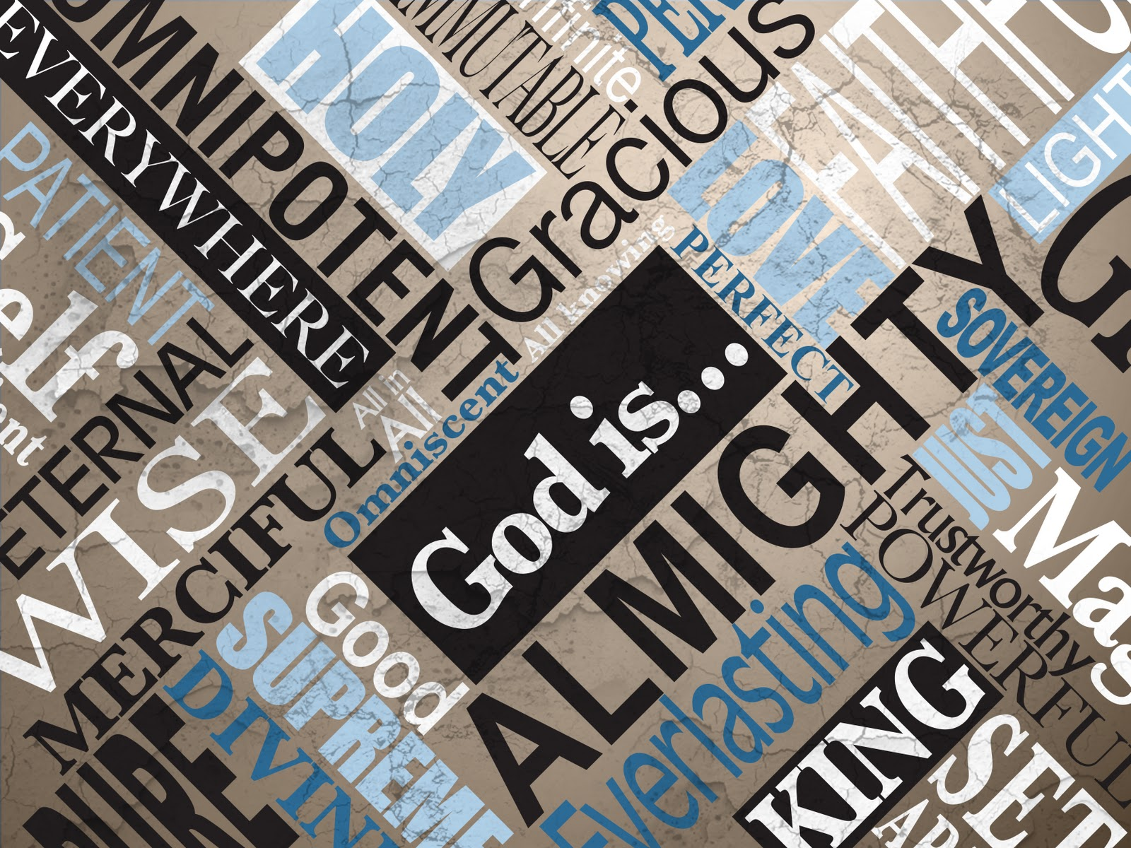

Slide 2
“There is a God we want, and there is a God who is—and they are not the same God.
The turning point of our lives is when we stop seeking the God we want and start seeking the God who is.”

Slide 3
Anytime you focus on just one attribute of God, you will come away with a distorted view of who God is.
God is the totality of all His attributes.

Slide 4
God is…
Worthy of Awe
Love
Sovereign
All Knowing/Present/Powerful
Holy
Good
Just

Slide 5
God is compassionate. God cares!

Slide 6
For we do not have a high priest who is unable to empathize with our weaknesses, but we have one who has been tempted in every way, just as we are—yet he did not sin.
Hebrews 4:15–16 (NIV)

Slide 7
empathy
noun
em·​pa·​thy | \ ˈem-pə-thē \
Definition of empathy
1: the action of understanding, being aware of, being sensitive to, and vicariously experiencing the feelings, thoughts, and experience of another of either the past or present without having the feelings, thoughts, and experience fully communicated in an objectively explicit manner

Slide 8
You may not think anyone understands, but God understands!
He feels what you are feeling… so you can talk to Him.
He cares about what is going on in your life.

Slide 9
Let us then approach God’s throne of grace with confidence, so that we may receive mercy and find grace to help us in our time of need.
Hebrews 4:15–16 (NIV)

Slide 10
Give me a sign of your goodness, that my enemies may see it and be put to shame, for you, Lord, have helped me and comforted me.
Psalm 86:17 (NIV)

Slide 11
Nevertheless I tell you the truth. It is to your advantage that I go away; for if I do not go away, the Helper will not come to you; but if I depart, I will send Him to you.
John 16:7 (NKJV)

Slide 12
And I will pray the Father, and he shall give you another Comforter, that he may abide with you for ever;
John 14:16 (KJV)

Slide 13
God cares
Jesus showed us how much God cares

Slide 14
When he saw the crowds, he had compassion on them, because they were harassed and helpless, like sheep without a shepherd.
Matthew 9:36 (NIV)

Slide 15
When Jesus landed and saw a large crowd,
he had compassion on them and
healed their sick.
Matthew 14:14 (NIV)

Slide 16
As Jesus and his disciples were leaving Jericho, a large crowd followed him. Two blind men were sitting by the roadside, and when they heard that Jesus was going by, they shouted, “Lord, Son of David, have mercy on us!”
Matthew 20:29–34 (NIV)

Slide 17
The crowd rebuked them and told them to be quiet, but they shouted all the louder, “Lord, Son of David, have mercy on us!” Jesus stopped and called them. “What do you want me to do for you?” he asked. “Lord,” they answered, “we want our sight.”
Matthew 20:29–34 (NIV)

Slide 18
Jesus had compassion on them and touched their eyes. Immediately they received their sight and followed him.
Matthew 20:29–34 (NIV)

Slide 19
Now Jesus called His disciples to Himself and said, “I have compassion on the multitude, because they have now continued with Me three days and have nothing to eat. And I do not want to send them away hungry, lest they faint on the way.”
Matthew 15:32 (NKJV)

Slide 20
“To know Jesus and make Him known while living, loving and serving like Him”

Slide 21
When Mary reached the place where Jesus was and saw him, she fell at his feet and said, “Lord, if you had been here, my brother would not have died.” When Jesus saw her weeping, and the Jews who had come along with her also weeping, he was deeply moved in spirit and troubled.
John 11:32-36 (NIV)

Slide 22
“Where have you laid him?” he asked. “Come and see, Lord,” they replied. Jesus wept. Then the Jews said, “See how he loved him!”
John 11:32-36 (NIV)

Slide 23
Remember, Lord, your great mercy and love, for they are from of old. Do not remember the sins of my youth and my rebellious ways; according to your love remember me, for you, Lord, are good.
Psalm 25:6–7 (NIV)

Slide 24
Have mercy on me, O God, according to your unfailing love; according to your great compassion blot out my transgressions. Wash away all my iniquity and cleanse me from my sin.
Psalm 51:1–2 (NIV)

Slide 25
So he got up and went to his father. “But while he was still a long way off, his father saw him and was filled with compassion for him; he ran to his son, threw his arms around him and kissed him.
Luke 15:20 (NIV)

Slide 26
If anyone is poor among your fellow Israelites in any of the towns of the land the Lord your God is giving you, do not be hardhearted or tightfisted toward them. Rather, be openhanded and freely lend them whatever they need…
Deuteronomy 15:7–11 (NIV)

Slide 27
When Jesus landed and saw a large crowd, he had compassion on them, because they were like sheep without a shepherd. So he began teaching them many things.
Deuteronomy 15:7–11 (NIV)

Slide 28
Give generously to them and do so without a grudging heart; then because of this the Lord your God will bless you in all your work and in everything you put your hand to.
Deuteronomy 15:7–11 (NIV)

Slide 29
When Jesus landed and saw a large crowd, he had compassion on them, because they were like sheep without a shepherd. So he began teaching them many things.
Mark 6:34 (NIV)

Slide 30
God cares
Jesus showed us how much God cares
God cares about you even when you don’t care about Him

Slide 31
As he approached Jerusalem and saw the city, he wept over it and said, “If you, even you, had only known on this day what would bring you peace—but now it is hidden from your eyes.
Luke 19:41–42 (NIV)

Slide 32
For we are God’s masterpiece. He has created us anew in Christ Jesus, so we can do the good things he planned for us long ago.
Ephesians 2:10 (NLT)

Slide 33
God cares
Jesus showed us how much God cares
God cares even when you don’t care about Him
You experience God’s compassion when you turn to Him

Slide 34
As a father has compassion on his children, so the LORD has compassion on those who fear him;
Psalm 103:13 (NIV)

Slide 35
The Lord is good, a refuge in times of trouble. He cares for those who trust in him,
Nahum 1:7 (NIV)

Slide 36
For “Everyone who calls on the name of the Lord will be saved.” But how can they call on him to save them unless they believe in him? And how can they believe in him if they have never heard about him?
Romans 10:13–15 (NLT)

Slide 37
God cares
Jesus showed us how much God cares
God cares even when you don’t care about Him
You experience God’s compassion when you turn to Him
If God cares, we should also care

Slide 38
Praise be to the God and Father of our Lord Jesus Christ, the Father of compassion and the God of all comfort, who comforts us in all our troubles,
2 Corinthians 1:3–4 (NIV)

Slide 39
so that we can comfort those in any trouble with the comfort we ourselves receive from God.
2 Corinthians 1:3–4 (NIV)

Slide 40
The expert in the law replied, “The one who had mercy on him.”
Jesus told him, “Go and do likewise.”
Luke 10:37 (NIV)

Slide 41
God cares
Jesus showed us how much God cares
God cares even when you don’t care about Him
You experience God’s compassion when you turn to Him
If God cares, we should also care

