Slide 2
Man is created different than the rest of creation

Slide 3
Then the Lord God formed a man from the dust of the ground and breathed into his nostrils the breath of life, and the man became a living being.
Genesis 2:7 (NIV)

Slide 4
Man is different than the rest of creation
You are made in the image of God

Slide 5
Then God said, “Let us make mankind in our image, in our likeness, …
Genesis 1:26–27 (NIV)

Slide 6
So God created mankind in his own image, in the image of God he created them; male and female he created them.
Genesis 1:26–27 (NIV)

Slide 7
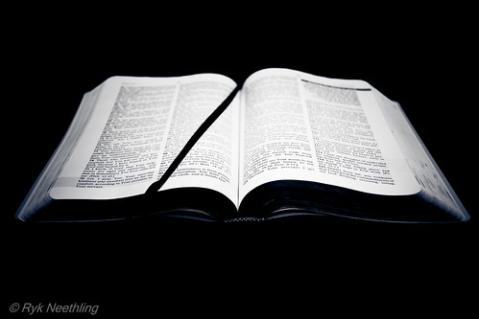
We were created to reflect God for the world to see

Slide 8
The Son is the image of the invisible God, the firstborn over all creation.
Colossians 1:15 (NIV)

Slide 9
and to put on the new self, created to be like God in true righteousness and holiness.
Ephesians 4:24 (NIV)

Slide 10
everyone who is called by my name, whom I created for my glory, whom I formed and made.”
Isaiah 43:7 (NIV)

Slide 11
If we are made to reflect God, then our actions don’t just affect us… they reflect on God. This is one reason sin is so egregious.

Slide 12
… I have come that they may have life, and have it to the full.
John 10:10 (NIV)

Slide 13
You make known to me the path of life; you will fill me with joy in your presence, with eternal pleasures at your right hand.
Psalm 16:11 (NIV)

Slide 14
How lovely is your dwelling place, Lord Almighty! My soul yearns, even faints, for the courts of the Lord; my heart and my flesh cry out for the living God.
Psalm 84:1–2 (NIV)

Slide 15
Better is one day in your courts than a thousand elsewhere; I would rather be a doorkeeper in the house of my God than dwell in the tents of the wicked.
Psalm 84:10 (NIV)

Slide 16
Though you have not seen him, you love him; and even though you do not see him now, you believe in him and are filled with an inexpressible and glorious joy,
1 Peter 1:8 (NIV)

Slide 17
Man is different than the rest of creation
We are made in the image of God
Since we are made in the image of God, then everyone has worth and value

Slide 18
How much are you worth?
Element | Mass in body (kg) | Value per kg ($) | Total value ($)
Oxygen | 43 | 3 | 129
Carbon | 16 | 24 | 384
Hydrogen | 7 | 100 | 700
Nitrogen | 1.8 | 4 | 7.2
Calcium | 1.0 | 200 | 200
Phosphorus | 0.780 | 300 | 234
Potassium | 0.140 | 1000 | 140
Sulphur | 0.140 | 500 | 70
Sodium | 0.100 | 250 | 25
Chlorine | 0.095 | 1.5 | 0.14
Magnesium | 0.019 | 37 | 0.7
Iron | 0.0042 | 72 | 0.3
This comes up to the total of $1890.34. But, what about the remaining 39 elements?
The body contains a remarkable range of elements from gold to uranium. However, with their quantities so low it only works out as only $95.41.
Giving the grand total cost of the human body as $1985.77.

Slide 19
Your worth is determined by the price one is willing to pay. Jesus thought you were worth dying for. You are precious to God!
“you were bought at a price. Therefore honor God with your bodies. “
1 Corinthians 6:20

Slide 20
For we are God’s handiwork, created in Christ Jesus to do good works, which God prepared in advance for us to do.
Ephesians 2:10 (NIV)

Slide 21
You made all the delicate, inner parts of my body and knit me together in my mother’s womb. Thank you for making me so wonderfully complex! Your workmanship is marvelous—how well I know it.
Psalm 139:13–14 (NLT)

Slide 22
“Whoever sheds human blood, by humans shall their blood be shed; for in the image of God has God made mankind.
Genesis 9:6 (NIV)

Slide 23
With the tongue we praise our Lord and Father, and with it we curse human beings, who have been made in God’s likeness
James 3:9 (NIV)

Slide 24
Man is different than the rest of creation
We are made in the image of God
Everyone has worth and value
Man is more special to God than all creation

Slide 25
Then the Lord God formed a man from the dust of the ground and breathed into his nostrils the breath of life, and the man became a living being. Now the Lord God had planted a garden in the east, in Eden; and there he put the man he had formed.
Genesis 2:7-10 (NIV)

Slide 26
The Lord God made all kinds of trees grow out of the ground—trees that were pleasing to the eye and good for food. In the middle of the garden were the tree of life and the tree of the knowledge of good and evil. A river watering the garden flowed from Eden…
Genesis 2:7-10 (NIV)

Slide 27
God blessed them and said to them, “Be fruitful and increase in number; fill the earth and subdue it. Rule over the fish in the sea and the birds in the sky and over every living creature that moves on the ground.”
Genesis 1:28 (NIV)

Slide 28
Command those who are rich in this present world not to be arrogant nor to put their hope in wealth, which is so uncertain, but to put their hope in God, who richly provides us with everything for our enjoyment.
1 Timothy 6:17 (NIV)

Slide 29
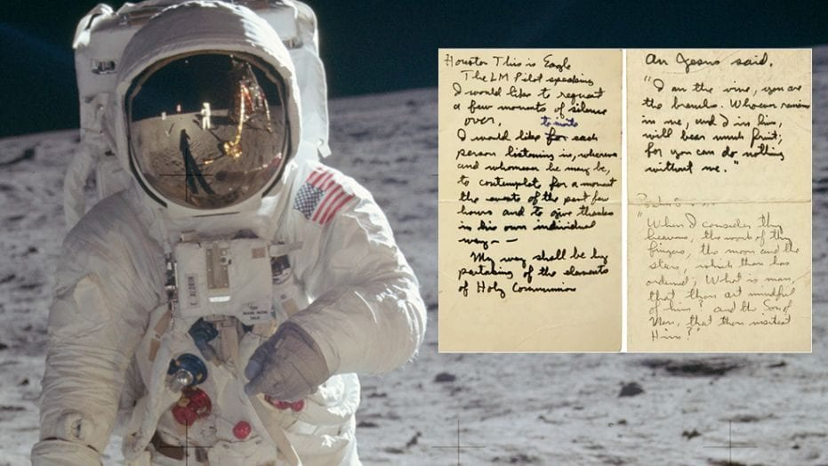

Slide 30
When I consider your heavens, the work of your fingers, the moon and the stars, which you have set in place, what is mankind that you are mindful of them, human beings that you care for them?
Psalm 8:3–4 (NIV)

Slide 31
The Lord God said, “It is not good for the man to be alone. I will make a helper suitable for him.” Now the Lord God had formed out of the ground all the wild animals and all the birds in the sky.
Genesis 2:18-20 (NIV)

Slide 32
He brought them to the man to see what he would name them; and whatever the man called each living creature, that was its name. So the man gave names to all the livestock, the birds in the sky and all the wild animals. But for Adam no suitable helper was found.
Genesis 2:18-20 (NIV)

Slide 33
God cares when you feel alone

Slide 34
The Lord God said, “It is not good for the man to be alone. I will make a helper suitable for him.”
Genesis 2:18 (NIV)

Slide 35
So the Lord God caused the man to fall into a deep sleep; and while he was sleeping, he took one of the man’s ribs and then closed up the place with flesh.
Genesis 2:21–23 (NIV)

Slide 36
Male and female are defined by God who created us biologically different

Slide 37
He created them male and female and blessed them. And he named them “Mankind” when they were created.
Genesis 5:2 (NIV)

Slide 38
That is why a man leaves his father and mother and is united to his wife, and they become one flesh.
Genesis 2:24 (NIV)

Slide 39
“Haven’t you read,” he replied, “that at the beginning the Creator ‘made them male and female,’
Matthew 19:4 (NIV)

Slide 40
Jesus defined marriage as being between a man and a woman as described in Genesis

Slide 41
And just as we have borne the image of the earthly man, so shall we bear the image of the heavenly man.
1 Corinthians 15:49 (NIV)

Slide 42
The Son is the image of the invisible God, the firstborn over all creation.
Colossians 1:15 (NIV)

Slide 43
Man is different than the rest of creation
We are made in the image of God
Everyone has worth and value
Man is more special to God than all creation
Man is created to work

Slide 44
The Lord God took the man and put him in the Garden of Eden to work it and take care of it.
Genesis 2:15 (NIV)

Slide 45
Whatever you do, work at it with all your heart, as working for the Lord, not for human masters,
Colossians 3:23 (NIV)

Slide 46
Anyone who has been stealing must steal no longer, but must work, doing something useful with their own hands, that they may have something to share with those in need.
Ephesians 4:28 (NIV)

Slide 47
Anyone who has been stealing must steal no longer, but must work, doing something useful with their own hands, that they may have something to share with those in need.
Ephesians 4:28 (NIV)

Slide 48
Man is created different than the rest of creation
We are made in the image of God
Everyone has worth and value
Man is more special to God than all creation
Man is created to work

