Slide 2
God has performed miracles

Slide 3
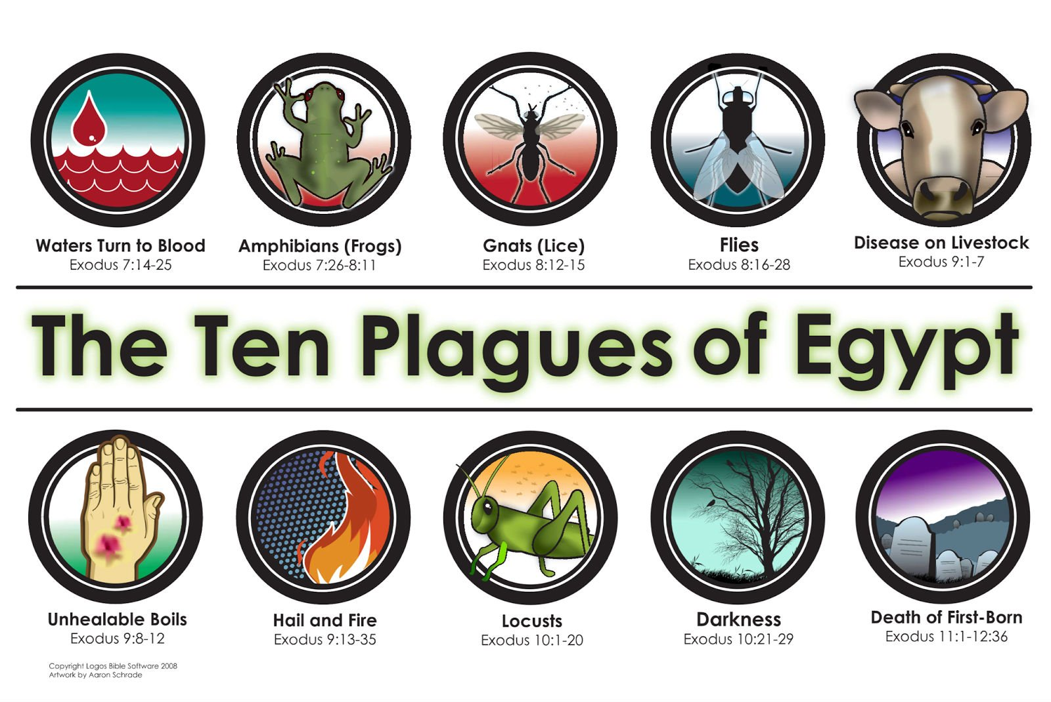

Slide 4
or this time I will send the full force of my plagues against you and against your officials and your people, so you may know that there is no one like me in all the earth.
Exodus 9:14 (NIV)

Slide 5
God performed miracles
Why does God perform miracles?

Slide 6
This is what the Lord says: By this you will know that I am the Lord: With the staff that is in my hand I will strike the water of the Nile, and it will be changed into blood.
Exodus 7:17 (NIV)

Slide 7
and said to them, “I know that the Lord has given you this land and that a great fear of you has fallen on us, so that all who live in this country are melting in fear because of you. We have heard how the Lord dried up the water of the Red Sea for you when you came out of Egypt…
Joshua 2:9–11 (NIV)

Slide 8
When we heard of it, our hearts melted in fear and everyone’s courage failed because of you, for the Lord your God is God in heaven above and on the earth below.
Joshua 2:9–11 (NIV)

Slide 9
how shall we escape if we ignore so great a salvation? This salvation, which was first announced by the Lord, was confirmed to us by those who heard him.
Hebrews 2:3–4 (NIV)

Slide 10
God also testified to it by signs, wonders and various miracles, and by gifts of the Holy Spirit distributed according to his will.
Hebrews 2:3–4 (NIV)

Slide 11
God performed miracles
Why does God perform miracles?
Can God still perform miracles today?

Slide 12
Believe me when I say that I am in the Father and the Father is in me; or at least believe on the evidence of the works themselves. Very truly I tell you, whoever believes in me will do the works I have been doing, and they will do even greater things than these, because I am going to the Father.
John 14:11–14 (NIV)

Slide 13
And I will do whatever you ask in my name, so that the Father may be glorified in the Son. You may ask me for anything in my name, and I will do it.
John 14:11–14 (NIV)

Slide 14
This is the confidence we have in approaching God: that if we ask anything according to his will, he hears us. And if we know that he hears us—whatever we ask—we know that we have what we asked of him.
1 John 5:14–15 (NIV)

Slide 15
Are any of you sick? You should call for the elders of the church to come and pray over you, anointing you with oil in the name of the Lord. Such a prayer offered in faith will heal the sick, and the Lord will make you well…
James 5:14–18 (NLT)

Slide 16
Confess your sins to each other and pray for each other so that you may be healed. The earnest prayer of a righteous person has great power and produces wonderful results.
James 5:14–18 (NLT)

Slide 17
Elijah was as human as we are, and yet when he prayed earnestly that no rain would fall, none fell for three and a half years! Then, when he prayed again, the sky sent down rain and the earth began to yield its crops.
James 5:14–18 (NLT)

Slide 18
God performed miracles
Why does God perform miracles?
Can God still perform miracles today?
Why doesn’t God give me a miracle?

Slide 19
“Father, if you are willing, please take this cup of suffering away from me. Yet I want your will to be done, not mine.”
Luke 22:42 (NLT)

Slide 20
Trust in him at all times, you people; pour out your hearts to him, for God is our refuge.
Psalm 62:8 (NIV)

Slide 21
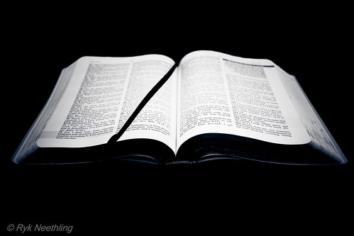
Your life is bigger than today.
There is an eternity ahead of each of us.
God’s promise for restoration will be fully fulfilled when He returns.

Slide 22
Though He slay me, yet will I trust Him. Even so, I will defend my own ways before Him.
Job 13:15 (NKJV)

Slide 23
Three times I pleaded with the Lord to take it away from me. But he said to me, “My grace is sufficient for you, for my power is made perfect in weakness.”
2 Corinthians 12:8–10 (NIV)

Slide 24
As you know, it was because of an illness that I first preached the gospel to you, and even though my illness was a trial to you, you did not treat me with contempt or scorn. Instead, you welcomed me as if I were an angel of God, as if I were Christ Jesus himself.
Galatians 4:13–14 (NIV)

Slide 25
Stop drinking only water, and use a little wine because of your stomach and your frequent illnesses.
1 Timothy 5:23 (NIV)

Slide 26
Erastus stayed in Corinth, and I left Trophimus sick in Miletus.
2 Timothy 4:20 (NIV)

Slide 27
I consider that our present sufferings are not worth comparing with the glory that will be revealed in us.
Romans 8:18 (NIV)

Slide 28
For our present troubles are small and won’t last very long. Yet they produce for us a glory that vastly outweighs them and will last forever!
2 Corinthians 4:17 (NLT)

Slide 29
… But he said to me, “My grace is sufficient for you, for my power is made perfect in weakness.”
2 Corinthians 12:8–10 (NIV)

Slide 30
Therefore I will boast all the more gladly about my weaknesses, so that Christ’s power may rest on me. That is why, for Christ’s sake, I delight in weaknesses, in insults, in hardships, in persecutions, in difficulties. For when I am weak, then I am strong.
2 Corinthians 12:8–10 (NIV)

Slide 31
Don’t worry about anything; instead, pray about everything. Tell God what you need, and thank him for all he has done. Then you will experience God’s peace, which exceeds anything we can understand. His peace will guard your hearts and minds as you live in Christ Jesus.
Philippians 4:6–7 (NLT)

Slide 32
Praise be to the God and Father of our Lord Jesus Christ, the Father of compassion and the God of all comfort, who comforts us in all our troubles, so that we can comfort those in any trouble with the comfort we ourselves receive from God.
2 Corinthians 1:3–4 (NIV)

Slide 33
If God doesn’t heal you, it doesn’t mean He doesn’t love you.
If God doesn’t heal you, it doesn’t mean you don’t have enough faith.
If God doesn’t heal you, it likely means that God has a special plan for your life to use you in a unique way to bring glory and honor to Him.

Slide 34
God performed miracles
Why does God perform miracles?
Can God still perform miracles today?
Why doesn’t God give me a miracle?

