Slide 2
Speak to all the congregation of the people of Israel and say to them, You shall be holy, for I the Lord your God am holy
Leviticus 19:2 (ESV)

Slide 3
You shall be holy to me, for I the Lord am holy and have separated you from the peoples, that you should be mine.
Leviticus 20:26 (ESV)

Slide 4
God is set apart in being and in action

Slide 5
Before the mountains were brought forth, or ever you had formed the earth and the world, from everlasting to everlasting you are God.
Psalm 90:2 (ESV)

Slide 6
You therefore must be perfect, as your heavenly Father is perfect.
Matt. 5:48 (ESV)

Slide 7
Have you not known? Have you not heard? The Lord is the everlasting God, the Creator of the ends of the earth. He does not faint or grow weary; his understanding is unsearchable.
Isaiah 40:28 (ESV)

Slide 8
Let no one say when he is tempted, “I am being tempted by God,” for God cannot be tempted with evil, and he himself tempts no one.
James 1:13 (ESV)

Slide 9
You will say to me then, “Why does he still find fault? For who can resist his will?” But who are you, O man, to answer back to God? Will what is molded say to its molder, “Why have you made me like this?” Has the potter no right over the clay, to make out of the same lump one vessel for honorable use and another for dishonorable use?
Romans 9:19-23 (ESV)

Slide 10
What if God, desiring to show his wrath and to make known his power, has endured with much patience vessels of wrath prepared for destruction, in order to make known the riches of his glory for vessels of mercy, which he has prepared beforehand for glory
Romans 9:19-23 (ESV)

Slide 11
Then Job arose and tore his robe and shaved his head and fell on the ground and worshiped. And he said, “Naked I came from my mother's womb, and naked shall I return. The Lord gave, and the Lord has taken away; blessed be the name of the Lord.” In all this Job did not sin or charge God with wrong.
Job 1:20-22 (ESV)

Slide 12
God is set apart in being and in action
We should have a high view of God

Slide 13
“There is none holy like the Lord; there is none besides you; there is no rock like our God.
1 Samuel 2:2(ESV)

Slide 14
For it was indeed fitting that we should have such a high priest, holy, innocent, unstained, separated from sinners, and exalted above the heavens.
Hebrews 7:26(ESV)

Slide 15
For the wages of sin is death...
Romans 6:23(ESV)

Slide 16
And the Lord said to Job: “Shall a faultfinder contend with the Almighty? He who argues with God, let him answer it.” Then Job answered the Lord and said: “Behold, I am of small account; what shall I answer you? I lay my hand on my mouth. I have spoken once, and I will not answer; twice, but I will proceed no further.”
Job 40:1-8(ESV)

Slide 17
Then the Lord answered Job out of the whirlwind and said: “Dress for action like a man; I will question you, and you make it known to me. Will you even put me in the wrong? Will you condemn me that you may be in the right?”
Job 40:1-8(ESV)

Slide 18
God is set apart in being and in action
We should have a high view of God
God is sovereign and holy and we are not

Slide 19
And one called to another and said:
“Holy, holy, holy is the Lord of hosts; the whole earth is full of his glory! And the foundations of the thresholds shook at the voice of him who called, and the house was filled with smoke.
Isaiah 6:3-5(ESV)

Slide 20
And I said: “Woe is me! For I am lost; for I am a man of unclean lips, and I dwell in the midst of a people of unclean lips; for my eyes have seen the King, the Lord of hosts!”
Isaiah 6:3-5(ESV)

Slide 21
but God shows his love for us in that while we were still sinners, Christ died for us.
Romans 5:8(ESV)

Slide 22
Blessed be the God and Father of our Lord Jesus Christ, who has blessed us in Christ with every spiritual blessing in the heavenly places,
Ephesians 1:3(ESV)

Slide 23
But as he who called you is holy, you also be holy in all your conduct
1 Peter 1:15(ESV)

Slide 24
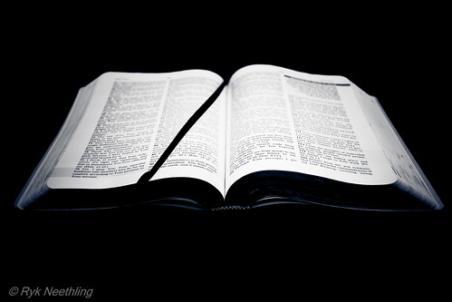
God is the LORD of all the universe and whether we want to admit it or not we are entirely under His authority and should be entirely submissive to Him in everything, even the things we don’t understand or don’t like. He is infinitely greater and holier in every way possible.

