Slide 2
The manna stopped the day after they ate this food from the land; there was no longer any manna for the Israelites, but that year they ate the produce of Canaan.
Joshua 5:12 (NIV)

Slide 3
Your past doesn’t have to determine your future

Slide 4
When Jesus had raised Himself up and saw no one but the woman, He said to her, “Woman, where are those accusers of yours? Has no one condemned you?” She said, “No one, Lord.” And Jesus said to her, “Neither do I condemn you; go and sin no more.”
John 8:10–11 (NKJV)

Slide 5
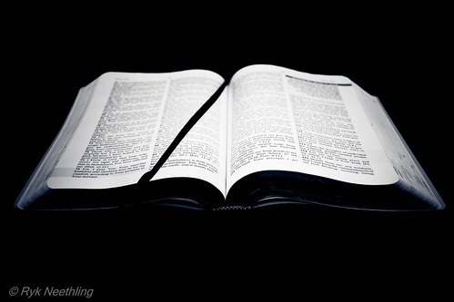
You can’t change your past.
Give it to God.
Learn from it, but don’t dwell on it.
Focus on what really matters… what you are going to do today.

Slide 6
This means that anyone who belongs to Christ has become a new person.
The old life is gone; a new life has begun!
2 Corinthians 5:17 (NLT)

Slide 7
You don’t have to be perfect to be used by God

Slide 8
It was by faith that Rahab the prostitute was not destroyed with the people in her city who refused to obey God. For she had given a friendly welcome to the spies.
Hebrews 11:31 (NLT)

Slide 9
So you see, we are shown to be right with God by what we do, not by faith alone. Rahab the prostitute is another example. She was shown to be right with God by her actions when she hid those messengers and sent them safely away by a different road.
James 2:24–26 (NLT)

Slide 10
Just as the body is dead without breath, so also faith is dead without good works.
James 2:24–26 (NLT)

Slide 11
Your past doesn’t determine your future
Deal with your issues today so they won’t be a threat tomorrow

Slide 12
Now when Joshua was near Jericho, he looked up and saw a man standing in front of him with a drawn sword in his hand. Joshua went up to him and asked, “Are you for us or for our enemies?”
“Neither,” he replied, “but as commander of the army of the Lord I have now come.”
Joshua 5:13–15 (NIV)

Slide 13
Then Joshua fell facedown to the ground in reverence, and asked him, “What message does my Lord have for his servant?” The commander of the Lord’s army replied, “Take off your sandals, for the place where you are standing is holy.” And Joshua did so.
Joshua 5:13–15 (NIV)

Slide 14
Then the Lord said to Joshua, “See, I have delivered Jericho into your hands, along with its king and its fighting men.
Joshua 6:2 (NIV)

Slide 15
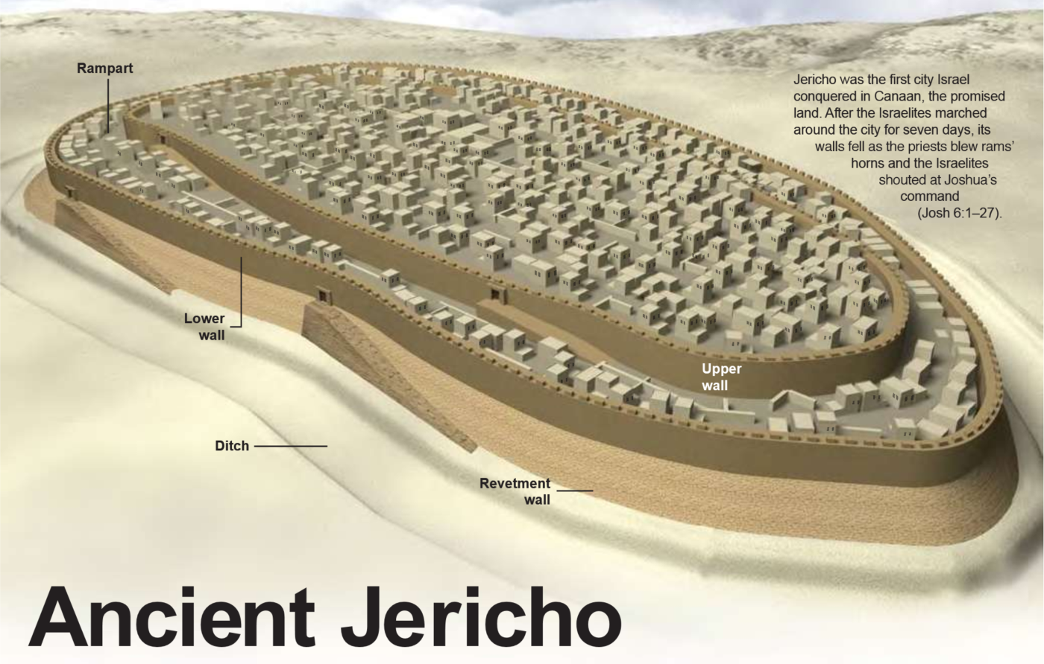

Slide 16
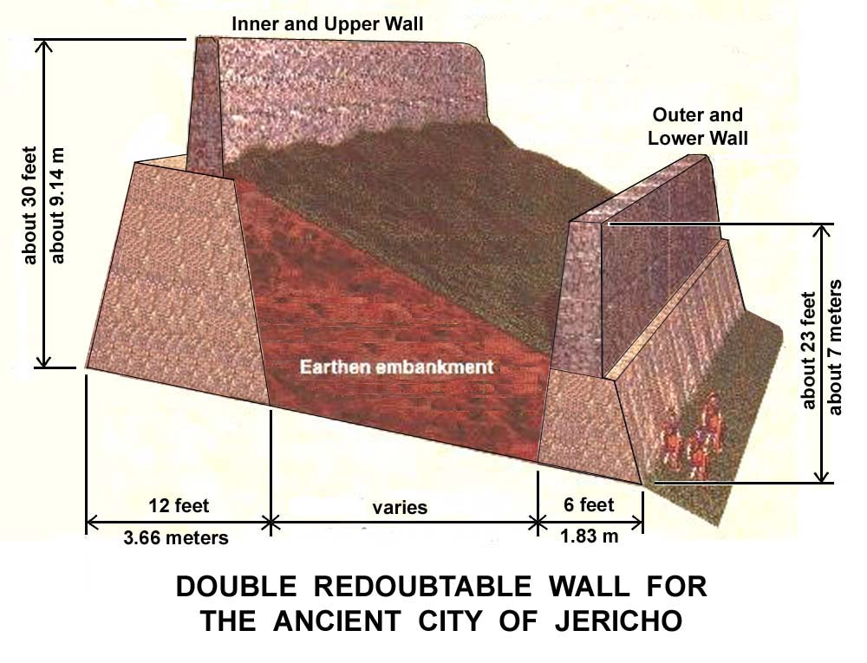

Slide 17
Your past doesn’t determine your future
Deal with your issues today so they won’t be a threat tomorrow
Faith sees God’s promises as present realities instead of future possibilities

Slide 18
Then the Lord said to Joshua, “See, I have delivered Jericho into your hands, along with its king and its fighting men.
Joshua 6:2 (NIV)

Slide 19
Your past determine your future
Deal with your issues today
Faith sees God’s promises as present realities instead of future possibilities
God’s plan may require you to set aside your plans

Slide 20
If your plan conflicts with God’s plan, then it is time to change your plan.
Making Jesus the Lord of your life means that you give Him control.

Slide 21
You and your fighting men should march around the town once a day for six days. Seven priests will walk ahead of the Ark, each carrying a ram’s horn. On the seventh day you are to march around the town seven times, with the priests blowing the horns.
Joshua 6:3–5 (NLT)

Slide 22
When you hear the priests give one long blast on the rams’ horns, have all the people shout as loud as they can. Then the walls of the town will collapse, and the people can charge straight into the town.”
Joshua 6:3–5 (NLT)

Slide 23
God has the advantage of seeing the future and knowing the path that is best for us, so we must seek and trust God’s plan for our lives

Slide 24
The instructions of the Lord are perfect, reviving the soul. The decrees of the Lord are trustworthy, making wise the simple. The commandments of the Lord are right, bringing joy to the heart. The commands of the Lord are clear, giving insight for living.
Psalm 19:7–8 (NLT)

Slide 25
Your past determine your future
Deal with your issues today
Faith sees God’s promises as present realities instead of future possibilities
God’s plan may require you to set aside your plans
It is not enough to know God’s plan. You must act on it.

Slide 26
So Joshua called together the priests and said, “Take up the Ark of the Lord’s Covenant, and assign seven priests to walk in front of it, each carrying a ram’s horn.” Then he gave orders to the people: “March around the town…
Joshua 6:6–7 (NLT)

Slide 27
God has the advantage of seeing the future and knowing the path that is best for us, so we must trust God’s plan for our lives

Slide 28
Your past determine your future
Deal with your issues today
Faith sees God’s promises as present realities instead of future possibilities
God’s plan may require you to set aside your plans
It is not enough to know God’s plan. You must act on it.
Following God’s plan is amazing!

Slide 29
When the people heard the sound of the rams’ horns, they shouted as loud as they could. Suddenly, the walls of Jericho collapsed, and the Israelites charged straight into the town and captured it.
Joshua 6:20 (NLT)

Slide 30
Faith sees God’s promises as present realities
God’s plan may require you to set aside your plans
You don’t have to understand the plan
It is not enough to know God’s plan. You must act on it.
Following God’s plan is amazing!

