Slide 2
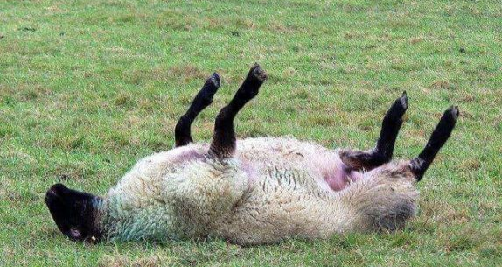
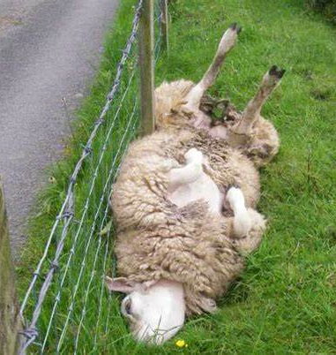
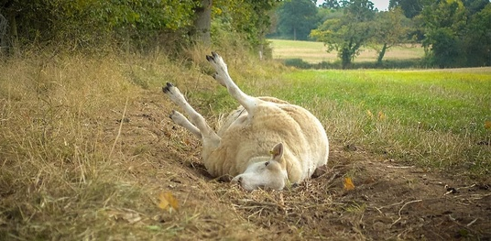

Slide 3
Why are you cast down, O my soul? And why are you disquieted within me? Hope in God; For I shall yet praise Him, The help of my countenance and my God.
Psalm 42:11 (NKJV)

Slide 4
I am the gate; whoever enters through me will be saved. They will come in and go out, and find pasture.
John 10:7–9 (NIV)

Slide 5
The thief comes only to steal and kill and destroy; I have come that they may have life, and have it to the full. “I am the good shepherd. The good shepherd lays down his life for the sheep.
John 10:10–13 (NIV)

Slide 6
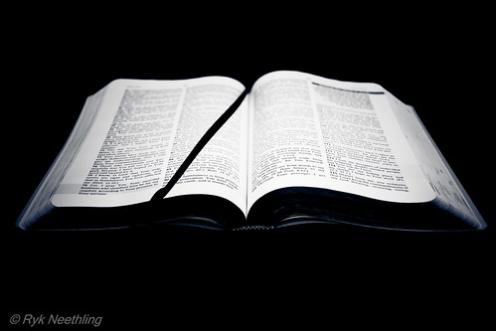
Jesus cares

Slide 7
The hired hand is not the shepherd and does not own the sheep. So when he sees the wolf coming, he abandons the sheep and runs away. Then the wolf attacks the flock and scatters it. The man runs away because he is a hired hand and cares nothing for the sheep.
John 10:10–13 (NIV)

Slide 8
“I am the good shepherd; I know my sheep and my sheep know me—just as the Father knows me and I know the Father—and I lay down my life for the sheep.
John 10:14–15 (NIV)

Slide 9
A Psalm of David. The Lord is my shepherd; I shall not want. He makes me to lie down in green pastures; He leads me beside the still waters. He restores my soul; He leads me in the paths of righteousness For His name’s sake.
Psalm 23 (NKJV)

Slide 10
Yea, though I walk through the valley of the shadow of death, I will fear no evil; For You are with me; Your rod and Your staff, they comfort me. You prepare a table before me in the presence of my enemies; You anoint my head with oil; My cup runs over.
Psalm 23 (NKJV)

Slide 11
Surely goodness and mercy shall follow me All the days of my life; And I will dwell in the house of the Lord Forever.
Psalm 23 (NKJV)

Slide 12
Your relationship with the Lord can be really personal

Slide 13
There is a big difference between knowing about God and knowing God.

Slide 14
The Lord is my shepherd; I shall not want.
Psalm 23 (NKJV)

Slide 15
Christ is the visible image of the invisible God. He existed before anything was created and is supreme over all creation, for through him God created everything in the heavenly realms and on earth. He made the things we can see and the things we can’t see— such as thrones, kingdoms, rulers, and authorities in the unseen world.
Colossians 1:15–20 (NLT)

Slide 16
Everything was created through him and for him. He existed before anything else, and he holds all creation together. Christ is also the head of the church, which is his body. He is the beginning, supreme over all who rise from the dead. So he is first in everything.
Colossians 1:15–20 (NLT)

Slide 17
For God in all his fullness was pleased to live in Christ, and through him God reconciled everything to himself. He made peace with everything in heaven and on earth by means of Christ’s blood on the cross.
Colossians 1:15–20 (NLT)

Slide 18
The Lord looks out for you

Slide 19
The Lord is my shepherd; I shall not want.
Psalm 23 (NKJV)

Slide 20
Fear the Lord, you his holy people, for those who fear him lack nothing.
Psalm 34:9 (NIV)

Slide 21
And my God will meet all your needs according to the riches of his glory in Christ Jesus.
Philippians 4:19 (NIV)

Slide 22
The Lord restores your soul

Slide 23
The human spirit can endure in sickness, but a crushed spirit who can bear?
Proverbs 18:14 (NIV)

Slide 24
He makes me to lie down in green pastures; He leads me beside the still waters.
Psalm 23:2 (NKJV)

Slide 25
Trust in the Lord and do good; dwell in the land and enjoy safe pasture.
Rest in the Lord, and wait patiently for Him; Do not fret because of him who prospers in his way, Because of the man who brings wicked schemes to pass.
Psalm 37:3,7

Slide 26
The law of the Lord is perfect, refreshing the soul. The statutes of the Lord are trustworthy, making wise the simple.
Psalm 19:7 (NIV)

Slide 27
…God has said, “Never will I leave you; never will I forsake you.” So we say with confidence, “The Lord is my helper; I will not be afraid. What can mere mortals do to me?”
Hebrews 13:5–6 (NIV)

Slide 28
The Lord leads you in paths of righteousness for HIS NAME’S SAKE

Slide 29
He leads me in the paths of righteousness For His name’s sake
Psalm 23 (NKJV)

Slide 30
He will lead you down the right path if you follow, but it is up to you to follow Him

Slide 31
If the Lord is your shepherd, your problems are His problems.
It is the Lord’s reputation on the line.

Slide 32
What, then, shall we say in response to these things? If God is for us, who can be against us? He who did not spare his own Son, but gave him up for us all—how will he not also, along with him, graciously give us all things?
Romans 8:31–32 (NIV)

Slide 33
The Lord is with you in the dark valleys

Slide 34
Yea, though I walk through the valley of the shadow of death, I will fear no evil; For You are with me; Your rod and Your staff, they comfort me.
Psalm 23 (NKJV)

Slide 35
We talk about God when things are going well, but we talk to God when things get hard.

Slide 36
When you go through deep waters, I will be with you. When you go through rivers of difficulty, you will not drown. When you walk through the fire of oppression, you will not be burned up; the flames will not consume you.
Isaiah 43:2 (NLT)

Slide 37
You don’t have to let your problems stress you out when you are with the Shepherd

Slide 38
You prepare a table before me in the presence of my enemies;
Psalm 23 (NKJV)

Slide 39
The Lord may have a lot of sheep, but He cares about you personally

Slide 40
You prepare a table before me in the presence of my enemies;
Psalm 23 (NKJV)

Slide 41
If your heart is full of God’s love, there will be no room for fear and doubt.

Slide 42
Following the Lord helps us in life, but it is bigger than that

Slide 43
Surely goodness and mercy shall follow me All the days of my life; And I will dwell in the house of the Lord Forever.
Psalm 23 (NKJV)

Slide 44
The Lord is my shepherd; I shall not want. He makes me to lie down in green pastures; He leads me beside the still waters. He restores my soul; He leads me in the paths of righteousness For His name’s sake. Yea, though I walk through the valley of the shadow of death, I will fear no evil; For You are with me; Your rod and Your staff, they comfort me. You prepare a table before me in the presence of my enemies; You anoint my head with oil; My cup runs over. Surely goodness and mercy shall follow me All the days of my life; And I will dwell in the house of the Lord Forever.
Psalm 23 (NKJV)

