Slide 1
Church Is

Slide 2
Christianity isn’t just about believing – it is also about belonging.
God never intended you to do this alone.

Slide 3
I will commit to the mission of my church
Mission Statement: “To know Jesus and make Him known while living, loving and serving like Him”
I am a church member:
I will stive to grow in my relationship with Jesus, obey the Great Commission Jesus gave in the gospels to share His love with the world, and live in a way that brings glory to God.

Slide 4
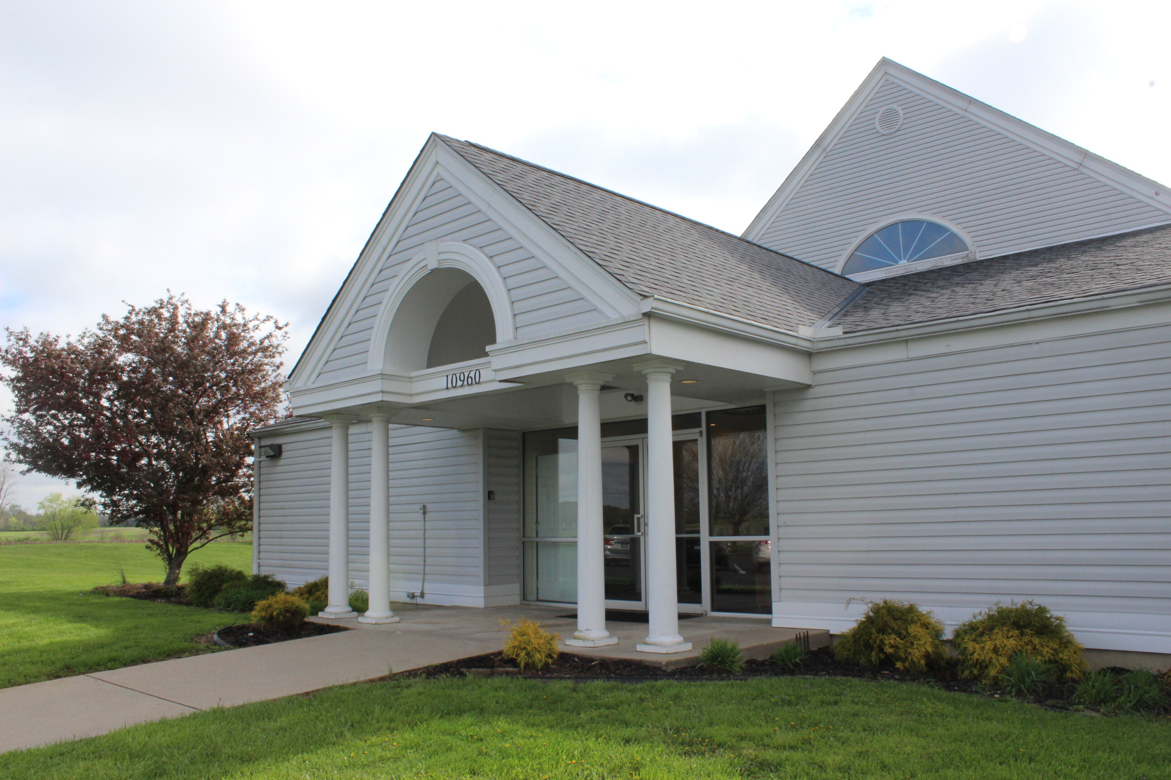
Awake to righteousness, and do not sin; for some do not have the knowledge of God. I speak this to your shame.
1 Corinthians 15:34

Slide 5
“To know Jesus and make Him known while living, loving and serving like Him”

Slide 6
Love God
Love People

Slide 7
Know Jesus

Slide 8
though I could have confidence in my own effort if anyone could. Indeed, if others have reason for confidence in their own efforts, I have even more!
Philippians 3:4–10 (NLT)

Slide 9
I was circumcised when I was eight days old. I am a pure-blooded citizen of Israel and a member of the tribe of Benjamin—a real Hebrew if there ever was one! I was a member of the Pharisees, who demand the strictest obedience to the Jewish law. I was so zealous that I harshly persecuted the church. And as for righteousness, I obeyed the law without fault.
Philippians 3:4–10 (NLT)

Slide 10
I once thought these things were valuable, but now I consider them worthless because of what Christ has done. Yes, everything else is worthless when compared with the infinite value of knowing Christ Jesus my Lord.
Philippians 3:4–10 (NLT)

Slide 11
Do you really know Jesus, or do you just know about Jesus?

Slide 12
For what will it profit a man if he gains the whole world, and loses his own soul?
Philippians 3:4–10 (NLT)

Slide 13
Are you growing in your relationship with Jesus?

Slide 14
For his sake I have discarded everything else, counting it all as garbage, so that I could gain Christ and become one with him.
Philippians 3:4–10 (NLT)

Slide 15
I no longer count on my own righteousness through obeying the law; rather, I become righteous through faith in Christ. For God’s way of making us right with himself depends on faith.
Philippians 3:4–10 (NLT)

Slide 16
I want to know Christ and experience the mighty power that raised him from the dead. I want to suffer with him, sharing in his death,
Philippians 3:4–10 (NLT)

Slide 17
So then faith comes by hearing, and hearing by the word of God.
Romans 10:17 (NKJV)

Slide 18
Know Jesus
Make Him Known

Slide 19
For Christ’s love compels us…
2 Corinthians 5:14 (NIV)

Slide 20
When you really know Jesus, you won’t want to keep it to yourself.

Slide 21
Now then, we are ambassadors for Christ, as though God were pleading through us: we implore you on Christ’s behalf, be reconciled to God.
2 Corinthians 5:20 (NKJV)

Slide 22
Even though I am a free man with no master, I have become a slave to all people to bring many to Christ…
When I am with those who are weak, I share their weakness, for I want to bring the weak to Christ. Yes, I try to find common ground with everyone, doing everything I can to save some.
1 Corinthians 9:19–22 (NLT)

Slide 23
Are we a “come and hear” church, or a “go and tell church”?
Jesus told us to “go and tell” the world about Him.

Slide 24
And He said to them, "Go into all the world and preach the gospel to every creature.
Mark 16:15

Slide 25
But you shall receive power when the Holy Spirit has come upon you; and you shall be witnesses to Me in Jerusalem, and in all Judea and Samaria, and to the end of the earth."
Acts 1:8

Slide 26
But how can they call on him to save them unless they believe in him? And how can they believe in him if they have never heard about him? And how can they hear about him unless someone tells them? And how will anyone go and tell them without being sent?
Romans 10:14–15 (NLT)

Slide 27
Know Jesus
Make Him Known
Live like Jesus

Slide 28
“If you love me, keep my commands.
John 14:15 (NIV)

Slide 29
Know Jesus
Make Him Known
Live like Jesus
Love like Jesus

Slide 30
Jesus cared! We must commit to care!

Slide 31
If I could speak all the languages of earth and of angels, but didn’t love others, I would only be a noisy gong or a clanging cymbal. If I had the gift of prophecy, and if I understood all of God’s secret plans and possessed all knowledge,
1 Corinthians 13:1–3 (NLT)

Slide 32
and if I had such faith that I could move mountains, but didn’t love others, I would be nothing. If I gave everything I have to the poor and even sacrificed my body, I could boast about it; but if I didn’t love others, I would have gained nothing.
1 Corinthians 13:1–3 (NLT)

Slide 33
Know Jesus
Make Him Known
Live like Jesus
Love like Jesus
Serve like Jesus

Slide 34
After washing their feet, he put on his robe again and sat down and asked, “Do you understand what I was doing? You call me ‘Teacher’ and ‘Lord,’ and you are right, because that’s what I am.
John 13:12–17 (NLT)

Slide 35
And since I, your Lord and Teacher, have washed your feet, you ought to wash each other’s feet.
I have given you an example to follow. Do as I have done to you.
John 13:12–17 (NLT)

Slide 36
I tell you the truth, slaves are not greater than their master. Nor is the messenger more important than the one who sends the message.
Now that you know these things, God will bless you for doing them.
John 13:12–17 (NLT)

Slide 37
Do you want God’s blessings????
Serve others!

Slide 38
I will commit to the mission of my church
Mission Statement: “To know Jesus and make Him known while living, loving and serving like Him”
I am a church member:
I will stive to grow in my relationship with Jesus, obey the Great Commission Jesus gave in the gospels to share His love with the world, and live in a way that brings glory to God.

Slide 39
Church Is

