Slide 1
Church Is

Slide 2
Christianity isn’t just about believing – it is also about belonging.
God never intended you to do this alone.

Slide 3
I will not expect my church to be perfect
I am a church member:
I realize that the church is made up of people who are not perfect, so the church will not be perfect. I am a work in progress and so is the person sitting next to me. God is working in all our lives to make us more like Jesus, so I will be patient and show others the grace God has shown me.

Slide 4
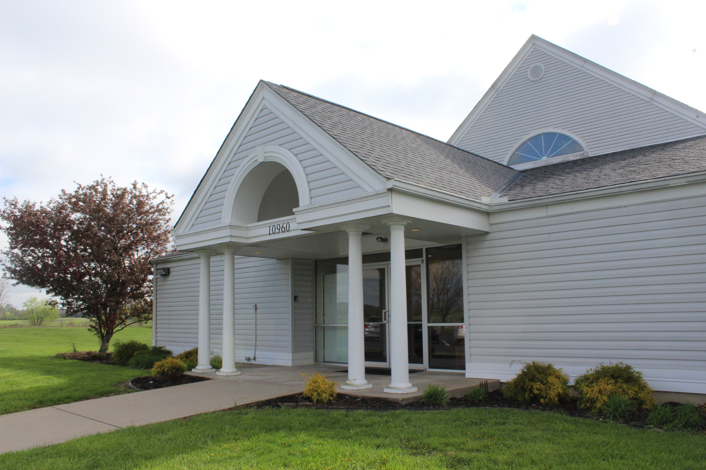
The church is made up of people

Slide 5
being confident of this, that he who began a good work in you will carry it on to completion until the day of Christ Jesus.
Philippians 1:6 (NIV)

Slide 6
The church is made up of people
People aren’t perfect

Slide 7
For there is not a just man on earth who does good And does not sin.
Ecclesiastes 7:20 (NKJV)

Slide 8
As it is written: "There is none righteous, no, not one; There is none who does good, no, not one."
Romans 3:10

Slide 9
When Adam sinned, sin entered the world. Adam’s sin brought death, so death spread to everyone, for everyone sinned.
Romans 5:12 (NLT)

Slide 10
For whoever keeps the whole law and yet stumbles at just one point is guilty of breaking all of it.
James 2:10 (NIV)

Slide 11
Therefore no one will be declared righteous in God’s sight by the works of the law; rather, through the law we become conscious of our sin.
Romans 3:20 (NIV)

Slide 12
For the wages of sin is death, but the gift of God is eternal life in Christ Jesus our Lord.
Romans 6:23 (NIV)

Slide 13
You need Jesus.
I need Jesus.
We all need Jesus!

Slide 14
God doesn’t require you to be good enough to be accepted by Him. Jesus took care of that on the cross. God accepts you where you are and then through a relationship with Jesus empowers you to become more like Jesus.

Slide 15
If we claim to be without sin, we deceive ourselves and the truth is not in us. …
If we claim we have not sinned, we make him out to be a liar and his word is not in us.
1 John 1:8, 10 (NIV)

Slide 16
I don’t really understand myself, for I want to do what is right, but I don’t do it. Instead, I do what I hate. But if I know that what I am doing is wrong, this shows that I agree that the law is good. So I am not the one doing wrong; it is sin living in me that does it.
Romans 7:15–25 (NLT)

Slide 17
And I know that nothing good lives in me, that is, in my sinful nature. I want to do what is right, but I can’t. I want to do what is good, but I don’t. I don’t want to do what is wrong, but I do it anyway. But if I do what I don’t want to do, I am not really the one doing wrong; it is sin living in me that does it.
Romans 7:15–25 (NLT)

Slide 18
I have discovered this principle of life—that when I want to do what is right, I inevitably do what is wrong. I love God’s law with all my heart. But there is another power within me that is at war with my mind. This power makes me a slave to the sin that is still within me.
Romans 7:15–25 (NLT)

Slide 19
Oh, what a miserable person I am! Who will free me from this life that is dominated by sin and death? Thank God! The answer is in Jesus Christ our Lord. So you see how it is: In my mind I really want to obey God’s law, but because of my sinful nature I am a slave to sin.
Romans 7:15–25 (NLT)

Slide 20
If we confess our sins, He is faithful and just to forgive us our sins and to cleanse us from all unrighteousness.
1 John 1:9

Slide 21
You’re not perfect, but you don’t have to be perfect to go to church!

Slide 22
The church is made up of people
People aren’t perfect
If nobody is perfect, don’t expect the person sitting next to you to be perfect

Slide 23
If you are in a place with imperfect people, you are going to experience imperfections.
You are never going to find a perfect church because churches are made up of imperfect people.

Slide 24
If the church deals with messy people, then sometimes it may get messy.

Slide 25
The church is made up of people
People aren’t perfect
If nobody is perfect, don’t expect the person sitting next to you to be perfect
I will show others the grace God has shown me

Slide 26
For it is by grace you have been saved, through faith—and this is not from yourselves, it is the gift of God—
Ephesians 2:8 (NIV)

Slide 27
“A new command I give you: Love one another. As I have loved you, so you must love one another.
John 13:34 (NIV)

Slide 28
Be kind and compassionate to one another, forgiving each other, just as in Christ God forgave you.
Ephesians 4:32 (NIV)

Slide 29
Very rarely will anyone die for a righteous person, though for a good person someone might possibly dare to die. But God demonstrates his own love for us in this: While we were still sinners, Christ died for us.
Romans 5:7–8 (NIV)

Slide 30
Therefore I, a prisoner for serving the Lord, beg you to lead a life worthy of your calling, for you have been called by God. Always be humble and gentle.
Be patient with each other, making allowance for each other’s faults because of your love.
Ephesians 4:1–6 (NLT)

Slide 31
Make every effort to keep yourselves united in the Spirit, binding yourselves together with peace. For there is one body and one Spirit, just as you have been called to one glorious hope for the future. There is one Lord, one faith, one baptism, one God and Father of all, who is over all, in all, and living through all.
Ephesians 4:1–6 (NLT)

Slide 32
Let us therefore make every effort to do what leads to peace and to mutual edification.
Romans 14:19 (NIV)

Slide 33
We need to let our love for the Jesus and the church outweigh our wounded pride and hurt feelings.

Slide 34
The church is made up of people
People aren’t perfect
If nobody is perfect, don’t expect the person sitting next to you to be perfect
I will show others the grace God has shown me

Slide 35
I will commit to the mission of my church
Mission Statement: “To know Jesus and make Him known while living, loving and serving like Him”
I am a church member:
I will strive to grow in my relationship with Jesus, obey the Great Commission Jesus gave in the gospels to share His love with the world, and live in a way that brings glory to God.

Slide 36
I will be a functioning member in my church
I am a church member:
I understand from 1 Corinthians 12 that God gave me gifts to be used for His glory. I will serve. I will give financially. I will make church a priority because I am needed.

Slide 37
I will see my church as a place to invest in others
I am a church member:
I understand that the church is a family to belong to. I will be purposeful about building relationships, supporting my church family and praying for my church leadership so each member can also grow in their walk with Jesus.

Slide 38
I will be a source of unity in my church
I am a church member:
I understand that Jesus said the world needs to see that we are one so they will believe the message of the cross of Christ. I may have different preferences, but I am willing to focus on what we have in common instead of our differences.

Slide 39
I will not expect my church to be perfect
I am a church member:
I realize that the church is made up of people who are not perfect, so the church will not be perfect. I am a work in progress and so is the person sitting next to me. God is working in all our lives to make us more like Jesus, so I will be patient and show others the grace God has shown me.

Slide 40
Church Is

