Slide 1
Church Is

Slide 2
Christianity isn’t just about believing – it is also about belonging.
God never intended you to do this alone.

Slide 3
Jesus knew we would need help living the Christian life, so He promised, “I will build my church.”

Slide 4
Church is not just about how it helps you.
Church is also about what you can do to help other believers.

Slide 5
I will commit to the mission of my church
Mission Statement: “To know Jesus and make Him known while living, loving and serving like Him”
I am a church member:
I will stive to grow in my relationship with Jesus, obey the Great Commission Jesus gave in the gospels to share His love with the world, and live in a way that brings glory to God.

Slide 6
I will be a functioning member in my church
I am a church member:
I understand from 1 Corinthians 12 that God gave me gifts to be used for His glory. I will serve. I will give financially. I will make church a priority because I am needed.

Slide 7
I will see my church as a place to invest in others
I am a church member:
I understand that the church is a family to belong to. I will be purposeful about building relationships, supporting my church family and praying for my church leadership so each member can also grow in their walk with Jesus.

Slide 8
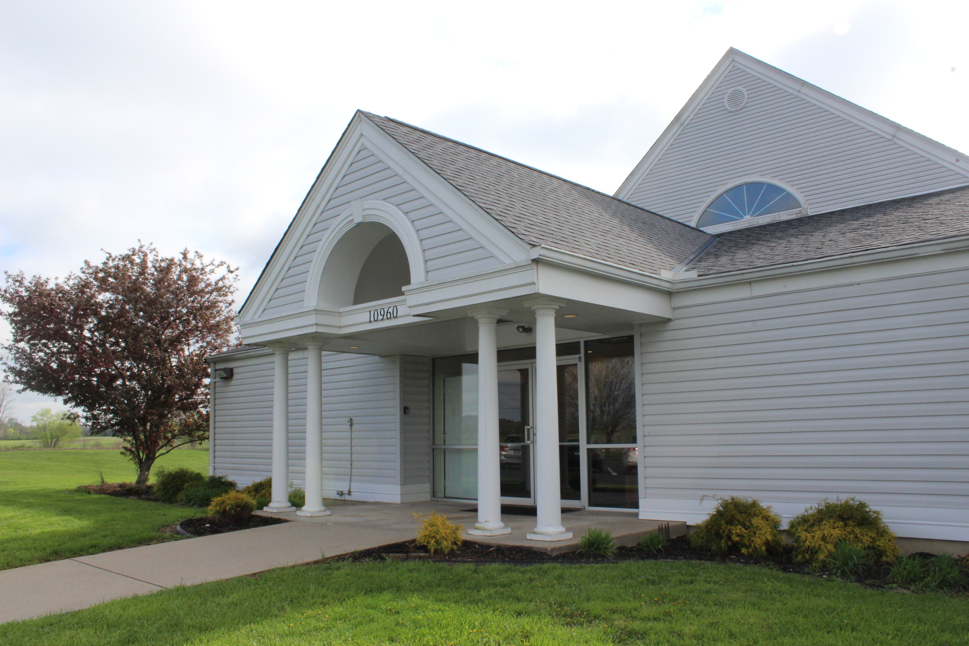
And all the believers met together in one place and shared everything they had. They sold their property and possessions and shared the money with those in need.
Acts 2:44–47 (NLT)

Slide 9
They worshiped together at the Temple each day, met in homes for the Lord’s Supper, and shared their meals with great joy and generosity—
Acts 2:44–47 (NLT)

Slide 10
all the while praising God and enjoying the goodwill of all the people.
And each day the Lord added to their fellowship those who were being saved.
Acts 2:44–47 (NLT)

Slide 11
The church is intended to be a family to belong to

Slide 12
“This, then, is how you should pray: “ ‘Our Father in heaven, hallowed be your name,
Matthew 6:9 (NIV)

Slide 13
Yet to all who did receive him, to those who believed in his name, he gave the right to become children of God—
John 1:12 (NIV)

Slide 14
For those who are led by the Spirit of God are the children of God.
Romans 8:14-16

Slide 15
The Spirit you received does not make you slaves, so that you live in fear again; rather, the Spirit you received brought about your adoption to sonship. And by him we cry, “Abba, Father.”
Romans 8:14-16

Slide 16
The Spirit himself testifies with our spirit that we are God’s children.
Romans 8:14-16

Slide 17
Then Jesus’ mother and brothers arrived. Standing outside, they sent someone in to call him. A crowd was sitting around him, and they told him, “Your mother and brothers are outside looking for you.”
Mark 3:31–35 (NIV)

Slide 18
“Who are my mother and my brothers?” he asked. Then he looked at those seated in a circle around him and said, “Here are my mother and my brothers!
Whoever does God’s will is my brother and sister and mother.”
Mark 3:31–35 (NIV)

Slide 19
For where two or three gather in my name, there am I with them.”
Matthew 18:20 (NIV)

Slide 20
The church is a family to belong to
The church should care for “ONE ANOTHER”

Slide 21
This is My commandment, that you love one another as I have loved you.
John 15:12

Slide 22
By this all will know that you are My disciples, if you have love for one another."
John 13:35

Slide 23
Keep on loving one another as brothers and sisters.
Hebrews 13:1 (NIV)

Slide 24
The church is a family to belong to
The church should care for “ONE ANOTHER”
Your purpose involves others

Slide 25
Accept one another, then, just as Christ accepted you, in order to bring praise to God.
Romans 15:7 (NIV)

Slide 26
Greet one another with a holy kiss. All the churches of Christ send greetings.
Hebrews 10:24 (NIV)

Slide 27
And let us consider how we may spur one another on toward love and good deeds,
Romans 16:16 (NIV)

Slide 28
Therefore let us pursue the things which make for peace and the things by which one may edify another.
Romans 14:19

Slide 29
Finally, brothers and sisters, rejoice! Strive for full restoration, encourage one another, be of one mind, live in peace. And the God of love and peace will be with you.
2 Corinthians 13:11 (NIV)

Slide 30
Therefore encourage one another and build each other up, just as in fact you are doing.
1 Thessalonians 5:11 (NIV)

Slide 31
Confess your trespasses to one another, and pray for one another, that you may be healed. The effective, fervent prayer of a righteous man avails much.
James 5:16

Slide 32
I myself am convinced, my brothers and sisters, that you yourselves are full of goodness, filled with knowledge and competent to instruct one another.
Romans 15:14 (NIV)

Slide 33
Be devoted to one another in love. Honor one another above yourselves.
Romans 12:10 (NIV)

Slide 34
You, my brothers and sisters, were called to be free. But do not use your freedom to indulge the flesh; rather, serve one another humbly in love.
Galatians 5:13 (NIV)

Slide 35
Bear one another's burdens, and so fulfill the law of Christ.
Galatians 6:2

Slide 36
Therefore comfort one another with these words.
1 Thessalonians 4:18

Slide 37
Therefore comfort each other and edify one another, just as you also are doing.
1 Thessalonians 5:11

Slide 38
And be kind to one another, tenderhearted, forgiving one another, just as God in Christ forgave you.
Ephesians 4:32

Slide 39
Live in harmony with one another. Do not be proud, but be willing to associate with people of low position. Do not be conceited.
Romans 12:16 (NIV)

Slide 40
And let us not neglect our meeting together, as some people do, but encourage one another, especially now that the day of his return is drawing near.
Hebrews 10:25 (NLT)

Slide 41
How can we “one another” if we are not here?

Slide 42
The church is a family to belong to
The church should care for “ONE ANOTHER”
Your purpose involves others

Slide 43
Church Is

Slide 44
I will be a source of unity in my church
I am a church member:
I understand that Jesus said the world needs to see that we are one so they will believe the message of the cross of Christ. I may have different preferences, but I am willing to focus on what we have in common instead of our differences.

Slide 45
I will not expect my church to be perfect
I am a church member:
I realize that the church is made up of people who are not perfect, so the church will not be perfect. I am a work in progress and so is the person sitting next to me. God is working in all our lives to make us more like Jesus, so I will be patient and show others the grace God has shown me.

