Slide 1
A Study on
Nehemiah

Slide 2
Nehemiah was just an ordinary guy with a secular job who was used in an extraordinary way by God.

Slide 3
Then I told them about how the gracious hand of God had been on me, and about my conversation with the king. They replied at once, “Yes, let’s rebuild the wall!”
So they began the good work.
Nehemiah 2:18 (NLT)

Slide 4
Understand your purpose

Slide 5
So whether you eat or drink or whatever you do,
do it all for the glory of God.
1 Corinthians 10:31 (NIV)

Slide 6
For it is by grace you have been saved, through faith—and this is not from yourselves, it is the gift of God—not by works, so that no one can boast. For we are God’s handiwork, created in Christ Jesus to do good works, which God prepared in advance for us to do.
Ephesians 2:8–10 (NIV)

Slide 7
If you’re not sure what to do, read the bible and you’ll begin to figure it out.

Slide 8
Understand your purpose
Live a good life

Slide 9
Good works can never earn salvation; but there is something radically wrong if salvation does not produce good actions.

Slide 10
You are the light of the world. A town built on a hill cannot be hidden. Neither do people light a lamp and put it under a bowl. Instead they put it on its stand, and it gives light to everyone in the house.
Matthew 5:14–16 (NIV)

Slide 11
In the same way, let your light shine before others, that they may see your good deeds and glorify your Father in heaven
Matthew 5:14–16 (NIV)

Slide 12
Therefore, as we have opportunity, let us do good to all people, especially to those who belong to the family of believers.
Galatians 6:10 (NIV)

Slide 13
The Greek phrase for making the most of every opportunity conveys the idea of “buying from time” or “redeeming time.”
Carefully use your time to create opportunities.

Slide 14
Live such good lives among the pagans that, though they accuse you of doing wrong, they may see your good deeds and glorify God on the day he visits us.
1 Peter 2:12 (NIV)

Slide 15
In the month of Nisan in the twentieth year of King Artaxerxes, when wine was brought for him, I took the wine and gave it to the king. I had not been sad in his presence before, so the king asked me, “Why does your face look so sad when you are not ill? This can be nothing but sadness of heart.”
Nehemiah 2:1–8 (NIV)

Slide 16
I was very much afraid, but I said to the king, “May the king live forever! Why should my face not look sad when the city where my ancestors are buried lies in ruins, and its gates have been destroyed by fire?” The king said to me, “What is it you want?”
Nehemiah 2:1–8 (NIV)

Slide 17
Nehemiah’s lifestyle opened the door for the opportunity to make a difference when it came.

Slide 18
Understand your purpose
Live a good life
Sit down to cry

Slide 19
The words of Nehemiah son of Hakaliah: In the month of Kislev in the twentieth year, while I was in the citadel of Susa, Hanani, one of my brothers, came from Judah with some other men, and I questioned them about the Jewish remnant that had survived the exile, and also about Jerusalem.
Nehemiah 1:1–3 (NIV)

Slide 20
They said to me, “Those who survived the exile and are back in the province are in great trouble and disgrace. The wall of Jerusalem is broken down, and its gates have been burned with fire.”
Nehemiah 1:1–3 (NIV)

Slide 21
When I heard these things, I sat down and wept. For some days I mourned and fasted and prayed before the God of heaven.
Nehemiah 1:1–3 (NIV)

Slide 22
You can have strength with compassion.

Slide 23
Your life will never have any real meaning until you begin to look outside yourself and focus on others.

Slide 24
Understand your purpose
Live a good life
Sit down to cry
Kneel down to pray

Slide 25
When I heard these things, I sat down and wept. For some days I mourned and fasted and prayed before the God of heaven. Then I said: “Lord, the God of heaven, the great and awesome God, who keeps his covenant of love with those who love him and keep his commandments,
Nehemiah 1:4–6 (NIV)

Slide 26
let your ear be attentive and your eyes open to hear the prayer your servant is praying before you day and night for your servants, the people of Israel. I confess the sins we Israelites, including myself and my father’s family, have committed against you.
Nehemiah 1:4–6 (NIV)

Slide 27
Lord, let your ear be attentive to the prayer of this your servant and to the prayer of your servants who delight in revering your name. Give your servant success today by granting him favor in the presence of this man.” I was cupbearer to the king.
Nehemiah 1:11 (NIV)

Slide 29
Understand your purpose
Live a good life
Sit down to cry
Kneel down to pray
Stand up and act

Slide 30
Pray for opportunities and then plan as if you expect God to answer your prayer.

Slide 31
In the month of Nisan in the twentieth year of King Artaxerxes, when wine was brought for him, I took the wine and gave it to the king. I had not been sad in his presence before, so the king asked me, “Why does your face look so sad when you are not ill? This can be nothing but sadness of heart.”
Nehemiah 2:1–8 (NIV)

Slide 32
I was very much afraid, but I said to the king, “May the king live forever! Why should my face not look sad when the city where my ancestors are buried lies in ruins, and its gates have been destroyed by fire?”
Nehemiah 2:1–8 (NIV)

Slide 33
The king said to me, “What is it you want?” Then I prayed to the God of heaven, and I answered the king, “If it pleases the king and if your servant has found favor in his sight, let him send me to the city in Judah where my ancestors are buried so that I can rebuild it.”
Nehemiah 2:1–8 (NIV)

Slide 34
Then the king, with the queen sitting beside him, asked me, “How long will your journey take, and when will you get back?” It pleased the king to send me; so I set a time. I also said to him, “If it pleases the king, may I have letters to the governors of Trans-Euphrates, so that they will provide me safe-conduct until I arrive in Judah?
Nehemiah 2:1–8 (NIV)

Slide 35
And may I have a letter to Asaph, keeper of the royal park, so he will give me timber to make beams for the gates of the citadel by the temple and for the city wall and for the residence I will occupy?” And because the gracious hand of my God was on me, the king granted my requests.
Nehemiah 2:1–8 (NIV)

Slide 36
Pray for opportunities and then plan as if you expect God to answer your prayer.

Slide 37
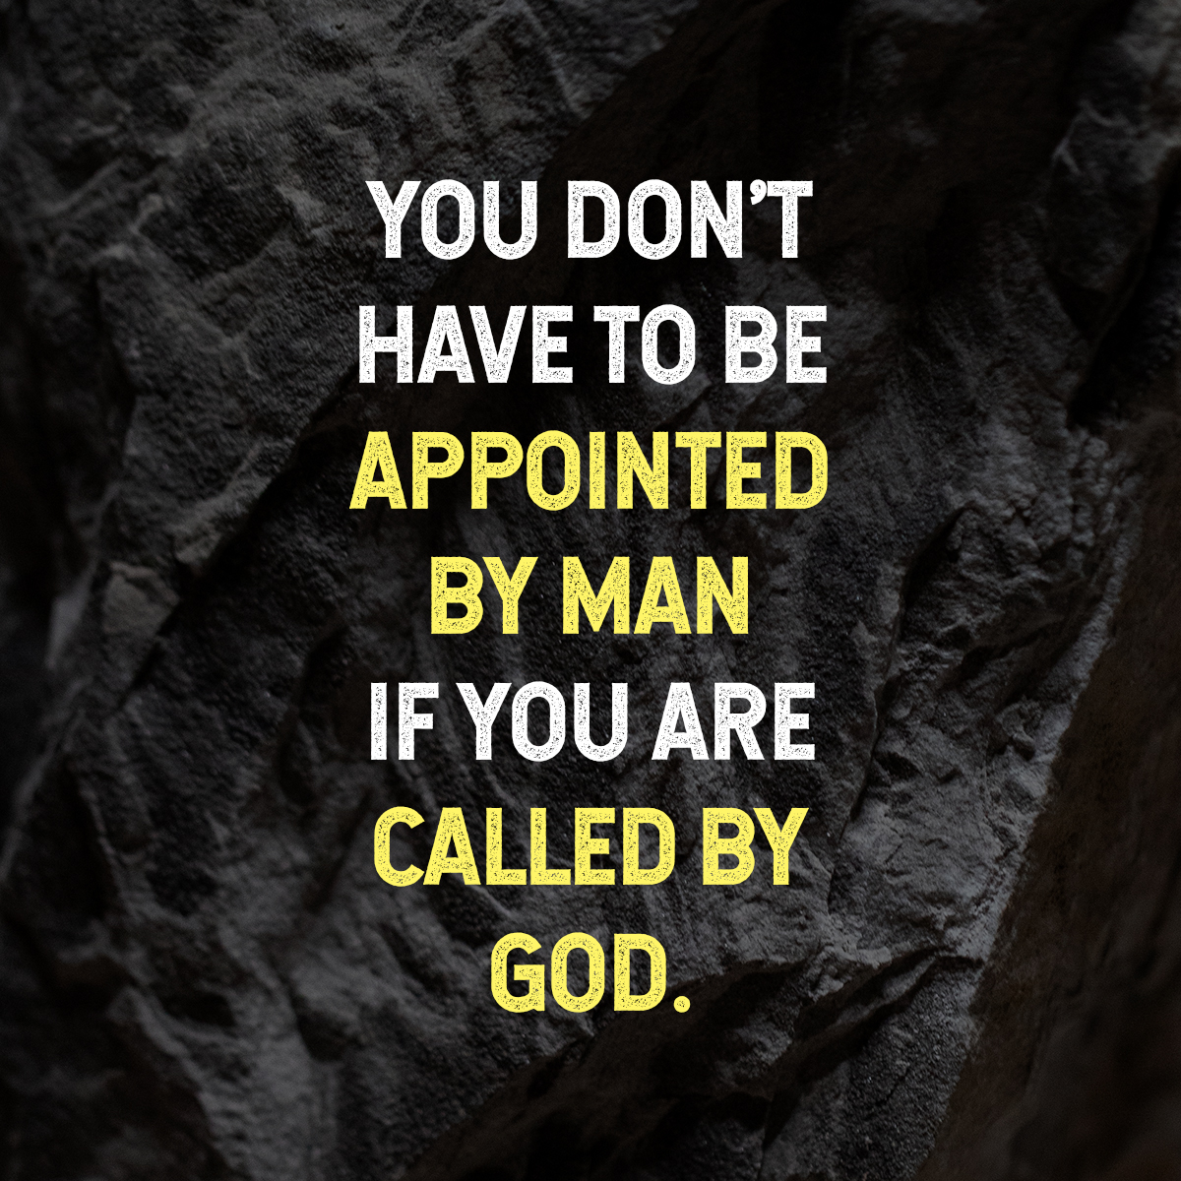

Slide 38
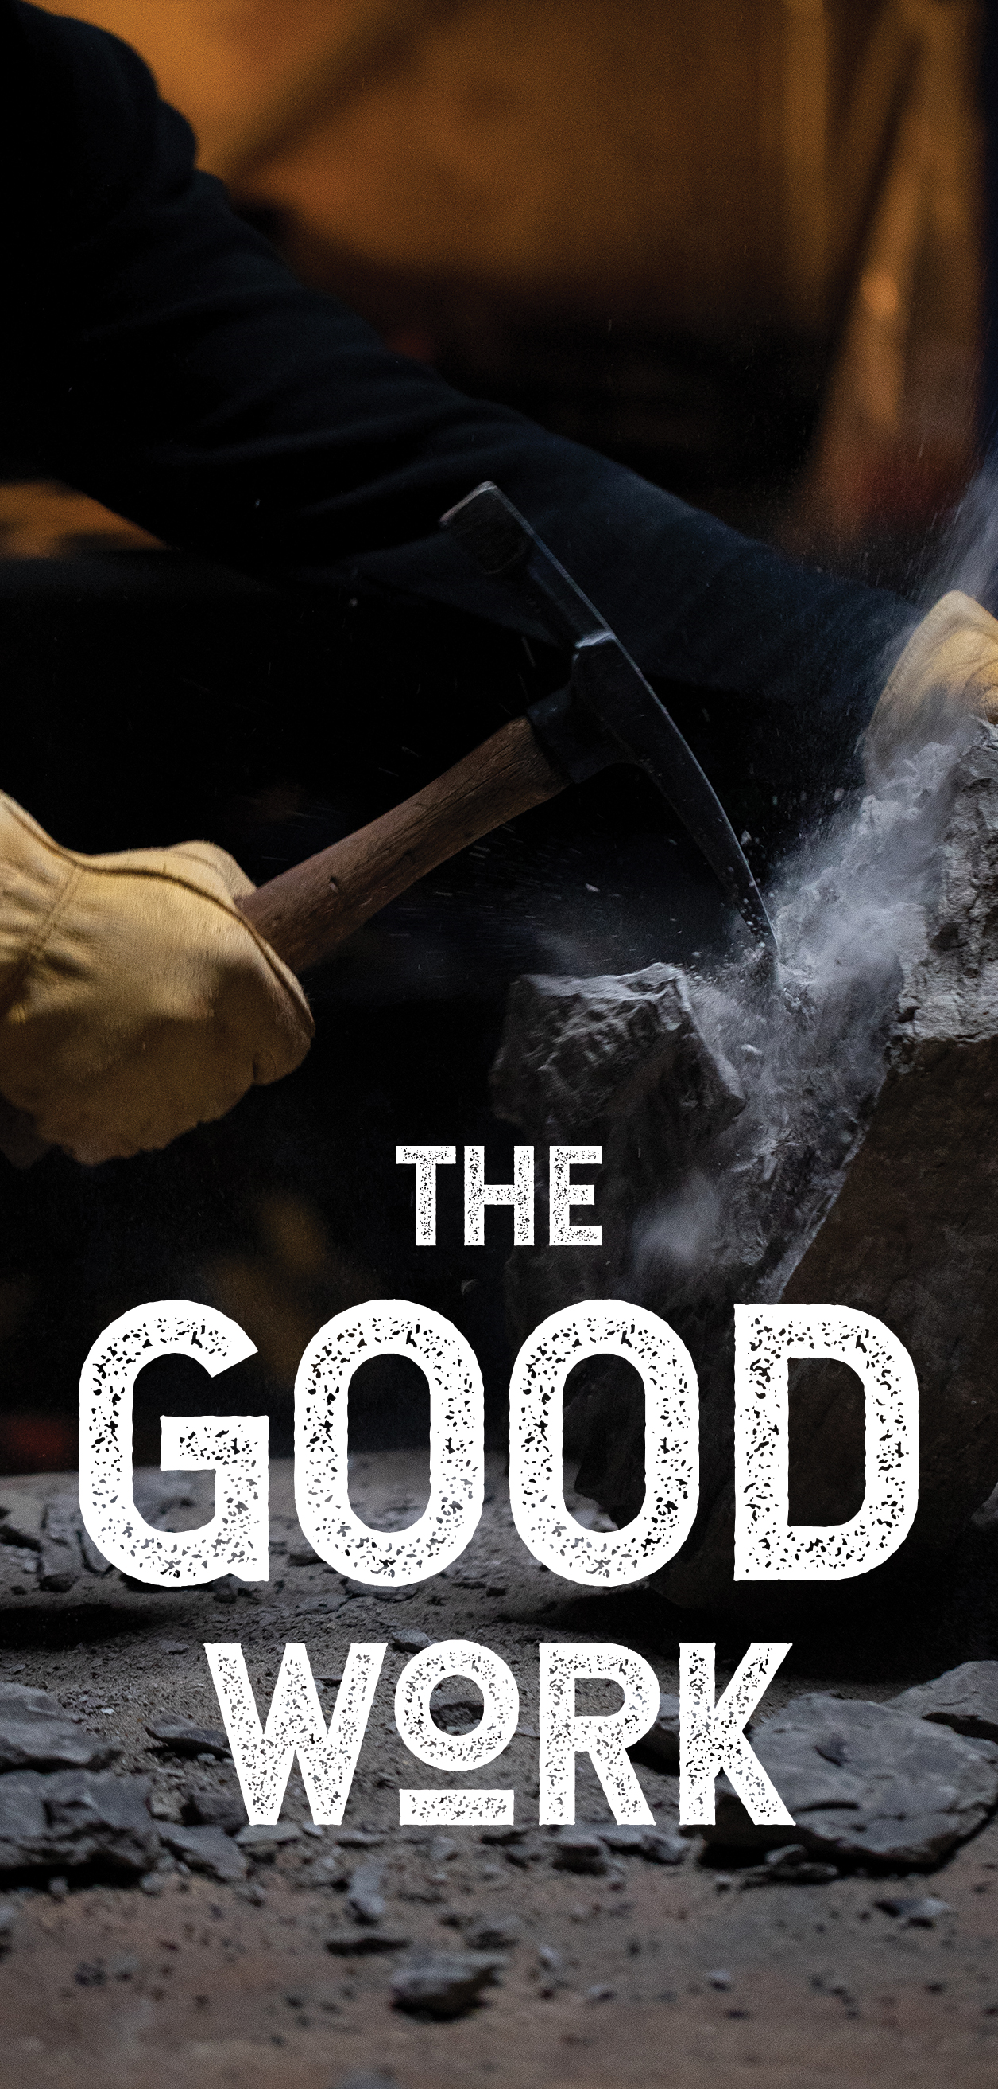
Understand your purpose
Live a good life
Sit down to cry
Kneel down to pray
Stand up and act

Slide 39
A Study on
Nehemiah

