Slide 1
A Study on
Nehemiah

Slide 2
Vision often begins with a need or concern.

Slide 3
God wants you to have a vision

Slide 4
May he give you the desire of your heart and make all your plans succeed.
Psalm 20:4 (NIV)

Slide 5
Take delight in the Lord, and he will give you the desires of your heart.
Psalm 37:4 (NIV)

Slide 6
For the eyes of the Lord range throughout the earth to strengthen those whose hearts are fully committed to him. ..
2 Chronicles 16:9 (NIV)

Slide 7
For we must all appear before the judgment seat of Christ, so that each of us may receive what is due us for the things done while in the body, whether good or bad.
2 Corinthians 5:10 (NIV)

Slide 8
Now faith is confidence in what we hope for and assurance about what we do not see.
Hebrews 11:1 (NIV)

Slide 9
And without faith it is impossible to please God, because anyone who comes to him must believe that he exists and that he rewards those who earnestly seek him.
Hebrews 11:6 (NIV)

Slide 10
Nothing is too big for God’s power or too small for God’s heart!
If prayer isn’t necessary to accomplish your vision, you’re not thinking big enough.

Slide 11
God wants you to have a vision
Define your vision clearly

Slide 12
For most people, it’s not a lack of caring that’s your problem. It’s a lack of clarity!
Craig Groeschel

Slide 13
The king said to me, “What is it you want?” Then I prayed to the God of heaven, and I answered the king, “If it pleases the king and if your servant has found favor in his sight, let him send me to the city in Judah where my ancestors are buried so that I can rebuild it.”
Nehemiah 2:4–5 (NIV)

Slide 14
If you can’t define it—You can’t do it!

Slide 15
God wants you to have a vision
Define your vision clearly
Make plans carefully

Slide 16
The plans of the diligent lead to profit as surely as haste leads to poverty.
Proverbs 21:5 (NIV)

Slide 17
But the noble make noble plans, and by noble deeds they stand.
Isaiah 32:8 (NIV)

Slide 18
Pray for opportunities and then plan as if you expect God to answer your prayers.

Slide 19
Dreamers dream about things being different.
Visionaries envision themselves making a difference.
Andy Stanley

Slide 20
God wants you to have a vision
Define your vision clearly
Make plans carefully
Your vision can inspire others

Slide 21
Then I said to them, “You see the trouble we are in: Jerusalem lies in ruins, and its gates have been burned with fire. Come, let us rebuild the wall of Jerusalem, and we will no longer be in disgrace.”
Nehemiah 2:17–18 (NIV)

Slide 22
I also told them about the gracious hand of my God on me and what the king had said to me. They replied, “Let us start rebuilding.” So they began this good work.
Nehemiah 2:17–18 (NIV)

Slide 23
For the Son of Man came to seek and to save the lost.”
Luke 19:10 (NIV)

Slide 24
He said to them, “Go into all the world and preach the gospel to all creation.
Mark 16:15 (NIV)

Slide 25
God wants you to have a vision
Define your vision clearly
Make plans carefully
Your vision can inspire others
Act on your vision

Slide 26
You don’t get what you wish for.
You get what you work for.

Slide 27
Then the king, with the queen sitting beside him, asked me, “How long will your journey take, and when will you get back?” It pleased the king to send me; so I set a time.
Nehemiah 2:6–8 (NIV)

Slide 28
I also said to him, “If it pleases the king, may I have letters to the governors of Trans-Euphrates, so that they will provide me safe-conduct until I arrive in Judah?
Nehemiah 2:6–8 (NIV)

Slide 29
And may I have a letter to Asaph, keeper of the royal park, so he will give me timber to make beams for the gates of the citadel by the temple and for the city wall and for the residence I will occupy?” And because the gracious hand of my God was on me, the king granted my requests.
Nehemiah 2:6–8 (NIV)

Slide 30
“Vision without action is merely a dream.
Action without vision just passes the time.
Vision with action can change your life.”

Slide 31
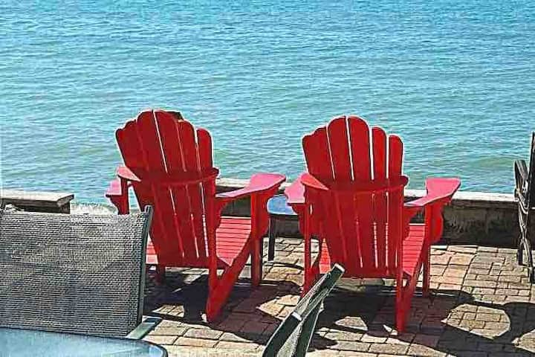

Slide 32
God wants you to have a vision
Define your vision clearly
Make plans carefully
Your vision can inspire others
Act on your vision

Slide 33
A Study on
Nehemiah

