Slide 2
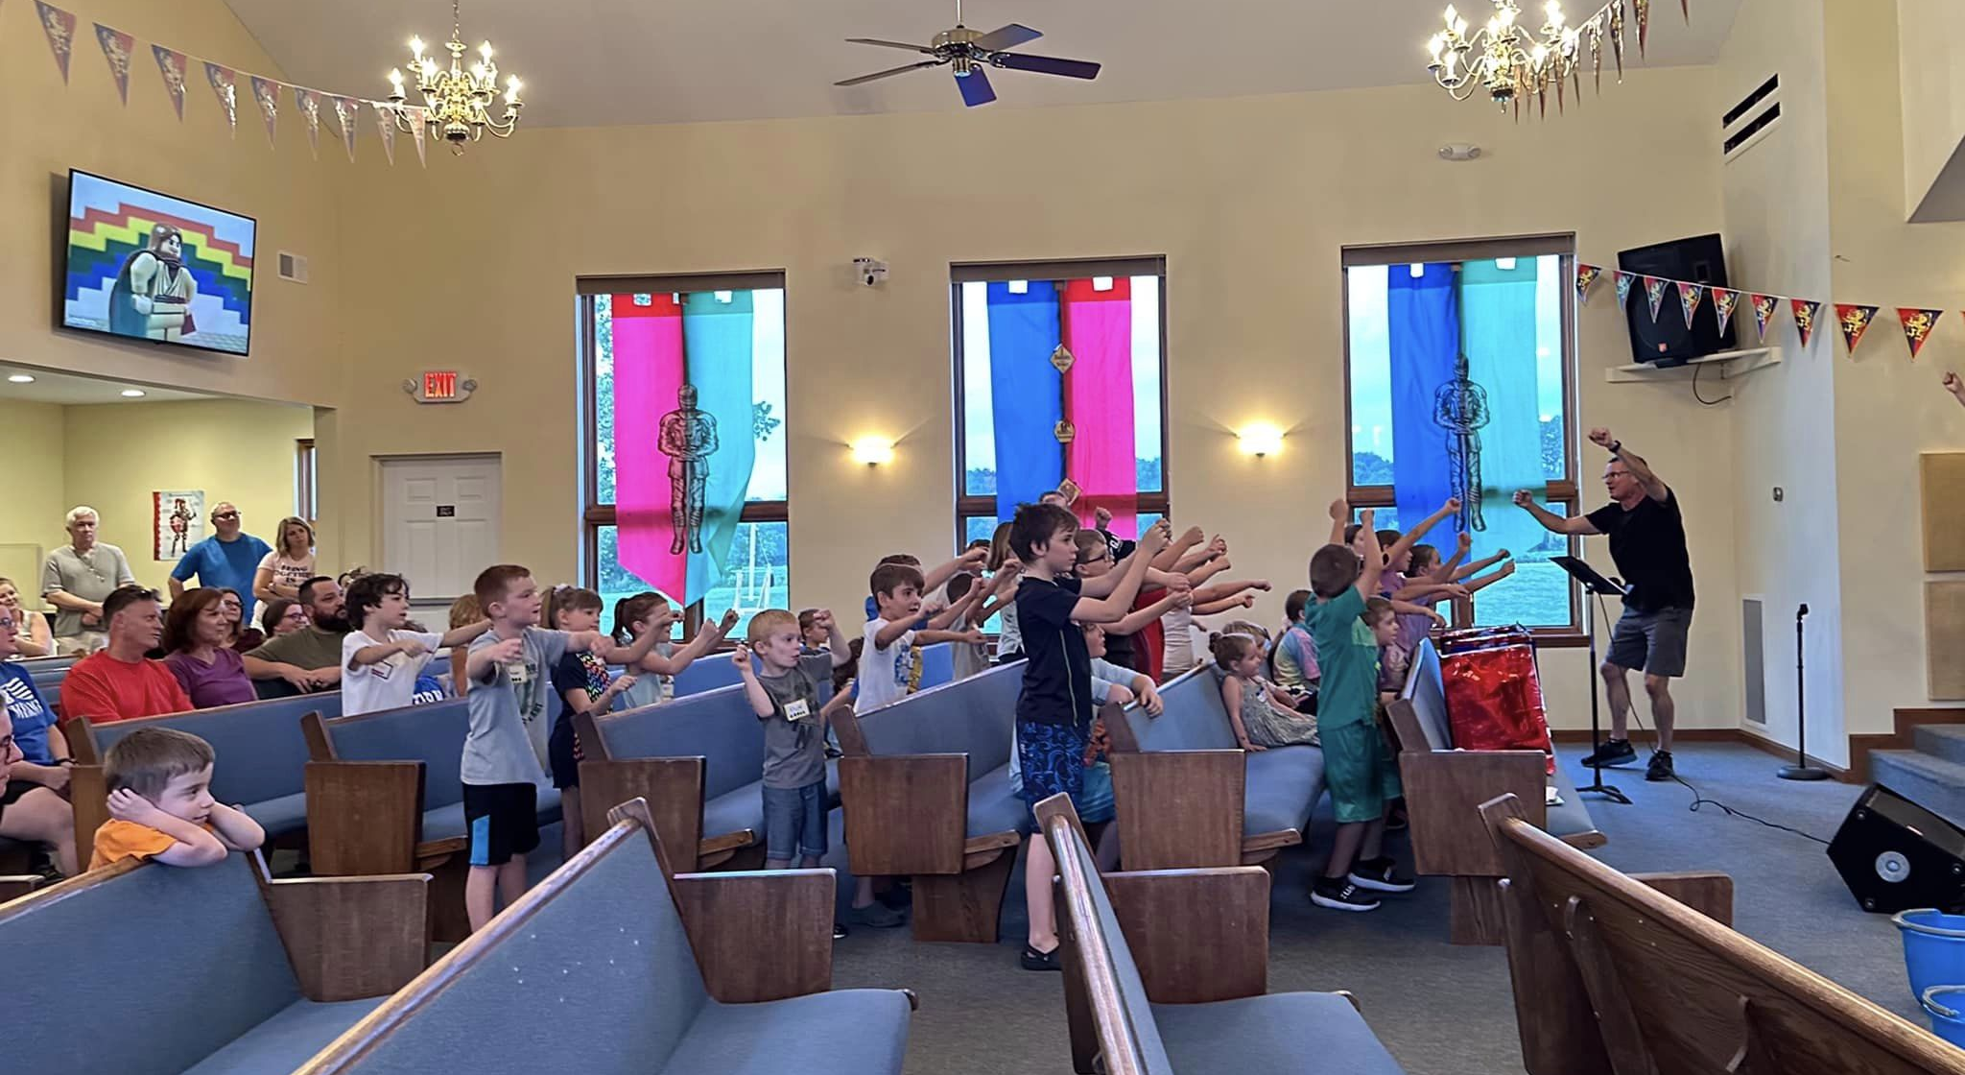
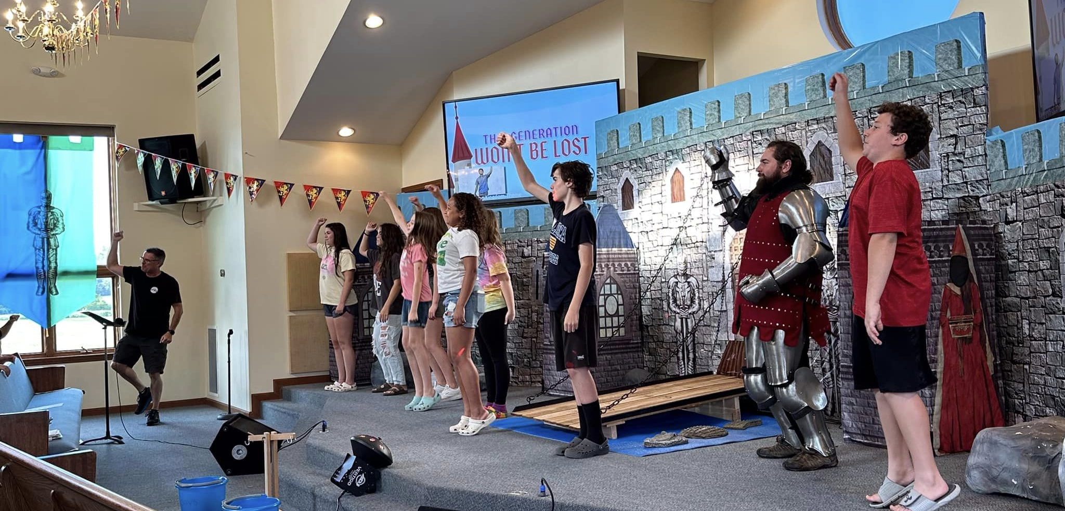
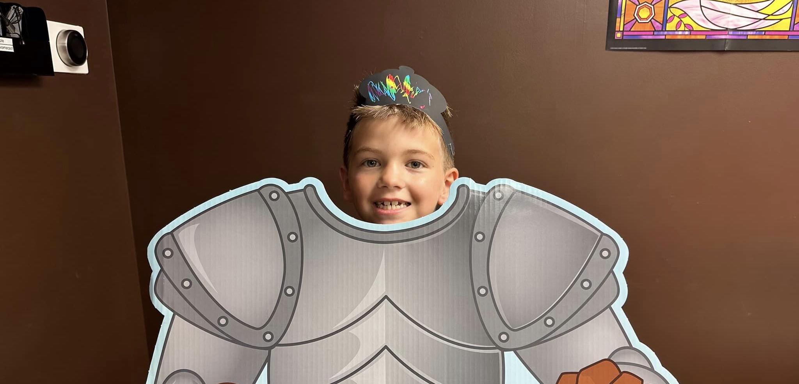

Slide 3
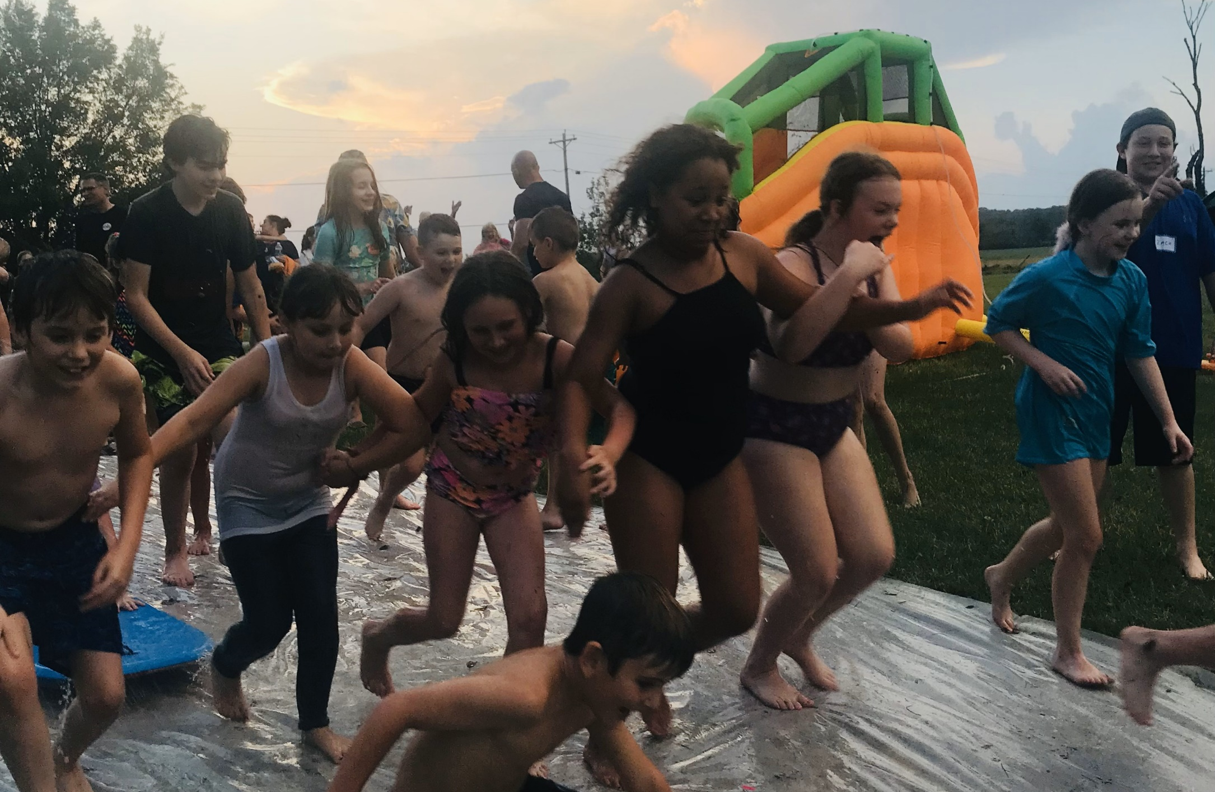
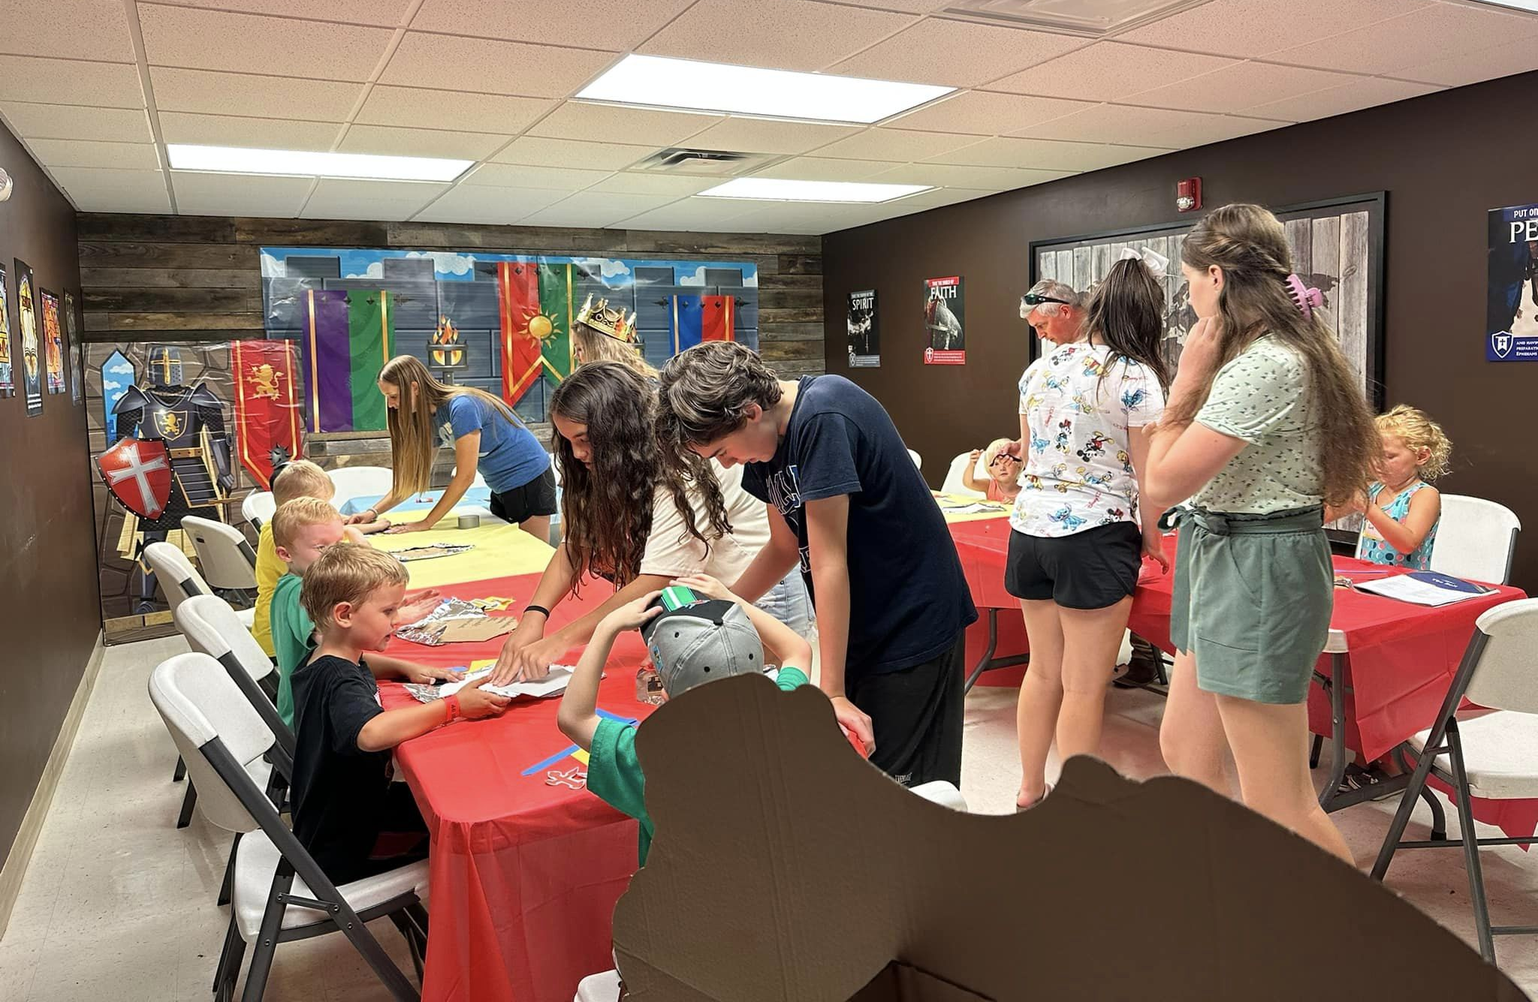
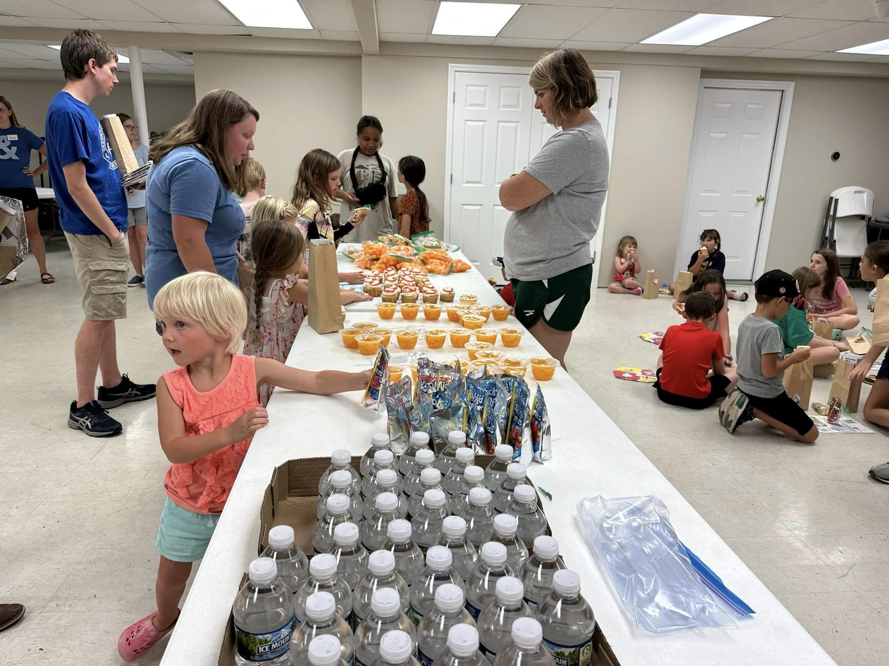
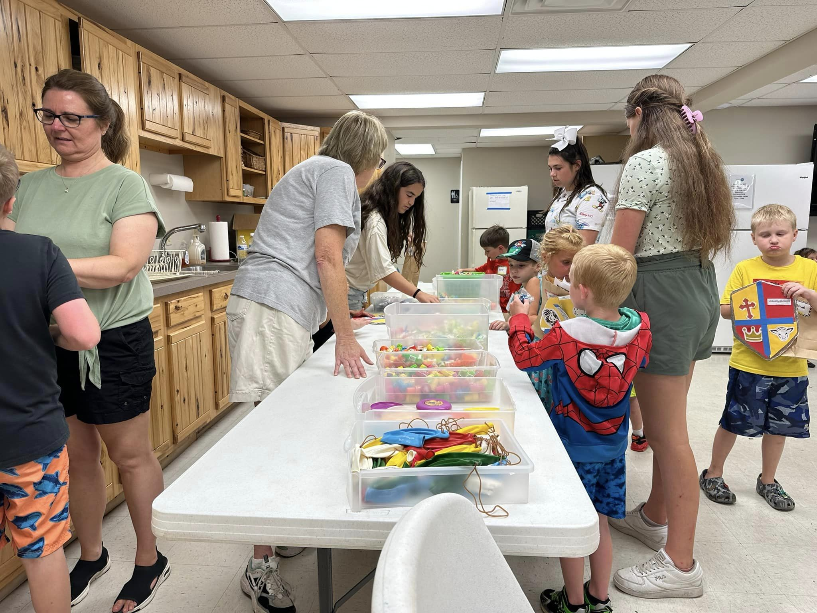

Slide 4
Finally, be strong in the Lord and in his mighty power.
Ephesians 6:10 (NIV)

Slide 5
There’s a battle raging in our world

Slide 6
Put on the full armor of God, so that you can take your stand against the devil’s schemes. For our struggle is not against flesh and blood, but against the rulers, against the authorities, against the powers of this dark world and against the spiritual forces of evil in the heavenly realms.
Ephesians 6:11–12 (NIV)

Slide 7
Jesus, full of the Holy Spirit, left the Jordan and was led by the Spirit into the wilderness, where for forty days he was tempted by the devil. He ate nothing during those days, and at the end of them he was hungry.
Luke 4:1–2 (NIV)

Slide 8
When the devil had finished all this tempting, he left him until an opportune time.
Luke 4:13 (NIV)

Slide 9
Jesus answered, “It is written: ‘Man shall not live on bread alone.’”
Jesus answered, “It is written: ‘Worship the Lord your God and serve him only.’”
Jesus answered, “It is said: ‘Do not put the Lord your God to the test.’”
Luke 4:4,8,12,13 (NIV)

Slide 10
You are going to get pummeled if you don’t live with an awareness that there is a spiritual battle raging.

Slide 11
There’s a battle raging in our world
You must be strong in the Lord

Slide 12
Finally, be strong in the Lord and in his mighty power.
Ephesians 6:10 (NIV)

Slide 13
But even the archangel Michael, when he was disputing with the devil about the body of Moses, did not himself dare to condemn him for slander but said, “The Lord rebuke you!”
Jude 9 (NIV)

Slide 14
You then, my son, be strong in the grace that is in Christ Jesus.
2 Timothy 2:1 (NIV)

Slide 15
Put on the full armor of God, so that you can take your stand against the devil’s schemes.
Ephesians 6:11 (NIV)

Slide 16
Therefore put on the full armor of God, so that when the day of evil comes, you may be able to stand your ground, and after you have done everything, to stand. Stand firm then, with the belt of truth buckled around your waist, with the breastplate of righteousness in place,
Ephesians 6:13-14 (NIV)

Slide 17
… he too shared in their humanity so that by his death he might break the power of him who holds the power of death—that is, the devil—
Hebrews 2:14 (NIV)

Slide 18
Be alert and of sober mind. Your enemy the devil prowls around like a roaring lion looking for someone to devour. Resist him, standing firm in the faith, because you know that the family of believers throughout the world is undergoing the same kind of sufferings.
1 Peter 5:8–9 (NIV)

Slide 19
There’s a battle raging in our world
Be strong in the Lord
Put on the “WHOLE” armor of God

Slide 20
Therefore put on the full armor of God, so that when the day of evil comes, you may be able to stand your ground, and after you have done everything, to stand.
Ephesians 6:13 (NIV)

Slide 21
Stand firm then, with the belt of truth buckled around your waist, with the breastplate of righteousness in place,
Ephesians 6:14 (NIV)

Slide 22
Woe to those who call evil good and good evil, who put darkness for light and light for darkness, who put bitter for sweet and sweet for bitter.
Isaiah 5:20 (NIV)

Slide 23
Jesus answered, “I am the way and the truth and the life. No one comes to the Father except through me.
John 14:6 (NIV)

Slide 24
Sanctify them by the truth; your word is truth.
John 17:17 (NIV)

Slide 25
Satan fights with lies.
The only way to recognize a lie is to know the truth.

Slide 26
The bible doesn’t always tell you what you want to hear, but it will always tell you what you need to hear.

Slide 27
Satan attacks our hearts, our emotions, our self-worth, our trust…

Slide 28
and with your feet fitted with the readiness that comes from the gospel of peace.
Ephesians 6:15 (NIV)

Slide 29
“You are the light of the world. A town built on a hill cannot be hidden. Neither do people light a lamp and put it under a bowl. Instead they put it on its stand, and it gives light to everyone in the house. In the same way, let your light shine before others, that they may see your good deeds and glorify your Father in heaven.
Matthew 5:14–16 (NIV)

Slide 30
But how can they call on him to save them unless they believe in him? And how can they believe in him if they have never heard about him? And how can they hear about him unless someone tells them?
Romans 10:14 (NLT)

Slide 31
Instead, you must worship Christ as Lord of your life. And if someone asks about your hope as a believer, always be ready to explain it.
1 Peter 3:15 (NLT)

Slide 32
In addition to all this, take up the shield of faith, with which you can extinguish all the flaming arrows of the evil one.
Ephesians 6:16 (NIV)

Slide 33
Take the helmet of salvation and the sword of the Spirit, which is the word of God.
Ephesians 6:17 (NIV)

Slide 34
Therefore, my brothers and sisters, make every effort to confirm your calling and election. For if you do these things, you will never stumble,
Ephesians 6:18 (NIV)

Slide 35
Take the helmet of salvation and the sword of the Spirit, which is the word of God.
Ephesians 6:17 (NIV)

Slide 36
And pray in the Spirit on all occasions with all kinds of prayers and requests. With this in mind, be alert and always keep on praying for all the Lord’s people.
Ephesians 6:17 (NIV)

Slide 37
There’s a battle raging in our world
You must be strong in the Lord
Put on the “WHOLE” armor of God

