Slide 1
A Study on
Nehemiah

Slide 2
If the enemy can’t get you to quit, he will distract you.

Slide 3
The process of diverting the attention of an individual or group from a desired area of focus and thereby blocking or diminishing the reception of desired information.
A thing that prevents someone from giving full attention to something else

Slide 4
Set your priorities

Slide 5
When word came to Sanballat, Tobiah, Geshem the Arab and the rest of our enemies that I had rebuilt the wall and not a gap was left in it—though up to that time I had not set the doors in the gates—Sanballat and Geshem sent me this message: “Come, let us meet together in one of the villages on the plain of Ono.”
Nehemiah 6:1–3 (NIV)

Slide 6
But they were scheming to harm me; so I sent messengers to them with this reply: “I am carrying on a great project and cannot go down. Why should the work stop while I leave it and go down to you?”
Nehemiah 6:1–3 (NIV)

Slide 7
“The main thing is to keep the main thing the main thing.”
Stephen R. Covey

Slide 8
By the grace God has given me, I laid a foundation as a wise builder, and someone else is building on it.
But each one should build with care.
For no one can lay any foundation other than the one already laid, which is Jesus Christ.
1 Corinthians 3:10–15 (NIV)

Slide 9
If anyone builds on this foundation using gold, silver, costly stones, wood, hay or straw, their work will be shown for what it is, because the Day will bring it to light. It will be revealed with fire, and the fire will test the quality of each person’s work.
1 Corinthians 3:10–15 (NIV)

Slide 10
If what has been built survives, the builder will receive a reward. If it is burned up, the builder will suffer loss but yet will be saved—even though only as one escaping through the flames.
1 Corinthians 3:10–15 (NIV)

Slide 11
What good is it for someone to gain the whole world, yet forfeit their soul? Or what can anyone give in exchange for their soul?
Mark 8:36–37 (NIV)

Slide 12
Anyone whose name was not found written in the book of life was thrown into the lake of fire.
Revelation 20:15 (NIV)

Slide 13
The Lord is …not wanting anyone to perish, but everyone to come to repentance.
2 Peter 3:9 (NIV)

Slide 14
“Do not store up for yourselves treasures on earth, where moths and vermin destroy, and where thieves break in and steal. But store up for yourselves treasures in heaven, where moths and vermin do not destroy, and where thieves do not break in and steal. For where your treasure is, there your heart will be also.
Matthew 6:19–21 (NIV)

Slide 15
…the dust returns to the ground it came from, and the spirit returns to God who gave it.
Ecclesiastes 12:7 (NIV)

Slide 16
For we brought nothing into the world, and we can take nothing out of it.
1 Timothy 6:7 (NIV)

Slide 17
We are to love people as we have been loved so they can see the One who is love.

Slide 18
Set your priorities
Learn to say “No”

Slide 19
Four times they sent me the same message, and each time I gave them the same answer.
1 Timothy 6:7 (NIV)

Slide 20
Opportunities can also be distractions.

Slide 21
Every time you say yes to something, you should ask yourself what you are saying no to.

Slide 22
Just because you COULD—Doesn’t mean you SHOULD!

Slide 23
Set your priorities
Learn to say “No”
Be aware of distractions

Slide 24
Then, the fifth time, Sanballat sent his aide to me with the same message, and in his hand was an unsealed letter 6 in which was written: “It is reported among the nations—and Geshem says it is true—that you and the Jews are plotting to revolt, and therefore you are building the wall.
Nehemiah 6:4–8 (NIV)

Slide 25
Moreover, according to these reports you are about to become their king and have even appointed prophets to make this proclamation about you in Jerusalem: ‘There is a king in Judah!’ Now this report will get back to the king; so come, let us meet together.”
Nehemiah 6:4–8 (NIV)

Slide 26
I sent him this reply: “Nothing like what you are saying is happening; you are just making it up out of your head.”
Nehemiah 6:4–8 (NIV)

Slide 27
They were just trying to intimidate us, imagining that they could discourage us and stop the work…
Nehemiah 6:9 (NLT)

Slide 28
Don’t worry about what people say about you.
Worry about what’s true about you.

Slide 29
From that time on Jesus began to explain to his disciples that he must go to Jerusalem and suffer many things at the hands of the elders, the chief priests and the teachers of the law, and that he must be killed and on the third day be raised to life.
Matthew 16:21–23 (NIV)

Slide 30
Peter took him aside and began to rebuke him. “Never, Lord!” he said. “This shall never happen to you!” Jesus turned and said to Peter, “Get behind me, Satan! You are a stumbling block to me; you do not have in mind the concerns of God, but merely human concerns.”
Matthew 16:21–23 (NIV)

Slide 31
As Jesus and his disciples were on their way, he came to a village where a woman named Martha opened her home to him. She had a sister called Mary, who sat at the Lord’s feet listening to what he said.
Luke 10:38–42 (NIV)

Slide 32
But Martha was distracted by all the preparations that had to be made. She came to him and asked, “Lord, don’t you care that my sister has left me to do the work by myself? Tell her to help me!”
Luke 10:38–42 (NIV)

Slide 33
Martha, Martha,” the Lord answered, “you are worried and upset about many things, but few things are needed—or indeed only one.
Mary has chosen what is better, and it will not be taken away from her.”
Luke 10:38–42 (NIV)

Slide 34
Don’t settle for what is good when you can have what is better.

Slide 35
Set your priorities
Learn to say “No”
Be aware of distractions
Don’t lose sight of your priorities

Slide 36
They were just trying to intimidate us, imagining that they could discourage us and stop the work.
So I continued the work with even greater determination.
Nehemiah 6:14–16 (NIV)

Slide 37
Remember Tobiah and Sanballat, my God, because of what they have done; remember also the prophet Noadiah and how she and the rest of the prophets have been trying to intimidate me. So the wall was completed on the twenty-fifth of Elul, in fifty-two days.
Nehemiah 6:9 (NLT)

Slide 38
When all our enemies heard about this, all the surrounding nations were afraid and lost their self-confidence, because they realized that this work had been done with the help of our God.
Nehemiah 6:9 (NLT)

Slide 39
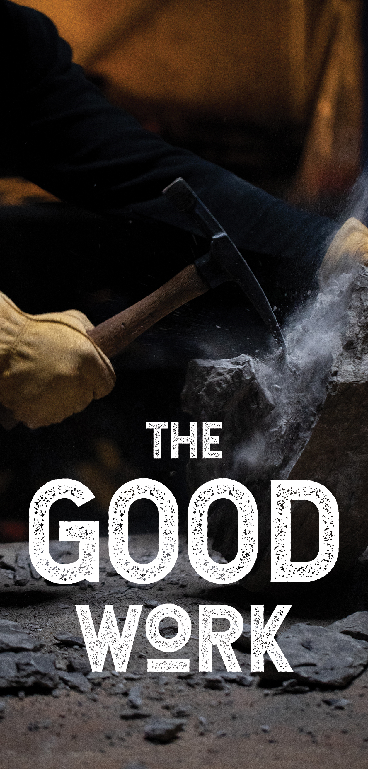
Set your priorities
Learn to say “No”
Be aware of distractions
Don’t lose sight of your priorities

Slide 40
You will never finish what you don’t start.
Time—To—Begin—The—Good—Work!

Slide 41
A Study on
Nehemiah

