Slide 2
The prophecy that Habakkuk the prophet received. How long, LORD, must I call for help, but you do not listen? Or cry out to you, “Violence!” but you do not save? Why do you make me look at injustice? Why do you tolerate wrongdoing? Destruction and violence are before me; there is strife, and conflict abounds. Therefore the law is paralyzed, and justice never prevails. The wicked hem in the righteous, so that justice is perverted.
Hab. 1:1-4 (NIV)

Slide 3
Evil always increases when there is false worship

Slide 4
But mark this: There will be terrible times in the last days. People will be lovers of themselves, lovers of money, boastful, proud, abusive, disobedient to their parents, ungrateful, unholy, without love, unforgiving, slanderous, without self-control, brutal, not lovers of the good, treacherous, rash, conceited, lovers of pleasure rather than lovers of God—having a form of godliness but denying its power.
2 Tim. 3:1-6 (NIV)

Slide 5
Have nothing to do with such people. They are the kind who worm their way into homes and gain control over gullible women, who are loaded down with sins and are swayed by all kinds of evil desires,
2 Tim. 3:1-6 (NIV)

Slide 6
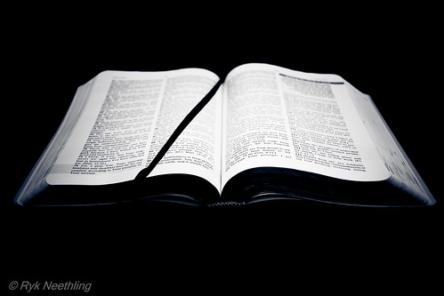
When we rebel against Gods good commands which are for our own good, things always get worse.

Slide 7
Look at the nations and watch— and be utterly amazed. For I am going to do something in your days that you would not believe, even if you were told. I am raising up the Babylonians, that ruthless and impetuous people, who sweep across the whole earth to seize dwellings not their own. They are a feared and dreaded people; they are a law to themselves and promote their own honor.
Hab.1:5-11 (NIV)

Slide 8
Their horses are swifter than leopards, fiercer than wolves at dusk. Their cavalry gallops headlong; their horsemen come from afar. They fly like an eagle swooping to devour; they all come intent on violence. Their hordes advance like a desert wind and gather prisoners like sand. They mock kings and scoff at rulers. They laugh at all fortified cities; by building earthen ramps they capture them. Then they sweep past like the wind and go on— guilty people, whose own strength is their god.
Hab.1:5-11 (NIV)

Slide 9
Evil always increases when there is false worship
God always brings judgment for sin

Slide 10
LORD, are you not from everlasting? My God, my Holy One, you will never die. You, LORD, have appointed them to execute judgment; you, my Rock, have ordained them to punish. Your eyes are too pure to look on evil; you cannot tolerate wrongdoing. Why then do you tolerate the treacherous? Why are you silent while the wicked swallow up those more righteous than themselves? You have made people like the fish in the sea, like the sea creatures that have no ruler.
Hab.1:12-17 (NIV)

Slide 11
The wicked foe pulls all of them up with hooks, he catches them in his net, he gathers them up in his dragnet; and so he rejoices and is glad. Therefore he sacrifices to his net and burns incense to his dragnet, for by his net he lives in luxury and enjoys the choicest food. Is he to keep on emptying his net, destroying nations without mercy?
Hab.1:12-17 (NIV)

Slide 12
Then I saw a great white throne and him who was seated on it. The earth and the heavens fled from his presence, and there was no place for them. And I saw the dead, great and small, standing before the throne, and books were opened. Another book was opened, which is the book of life. The dead were judged according to what they had done as recorded in the books.
Rev.20:11-15 (NIV)

Slide 13
The sea gave up the dead that were in it, and death and Hades gave up the dead that were in them, and each person was judged according to what they had done. Then death and Hades were thrown into the lake of fire. The lake of fire is the second death. Anyone whose name was not found written in the book of life was thrown into the lake of fire.
Rev.20:11-15 (NIV)

Slide 14
If we claim we have not sinned, we make him out to be a liar and his word is not in us.
1 John 1:10 (NIV)

Slide 15
Evil always increases when there is false worship
God always brings judgment for sin
Genuine faith in Jesus Christ as Lord and Savior

Slide 16
For God so loved the world that he gave his one and only Son, that whoever believes in him shall not perish but have eternal life. For God did not send his Son into the world to condemn the world, but to save the world through him. Whoever believes in him is not condemned, but whoever does not believe stands condemned already because they have not believed in the name of God’s one and only Son.
John 3:16-18 (NIV)

Slide 17
Not everyone who says to me, ‘Lord, Lord,’ will enter the kingdom of heaven, but only the one who does the will of my Father who is in heaven.
Matt. 7:21 (NIV)

Slide 18
What good is it, my brothers and sisters, if someone claims to have faith but has no deeds? Can such faith save them?
James 2:14 (NIV)

Slide 19
If you declare with your mouth, “Jesus is Lord,” and believe in your heart that God raised him from the dead, you will be saved. For it is with your heart that you believe and are justified, and it is with your mouth that you profess your faith and are saved.
Romans 10:9-10 (NIV)

