Slide 2
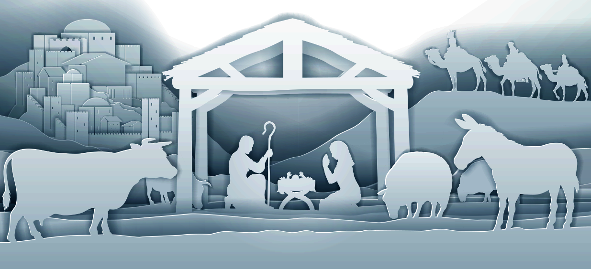
Who, being in very nature God, did not consider equality with God something to be used to his own advantage; rather, he made himself nothing by taking the very nature of a servant, being made in human likeness. And being found in appearance as a man, he humbled himself by becoming obedient to death— even death on a cross!
Philippians 2:6–11 (NIV)

Slide 3
Therefore God exalted him to the highest place and gave him the name that is above every name, that at the name of Jesus every knee should bow, in heaven and on earth and under the earth, and every tongue acknowledge that Jesus Christ is Lord, to the glory of God the Father.
Philippians 2:6–11 (NIV)

Slide 4
Jesus always existed

Slide 5
Who, being in very nature God, did not consider equality with God something to be used to his own advantage;
Philippians 2:6 (NIV)

Slide 6
In the beginning was the Word, and the Word was with God, and the Word was God. He was with God in the beginning. Through him all things were made; without him nothing was made that has been made.
John 1:1–3 (NIV)

Slide 7
“Very truly I tell you,” Jesus answered, “before Abraham was born, I am!”
John 8:58 (NIV)

Slide 8
In the year that King Uzziah died, I saw the Lord, high and exalted, seated on a throne; and the train of his robe filled the temple. Above him were seraphim, each with six wings: With two wings they covered their faces, with two they covered their feet, and with two they were flying.
Isaiah 6:1–5 (NIV)

Slide 9
And they were calling to one another: “Holy, holy, holy is the Lord Almighty; the whole earth is full of his glory.” At the sound of their voices the doorposts and thresholds shook and the temple was filled with smoke.
Isaiah 6:1–5 (NIV)

Slide 10
“Woe to me!” I cried. “I am ruined! For I am a man of unclean lips, and I live among a people of unclean lips, and my eyes have seen the King, the Lord Almighty.”
Isaiah 6:1–5 (NIV)

Slide 11
At once I was in the Spirit, and there before me was a throne in heaven with someone sitting on it. And the one who sat there had the appearance of jasper and ruby. A rainbow that shone like an emerald encircled the throne… From the throne came flashes of lightning, rumblings and peals of thunder… Also in front of the throne there was what looked like a sea of glass, clear as crystal.
Revelation 4:2–6 (NIV)

Slide 12
You believe that there is one God. Good! Even the demons believe that—and shudder.
James 2:19 (NIV)

Slide 13
And now, Father, glorify me in your presence with the glory I had with you before the world began.
John 17:5 (NIV)

Slide 14
“Father, I want those you have given me to be with me where I am, and to see my glory, the glory you have given me because you loved me before the creation of the world.
John 17:24 (NIV)

Slide 15
After six days Jesus took Peter, James and John with him and led them up a high mountain, where they were all alone. There he was transfigured before them. His clothes became dazzling white, whiter than anyone in the world could bleach them.
Mark 9:2–3 (NIV)

Slide 16
Above the vault over their heads was what looked like a throne of lapis lazuli, and high above on the throne was a figure like that of a man. I saw that from what appeared to be his waist up he looked like glowing metal, as if full of fire, and that from there down he looked like fire; and brilliant light surrounded him.
Ezekiel 1:26–28 (NIV)

Slide 17
Like the appearance of a rainbow in the clouds on a rainy day, so was the radiance around him. This was the appearance of the likeness of the glory of the Lord. When I saw it, I fell facedown..
Ezekiel 1:26–28 (NIV)

Slide 18
the twenty-four elders fall down before him who sits on the throne and worship him who lives for ever and ever. They lay their crowns before the throne and say: “You are worthy, our Lord and God, to receive glory and honor and power, for you created all things, and by your will they were created and have their being.”
Revelation 4:9–11 (NIV)

Slide 19
And there were shepherds living out in the fields nearby, keeping watch over their flocks at night. An angel of the Lord appeared to them, and the glory of the Lord shone around them, and they were terrified.
Luke 2:8–14 (NIV)

Slide 20
But the angel said to them, “Do not be afraid. I bring you good news that will cause great joy for all the people. Today in the town of David a Savior has been born to you; he is the Messiah, the Lord.
Luke 2:8–14 (NIV)

Slide 21
This will be a sign to you: You will find a baby wrapped in cloths and lying in a manger.” Suddenly a great company of the heavenly host appeared with the angel, praising God and saying, “Glory to God in the highest heaven, and on earth peace to those on whom his favor rests.”
Luke 2:8–14 (NIV)

Slide 22
Jesus is not a man becoming a God.
He is God becoming a man.

Slide 23
Jesus always existed
Jesus was born into humanity

Slide 24
rather, he made himself nothing by taking the very nature of a servant, being made in human likeness. And being found in appearance as a man, he humbled himself by becoming obedient to death— even death on a cross!
Philippians 2:7–8 (NIV)

Slide 25
So will it be with the resurrection of the dead. The body that is sown is perishable, it is raised imperishable; it is sown in dishonor, it is raised in glory; it is sown in weakness, it is raised in power; it is sown a natural body, it is raised a spiritual body…
1 Corinthians 15:42–44 (NIV)

Slide 26
Yet what we suffer now is nothing compared to the glory he will reveal to us later. For all creation is waiting eagerly for that future day when God will reveal who his children really are. Against its will, all creation was subjected to God’s curse.
Romans 8:18–23 (NLT)

Slide 27
But with eager hope, the creation looks forward to the day when it will join God’s children in glorious freedom from death and decay. For we know that all creation has been groaning as in the pains of childbirth right up to the present time.
Romans 8:18–23 (NLT)

Slide 28
And we believers also groan, even though we have the Holy Spirit within us as a foretaste of future glory, for we long for our bodies to be released from sin and suffering.
Romans 8:18–23 (NLT)

Slide 29
We, too, wait with eager hope for the day when God will give us our full rights as his adopted children, including the new bodies he has promised us.
Romans 8:18–23 (NLT)

Slide 30
Jesus replied, “Very truly I tell you, no one can see the kingdom of God unless they are born again.”
John 3:3 (NIV)

Slide 31
Just as Moses lifted up the snake in the wilderness, so the Son of Man must be lifted up, that everyone who believes may have eternal life in him.” For God so loved the world that he gave his one and only Son, that whoever believes in him shall not perish but have eternal life.
John 3:14–18 (NIV)

Slide 32
For God did not send his Son into the world to condemn the world, but to save the world through him. Whoever believes in him is not condemned, but whoever does not believe stands condemned already because they have not believed in the name of God’s one and only Son.
John 3:14–18 (NIV)

Slide 33
Salvation is found in no one else, for there is no other name under heaven given to mankind by which we must be saved.”
Acts 4:12 (NIV)

Slide 34
Jesus answered, “I am the way and the truth and the life. No one comes to the Father except through me.
John 14:6 (NIV)

Slide 35
For you know the grace of our Lord Jesus Christ, that though he was rich, yet for your sake he became poor, so that you through his poverty might become rich.
2 Corinthians 8:9 (NIV)

Slide 36
Jesus always existed
Jesus was born into humanity
Jesus returned to glory

Slide 37
But you will receive power when the Holy Spirit comes on you; and you will be my witnesses in Jerusalem, and in all Judea and Samaria, and to the ends of the earth.” After he said this, he was taken up before their very eyes, and a cloud hid him from their sight.
Acts 1:8–11 (NIV)

Slide 38
They were looking intently up into the sky as he was going, when suddenly two men dressed in white stood beside them. “Men of Galilee,” they said, “why do you stand here looking into the sky? This same Jesus, who has been taken from you into heaven, will come back in the same way you have seen him go into heaven.”
Acts 1:8–11 (NIV)

Slide 39
Therefore God exalted him to the highest place and gave him the name that is above every name, that at the name of Jesus every knee should bow, in heaven and on earth and under the earth, and every tongue acknowledge that Jesus Christ is Lord, to the glory of God the Father.
Philippians 2:9–11 (NIV)

Slide 40
That is what the Scriptures mean when they say, “No eye has seen, no ear has heard, and no mind has imagined what God has prepared for those who love him.”
1 Corinthians 2:9 (NLT)

Slide 41
Jesus always existed
Jesus was born into humanity
Jesus returned to glory

