Slide 2
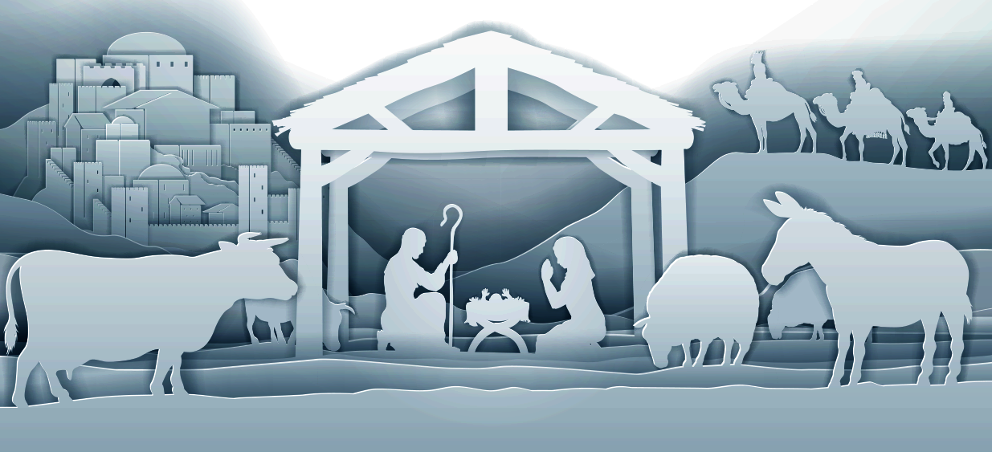
This is how the birth of Jesus the Messiah came about: His mother Mary was pledged to be married to Joseph, but before they came together, she was found to be pregnant through the Holy Spirit. Because Joseph her husband was faithful to the law, and yet did not want to expose her to public disgrace, he had in mind to divorce her quietly.
Matthew 1:18–25 (NIV)

Slide 3
But after he had considered this, an angel of the Lord appeared to him in a dream and said, “Joseph son of David, do not be afraid to take Mary home as your wife, because what is conceived in her is from the Holy Spirit. She will give birth to a son, and you are to give him the name Jesus, because he will save his people from their sins.”
Matthew 1:18–25 (NIV)

Slide 4
All this took place to fulfill what the Lord had said through the prophet: “The virgin will conceive and give birth to a son, and they will call him Immanuel” (which means “God with us”). When Joseph woke up, he did what the angel of the Lord had commanded him and took Mary home as his wife. But he did not consummate their marriage until she gave birth to a son. And he gave him the name Jesus.
Matthew 1:18–25 (NIV)

Slide 5
This is how the birth of Jesus the Messiah came about: His mother Mary was pledged to be married to Joseph, but before they came together, she was found to be pregnant through the Holy Spirit.
Matthew 1:18–25 (NIV)

Slide 6
Mary was Jesus’ mom, but Joseph was not Jesus’ dad

Slide 7
Zerubbabel the father of Abihud, Abihud the father of Eliakim, Eliakim the father of Azor, Azor the father of Zadok, Zadok the father of Akim, Akim the father of Elihud, Elihud the father of Eleazar, Eleazar the father of Matthan, Matthan the father of Jacob, and Jacob the father of Joseph, the husband of Mary, and Mary was the mother of Jesus who is called the Messiah.
Matthew 1:13–16 (NIV)

Slide 8
All this took place to fulfill what the Lord had said through the prophet: “The virgin will conceive and give birth to a son, and they will call him Immanuel” (which means “God with us”).
Matthew 1:22-23 (NIV)

Slide 9
When Joseph woke up, he did what the angel of the Lord had commanded him and took Mary home as his wife. But he did not consummate their marriage until she gave birth to a son. And he gave him the name Jesus.
Matthew 1:24-25 (NIV)

Slide 10
Mary was Jesus’ mom, but Joseph was not Jesus’ dad
Jesus was man and Jesus was God

Slide 11
And Jesus grew in wisdom and stature, and in favor with God and man.
Luke 2:52 (NIV)

Slide 12
He took Peter and the two sons of Zebedee along with him, and he began to be sorrowful and troubled. Then he said to them, “My soul is overwhelmed with sorrow to the point of death. Stay here and keep watch with me.”
Matthew 26:37–38 (NIV)

Slide 13
Jesus wept.
John 11:35 (NIV)

Slide 14
Coming to his hometown, he began teaching the people in their synagogue, and they were amazed. “Where did this man get this wisdom and these miraculous powers?” they asked. “Isn’t this the carpenter’s son? Isn’t his mother’s name Mary, and aren’t his brothers James, Joseph, Simon and Judas? Aren’t all his sisters with us? Where then did this man get all these things?”
Matthew 13:54–56 (NIV)

Slide 15
When his family heard about this, they went to take charge of him, for they said, “He is out of his mind.”
Mark 3:21 (NIV)

Slide 16
For we do not have a high priest who is unable to empathize with our weaknesses, but we have one who has been tempted in every way, just as we are—yet he did not sin. Let us then approach God’s throne of grace with confidence, so that we may receive mercy and find grace to help us in our time of need.
Hebrews 4:15–16 (NIV)

Slide 17
As soon as Jesus was baptized, he went up out of the water. At that moment heaven was opened, and he saw the Spirit of God descending like a dove and alighting on him. And a voice from heaven said, “This is my Son, whom I love; with him I am well pleased.”
Matthew 3:16–17 (NIV)

Slide 18
So it is written: “The first man Adam became a living being”; the last Adam, a life-giving spirit.
1 Corinthians 15:45 (NIV)

Slide 19
Therefore, just as sin entered the world through one man, and death through sin, and in this way death came to all people, because all sinned—
Romans 5:12 (NIV)

Slide 20
But the gift is not like the trespass. For if the many died by the trespass of the one man, how much more did God’s grace and the gift that came by the grace of the one man, Jesus Christ, overflow to the many!
Romans 5:15–19 (NIV)

Slide 21
Nor can the gift of God be compared with the result of one man’s sin: The judgment followed one sin and brought condemnation, but the gift followed many trespasses and brought justification.
Romans 5:15–19 (NIV)

Slide 22
For if, by the trespass of the one man, death reigned through that one man, how much more will those who receive God’s abundant provision of grace and of the gift of righteousness reign in life through the one man, Jesus Christ!
Romans 5:15–19 (NIV)

Slide 23
Consequently, just as one trespass resulted in condemnation for all people, so also one righteous act resulted in justification and life for all people.
For just as through the disobedience of the one man the many were made sinners, so also through the obedience of the one man the many will be made righteous.
Romans 5:15–19 (NIV)

Slide 24
How much more, then, will the blood of Christ, who through the eternal Spirit offered himself unblemished to God, cleanse our consciences from acts that lead to death, so that we may serve the living God!
Hebrews 9:14 (NIV)

Slide 25
God made him who had no sin to be sin for us, so that in him we might become the righteousness of God.
2 Corinthians 5:21 (NIV)

Slide 26
Surely he took up our pain and bore our suffering, yet we considered him punished by God, stricken by him, and afflicted. But he was pierced for our transgressions, he was crushed for our iniquities; the punishment that brought us peace was on him, and by his wounds we are healed.
Isaiah 53:4–6 (NIV)

Slide 27
We all, like sheep, have gone astray, each of us has turned to our own way; and the Lord has laid on him the iniquity of us all.
Isaiah 53:4–6 (NIV)

Slide 28
Mary was Jesus’ mom, but Joseph was not Jesus’ dad
Jesus was man and Jesus was God
Joseph could have condemned, but he showed grace

Slide 29
This is how the birth of Jesus the Messiah came about: His mother Mary was pledged to be married to Joseph, but before they came together, she was found to be pregnant through the Holy Spirit.
Matthew 1:18 (NIV)

Slide 30
Because Joseph her husband was faithful to the law, and yet did not want to expose her to public disgrace, he had in mind to divorce her quietly.
Matthew 1:19 (NIV)

Slide 31
And forgive us our debts, as we also have forgiven our debtors. And lead us not into temptation, but deliver us from the evil one.’ For if you forgive other people when they sin against you, your heavenly Father will also forgive you. But if you do not forgive others their sins, your Father will not forgive your sins.
Matthew 6:12–15 (NIV)

Slide 32
Mary was Jesus’ mom, but Joseph was not Jesus’ dad
Jesus was man and Jesus was God
Joseph could have condemned, but he showed grace
God has a right to change your plans

Slide 33
“Isn’t this the carpenter’s son? Isn’t his mother’s name Mary, and aren’t his brothers James, Joseph, Simon and Judas?
Matthew 13:55 (NIV)

Slide 34
But after he had considered this, an angel of the Lord appeared to him in a dream and said, “Joseph son of David, do not be afraid to take Mary home as your wife, because what is conceived in her is from the Holy Spirit.
Matthew 1:20 (NIV)

Slide 35
Mary was Jesus’ mom, but Joseph was not Jesus’ dad
Jesus was man and Jesus was God
Joseph could have condemned, but he showed grace
God has a right to change your plans
Following Jesus can be difficult

Slide 36
The thief comes only to steal and kill and destroy; I have come that they may have life, and have it to the full.
John 10:10 (NIV)

Slide 37
Then Jesus said to his disciples, “Whoever wants to be my disciple must deny themselves and take up their cross and follow me. For whoever wants to save their life will lose it, but whoever loses their life for me will find it.
Matthew 16:24–27 (NIV)

Slide 38
She will give birth to a son, and you are to give him the name Jesus, because he will save his people from their sins.”
Matthew 1:21 (NIV)

Slide 39
“Turn to me and be saved, all you ends of the earth; for I am God, and there is no other.
Isaiah 45:22 (NIV)

Slide 40
Mary was Jesus’ mom, but Joseph was not Jesus’ dad
Jesus was man and Jesus was God
Joseph could have condemned, but he showed grace
God has a right to change your plans
Following Jesus can be difficult
Turn to Jesus and be saved

Slide 43
We are afraid to lose what we have because we don’t fully understand what we will gain.

