Slide 2
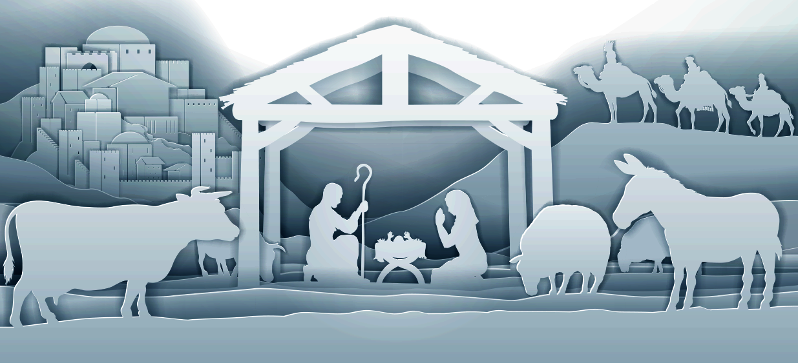
In the sixth month of Elizabeth’s pregnancy, God sent the angel Gabriel to Nazareth, a town in Galilee, to a virgin pledged to be married to a man named Joseph, a descendant of David. The virgin’s name was Mary.
Luke 1:26–27 (NIV)

Slide 3
Therefore the Lord himself will give you a sign: The virgin will conceive and give birth to a son, and will call him Immanuel.
Isaiah 7:14 (NIV)

Slide 4
Mary’s initial response to being chosen was to be afraid

Slide 5
Mary was greatly troubled at his words and wondered what kind of greeting this might be. But the angel said to her, “Do not be afraid, Mary; you have found favor with God.
Luke 1:29–30 (NIV)

Slide 6
Mary’s initial response to being chosen was to be afraid
God presents the mission

Slide 7
You will conceive and give birth to a son, and you are to call him Jesus. He will be great and will be called the Son of the Most High. The Lord God will give him the throne of his father David, and he will reign over Jacob’s descendants forever; his kingdom will never end.”
Luke 1:31-32 (NIV)

Slide 8
Mary’s initial response to being chosen was to be afraid
God presents the mission
God looks at your heart… not your qualifications

Slide 9
But the Lord said to Samuel, “Do not consider his appearance or his height, for I have rejected him.
The Lord does not look at the things people look at. People look at the outward appearance, but the Lord looks at the heart.”
1 Samuel 16:7 (NIV)

Slide 10
Brothers and sisters, think of what you were when you were called. Not many of you were wise by human standards; not many were influential; not many were of noble birth. But God chose the foolish things of the world to shame the wise; God chose the weak things of the world to shame the strong.
1 Samuel 16:7 (NIV)

Slide 11
God chose the lowly things of this world and the despised things—and the things that are not—to nullify the things that are, so that no one may boast before him.
1 Samuel 16:7 (NIV)

Slide 12
For we are God’s handiwork, created in Christ Jesus to do good works, which God prepared in advance for us to do.
Ephesians 2:10 (NIV)

Slide 13
In a wealthy home some utensils are made of gold and silver, and some are made of wood and clay. The expensive utensils are used for special occasions, and the cheap ones are for everyday use. If you keep yourself pure, you will be a special utensil for honorable use. Your life will be clean, and you will be ready for the Master to use you for every good work.
2 Timothy 2:20–21 (NLT)

Slide 14
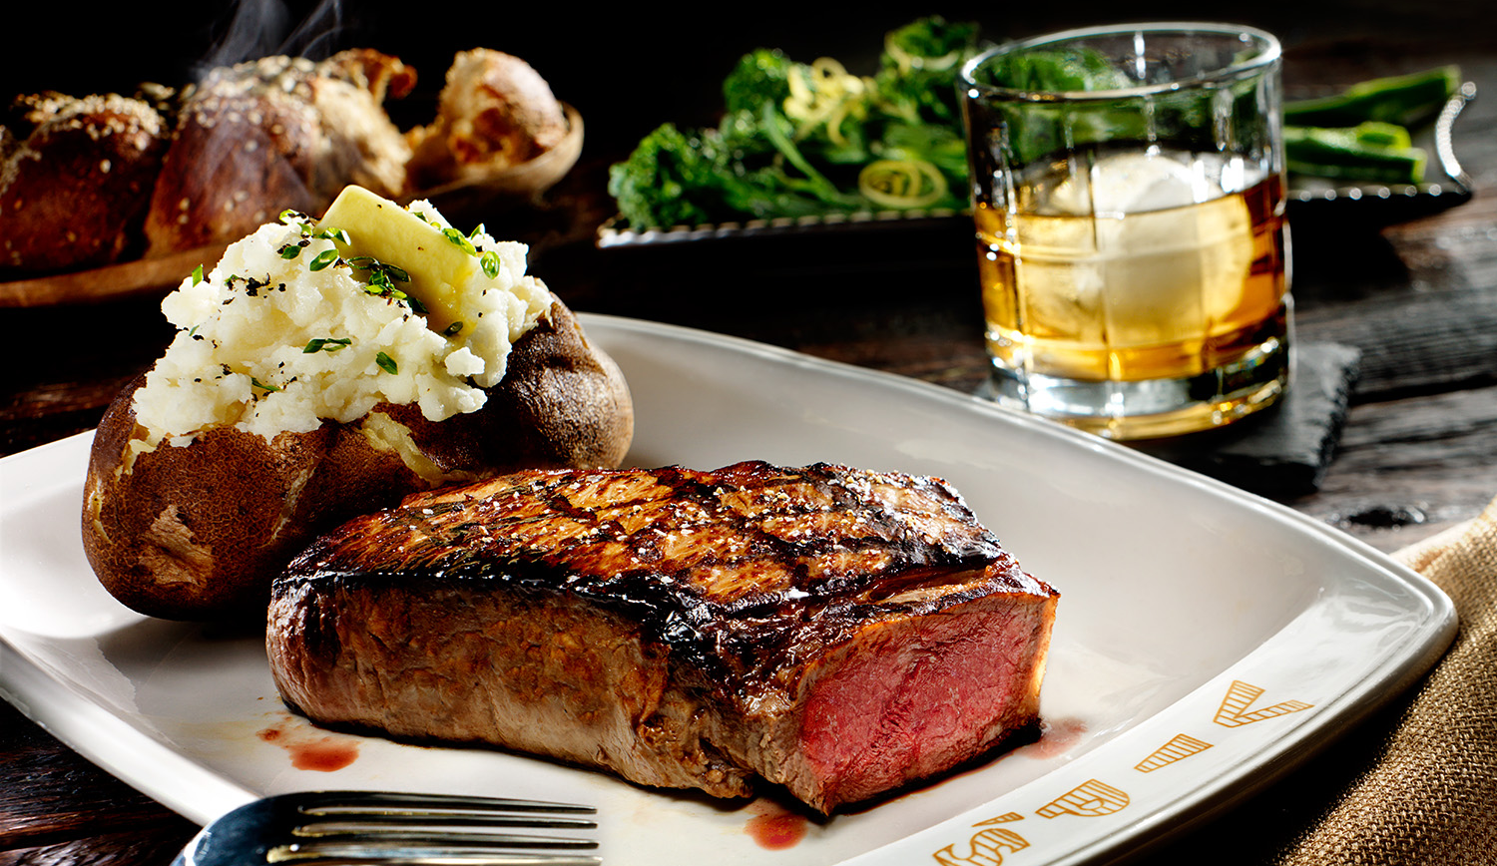

Slide 15
It’s not your job to choose how you will be used by God.
It’s your job to be usable.

Slide 16
Mary’s initial response to being chosen was to be afraid
God presents the mission
God looks at your heart… not your qualifications
God chose Mary because she would believe Him

Slide 17
The angel went to her and said, “Greetings, you who are highly favored! The Lord is with you.” Mary was greatly troubled at his words and wondered what kind of greeting this might be. But the angel said to her, “Do not be afraid, Mary; you have found favor with God.
Luke 1:28-30 (NIV)

Slide 18
But why am I so favored, that the mother of my Lord should come to me? As soon as the sound of your greeting reached my ears, the baby in my womb leaped for joy.
Blessed is she who has believed that the Lord would fulfill his promises to her!”
Luke 1:43-45 (NIV)

Slide 19
… I tell you, if you have faith as small as a mustard seed, you can say to this mountain, ‘Move from here to there,’ and it will move. Nothing will be impossible for you.”
Matthew 17:20–21 (NIV)

Slide 20
For no word from God will ever fail.”
Luke 1:37 (NIV)

Slide 21
Zechariah asked the angel, “How can I be sure of this? I am an old man and my wife is well along in years.”
Luke 1:18 (NIV)

Slide 22
“How will this be,” Mary asked the angel, “since I am a virgin?”
Luke 1:34–38 (NIV)

Slide 23
The angel answered, “The Holy Spirit will come on you, and the power of the Most High will overshadow you. So the holy one to be born will be called the Son of God. Even Elizabeth your relative is going to have a child in her old age, and she who was said to be unable to conceive is in her sixth month. For no word from God will ever fail.”
Luke 1:34–38 (NIV)

Slide 24
Now faith is confidence in what we hope for and assurance about what we do not see.
And without faith it is impossible to please God, because anyone who comes to him must believe that he exists and that he rewards those who earnestly seek him.
Hebrews 11:1,6 (NIV)

Slide 25
Mary’s initial response to being chosen was to be afraid
God presents the mission
God looks at your heart… not your qualifications
God chose Mary because she would believe Him
Mary’s response – “Pick me!”

Slide 26
“I am the Lord’s servant,” Mary answered. “May your word to me be fulfilled.” Then the angel left her.
Luke 1:38 (NIV)

Slide 27
And Mary said: “My soul glorifies the Lord and my spirit rejoices in God my Savior, for he has been mindful of the humble state of his servant. From now on all generations will call me blessed, for the Mighty One has done great things for me— holy is his name.
Luke 1:46-56 (NIV)

Slide 28
His mercy extends to those who fear him, from generation to generation. He has performed mighty deeds with his arm; he has scattered those who are proud in their inmost thoughts. He has brought down rulers from their thrones but has lifted up the humble.
Luke 1:46-56 (NIV)

Slide 29
He has filled the hungry with good things but has sent the rich away empty. He has helped his servant Israel, remembering to be merciful to Abraham and his descendants forever, just as he promised our ancestors.” Mary stayed with Elizabeth for about three months and then returned home.
Luke 1:46-56 (NIV)

Slide 30
Mary’s initial response to being chosen was to be afraid
God presents the mission
God looks at your heart… not your qualifications
God chose Mary because she would believe Him
Mary’s response – Pick me!

