Slide 1
RUN
TO
WIN
CROSBY COMMUNITY CHURCH

Slide 2
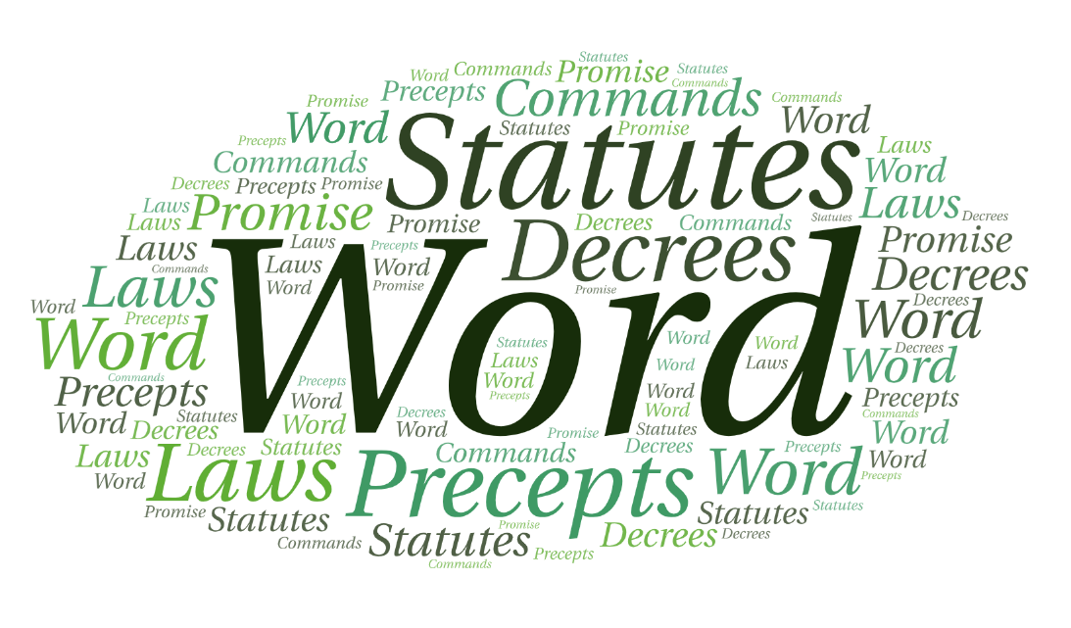

Slide 3
You need to know what the bible says

Slide 4
In Psalm 119 God tells us the value of reading the bible over 170 times.
That should get our attention.

Slide 5
Cause me to understand the way of your precepts, that I may meditate on your wonderful deeds.
Psalm 119:27 (NIV)

Slide 6
I meditate on your precepts and consider your ways.
Psalm 119:15 (NIV)

Slide 7
Oh, how I love your law! I meditate on it all day long. Your commands are always with me and make me wiser than my enemies. I have more insight than all my teachers, for I meditate on your statutes.
Psalm 119:97–99 (NIV)

Slide 8
I have hidden your word in my heart that I might not sin against you.
Psalm 119:11 (NIV)

Slide 9
These commandments that I give you today are to be on your hearts.
Deuteronomy 6:6 (NIV)

Slide 10
Accept instruction from his mouth and lay up his words in your heart.
Job 22:22 (NIV)

Slide 11
Blessed is the one who does not walk in step with the wicked or stand in the way that sinners take or sit in the company of mockers, but whose delight is in the law of the Lord, and who meditates on his law day and night. That person is like a tree planted by streams of water, which yields its fruit in season and whose leaf does not wither— whatever they do prospers.
Psalm 1:1–3 (NIV)

Slide 12
Your word is a lamp for my feet, a light on my path.
Psalm 119:105 (NIV)

Slide 13
You need to know what the bible says
Reading the bible can be rewarding

Slide 14
Blessed are those whose ways are blameless, who walk according to the law of the Lord.
Blessed are those who keep his statutes and seek him with all their heart—
Psalm 119:1–8 (NIV)

Slide 15
Therefore no one will be declared righteous in God’s sight by the works of the law; rather, through the law we become conscious of our sin.
Romans 3:20 (NIV)

Slide 16
For the word of God is alive and active. Sharper than any double-edged sword, it penetrates even to dividing soul and spirit, joints and marrow; it judges the thoughts and attitudes of the heart.
Hebrews 4:12 (NIV)

Slide 17
But whoever looks intently into the perfect law that gives freedom, and continues in it—not forgetting what they have heard, but doing it—they will be blessed in what they do.
James 1:25 (NIV)

Slide 18
For the wages of sin is death, but the gift of God is eternal life in Christ Jesus our Lord.
Romans 6:23 (NIV)

Slide 19
The wages of the righteous is life, but the earnings of the wicked are sin and death.
Proverbs 10:16 (NIV)

Slide 20
The mind governed by the flesh is death, but the mind governed by the Spirit is life and peace.
Romans 8:6 (NIV)

Slide 21
Do not be deceived: God cannot be mocked. A man reaps what he sows.
Whoever sows to please their flesh, from the flesh will reap destruction; whoever sows to please the Spirit, from the Spirit will reap eternal life.
Galatians 6:7–8 (NIV)

Slide 22
The thief comes only to steal and kill and destroy;
I have come that they may have life, and have it to the full.
John 10:10 (NIV)

Slide 23
Following the instruction manual (bible) given to you by the One who created you just seems like a good idea!

Slide 24
The law of the Lord is perfect, refreshing the soul. The statutes of the Lord are trustworthy, making wise the simple. The precepts of the Lord are right, giving joy to the heart. The commands of the Lord are radiant, giving light to the eyes.
Psalm 19:7–8 (NIV)

Slide 25
You need to know what the bible says
Reading the bible can be rewarding
You are to obey what has been revealed

Slide 26
they do no wrong but follow his ways. You have laid down precepts that are to be fully obeyed. Oh, that my ways were steadfast in obeying your decrees! Then I would not be put to shame when I consider all your commands. I will praise you with an upright heart as I learn your righteous laws. I will obey your decrees; do not utterly forsake me.
Psalm 119:3-8 (NIV)

Slide 27
Do not merely listen to the word, and so deceive yourselves. Do what it says.
Anyone who listens to the word but does not do what it says is like someone who looks at his face in a mirror and, after looking at himself, goes away and immediately forgets what he looks like.
James 1:22–25 (NIV)

Slide 28
Partial obedience is not obedience.
You will never experience all God has for you until you fully surrender to Him.

Slide 29
But seek first his kingdom and his righteousness, and all these things will be given to you as well.
Matthew 6:33 (NIV)

Slide 30
He answered, “ ‘Love the Lord your God with all your heart and with all your soul and with all your strength and with all your mind’; and, ‘Love your neighbor as yourself.’”
Luke 10:27 (NIV)

Slide 31
“You shall have no other gods before me.
Exodus 20:3 (NIV)

Slide 32
We need to know what the bible says
Reading the bible can be rewarding
You are to obey what has been revealed
As you begin to see the results in your life, you will begin to crave it

Slide 33
How I long for your precepts! In your righteousness preserve my life.
Psalm 119:20 (NIV)

Slide 34
My soul is consumed with longing for your laws at all times.
Psalm 119:40 (NIV)

Slide 35
I delight in your decrees; I will not neglect your word.
Psalm 119:16 (NIV)

Slide 36
You need to know what the bible says
Reading your bible can be rewarding
You are to obey what has been revealed
As you begin to see the results in your life, you will begin to crave it

Slide 37
RUN
TO
WIN
CROSBY COMMUNITY CHURCH

