Slide 2
All Scripture is God-breathed and is useful for teaching, rebuking, correcting and training in righteousness,
2 Tim 3:16 (NIV)

Slide 3
How did we get the scriptures and are they accurate?

Slide 4
οὕτως γὰρ ἠγάπησεν ὁ θεὸς τὸν κόσμον, ὥστε τὸν υἱὸν τὸν μονογενῆ
ἔδωκεν, ἵνα πᾶς ὁ πιστεύων εἰς αὐτὸν μὴ ἀπόληται ἀλλ᾽ ἔχῃ ζωὴν αἰώνιον

Slide 5
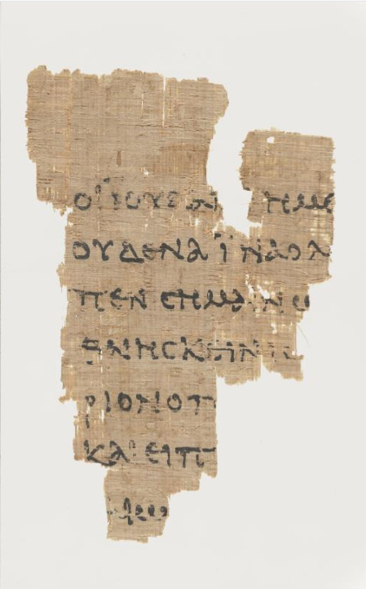
P52, Manuscript of the gospel of John dated to approximately 90 AD-150 AD. Possibly the earliest manuscript we have.

Slide 6
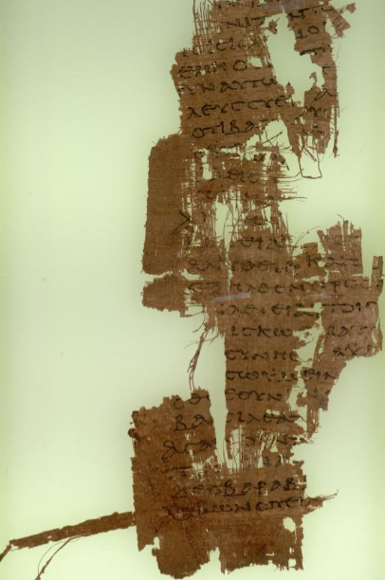
P90 Manuscript of the gospels from the 2nd Century

Slide 7
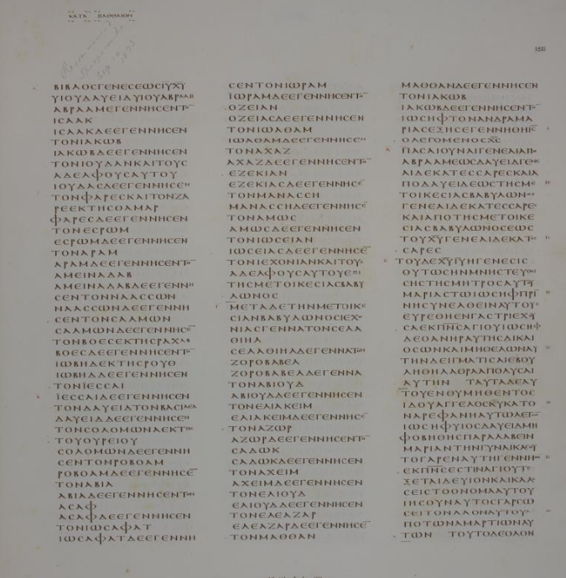
GA03 or Codex Vaticanus Which is one of the first Sets done by professional Scribes. This was about the time that the church was legalized with Constantine. This is just one of the 142 parchment leaves in Codex Vaticanus.

Slide 9
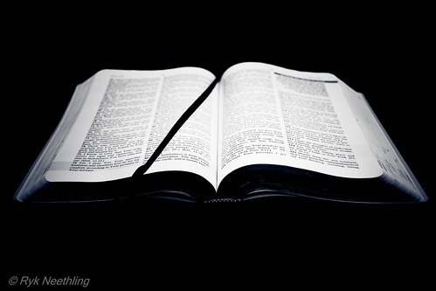
There are no major issues that change doctrines essential to the faith.

Slide 10
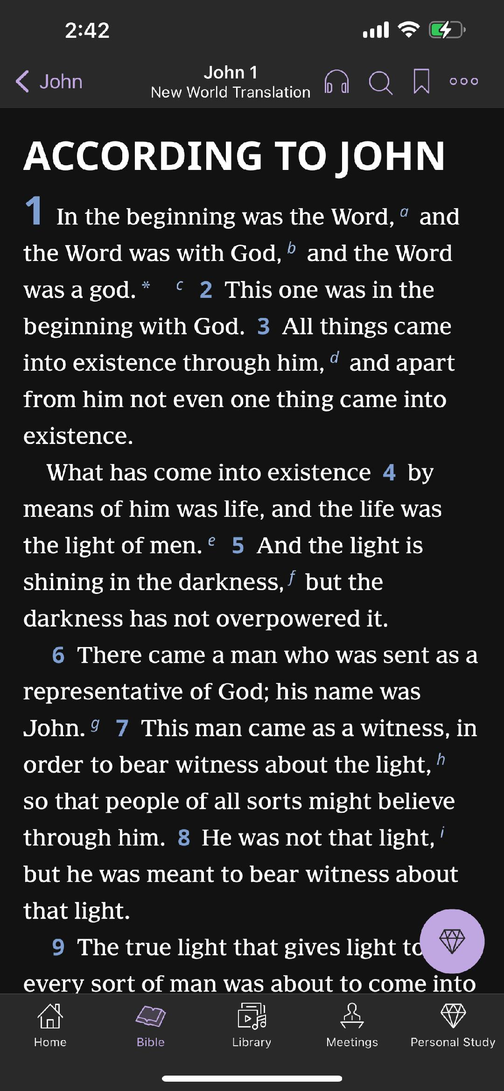

Slide 11
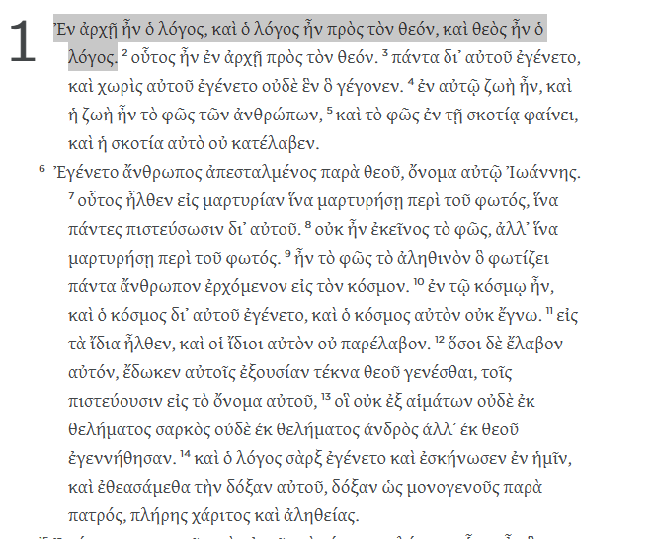
From the Tyndale
Greek New Testament

Slide 12
Trembling and bewildered, the women went out and fled from the tomb. They said nothing to anyone, because they were afraid.
Mark 16:8 (NIV)

Slide 13
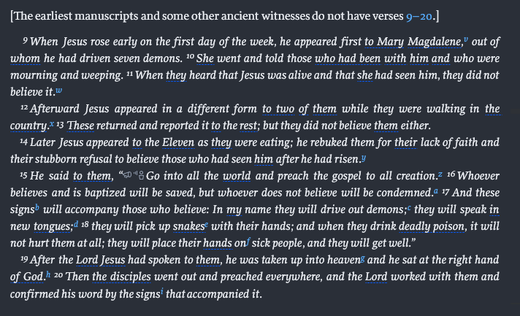
Mark 16:9-20 (NIV)

Slide 14
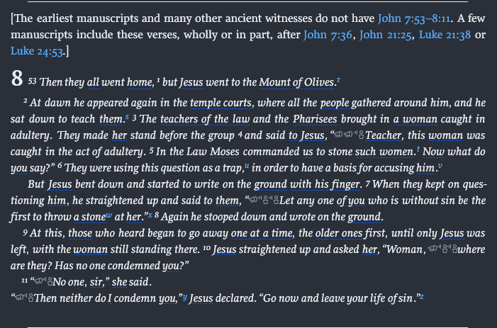
John 7:53-8:11 (NIV)

Slide 15
The truth is not that we have 50% or 75% of the original, the more accurate way of explaining the situation is that we have 100% of the original and 10% additions. The work is about weeding out he additions to get right at 100%.

Slide 20
With all of this being said, we can confidently say the New Testament is reliable beyond doubt and is trustworthy.

Slide 21
And if Christ has not been raised, our preaching is useless and so is your faith. More than that, we are then found to be false witnesses about God, for we have testified about God that he raised Christ from the dead. But he did not raise him if in fact the dead are not raised. For if the dead are not raised, then Christ has not been raised either.
1 Cor.15:14-19 (NIV)

Slide 22
And if Christ has not been raised, your faith is futile; you are still in your sins. Then those also who have fallen asleep in Christ are lost. If only for this life we have hope in Christ, we are of all people most to be pitied.
1 Cor.15:14-19 (NIV)

Slide 23
Why should you be a Christian?

Slide 24
For it is by grace you have been saved, through faith—and this is not from yourselves, it is the gift of God—not by works, so that no one can boast.
Ephesians 2:8-9 (NIV)

Slide 25
For God so loved the world that he gave his one and only Son, that whoever believes in him shall not perish but have eternal life.
John 3:16 (NIV)

