Slide 2
James 1: Written to the tribes. Many trials produce perseverance. Riches will fade. Every good gift comes from the Father. Be doers of the word.
James 2: If you show partiality to the rich you are committing sin. Act as those who are under the law of liberty. Faith without works is dead.

Slide 3
James 3: No one can tame the tongue. With it we bless our Father and with it we curse others. The wisdom from above is pure and peace-loving.
James 4: Your worldly desires cause conflict. Resist the devil, draw near to God. Who are you to judge your neighbour? You boast in arrogance.
James 5:You rich have fattened yourselves for slaughter. Brothers, be patient until the Lord comes.

Slide 4
13 Is anyone among you in trouble? Let them pray. Is anyone happy? Let them sing songs of praise. 14 Is anyone among you sick? Let them call the elders of the church to pray over them and anoint them with oil in the name of the Lord. 15 And the prayer offered in faith will make the sick person well; the Lord will raise them up. If they have sinned, they will be forgiven.
James 5:13-20 (NIV)

Slide 5
16 Therefore confess your sins to each other and pray for each other so that you may be healed. The prayer of a righteous person is powerful and effective.
17 Elijah was a human being, even as we are. He prayed earnestly that it would not rain, and it did not rain on the land for three and a half years. 18 Again he prayed, and the heavens gave rain, and the earth produced its crops.
James 5:13-20 (NIV)

Slide 6
19 My brothers and sisters, if one of you should wander from the truth and someone should bring that person back, 20 remember this: Whoever turns a sinner from the error of their way will save them from death and cover over a multitude of sins.
James 5:13-20 (NIV)

Slide 7
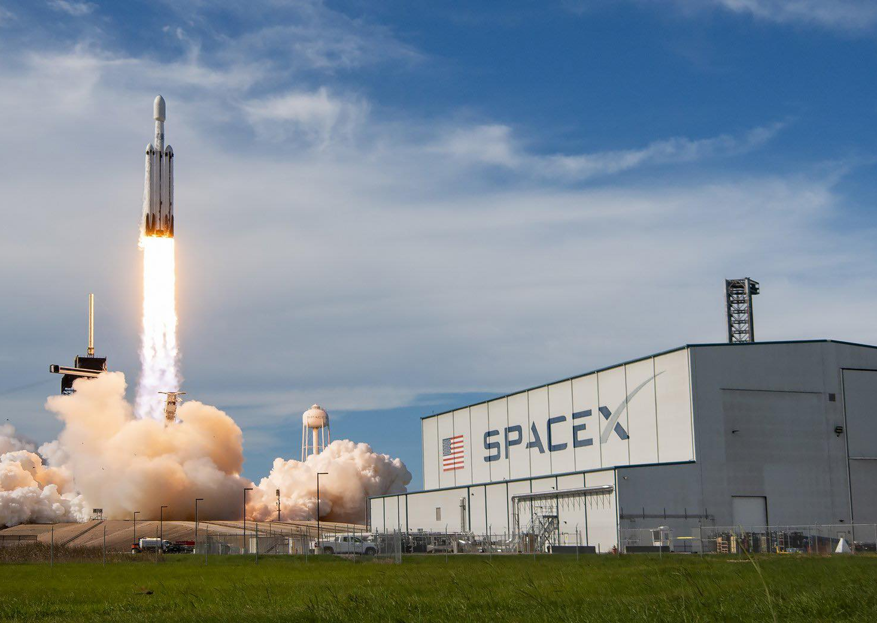
Falcon 9 is a reusable, two-stage rocket designed and manufactured by SpaceX for the reliable and safe transport of people and payloads into Earth orbit and beyond. Falcon 9 is the world’s first orbital class reusable rocket. Reusability allows SpaceX to refly the most expensive parts of the rocket, which in turn drives down the cost of space access.-SpaceX ‘24

Slide 8
Prayer is powerful

Slide 9
Prayer is not meditation or passive reflection; it is direct address to God. It is the communication of the human soul with the Lord who created the soul. Prayer is the primary way for the believer in Jesus Christ to communicate his emotions and desires with God and to fellowship with God.

Slide 10
But you, beloved, building yourselves up in your most holy faith and praying in the Holy Spirit, 21 keep yourselves in the love of God, waiting for the mercy of our Lord Jesus Christ that leads to eternal life
Jude 1:20-21 (ESV)

Slide 11
And he told them a parable to the effect that they ought always to pray and not lose heart.
Luke 18:1 (ESV)

Slide 12
Rejoice in hope, be patient in tribulation, be constant in prayer.
Romans 12:12 (ESV)

Slide 13
…Praying at all times in the Spirit, with all prayer and supplication. To that end, keep alert with all perseverance, making supplication for all the saints,
Ephesians 6:18 (ESV)

Slide 14
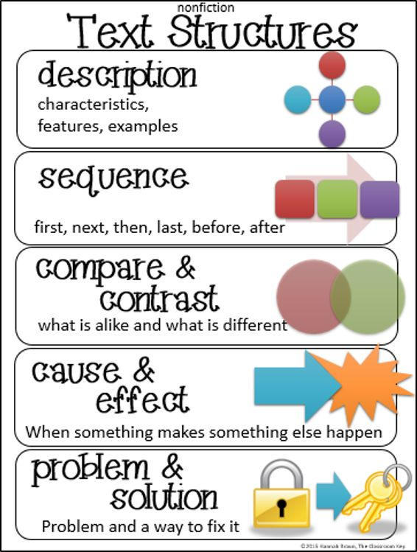
Phrase or sub point

Slide 15
13 Is anyone among you in trouble? Let them pray. Is anyone happy? Let them sing songs of praise. 14 Is anyone among you sick? Let them call the elders of the church to pray over them and anoint them with oil in the name of the Lord. 15 And the prayer offered in faith will make the sick person well; the Lord will raise them up. If they have sinned, they will be forgiven.
James 5:13-15 (NIV)

Slide 16
13 Is anyone among you in trouble? Let them pray. Is anyone happy? Let them sing songs of praise. 14 Is anyone among you sick? Let them call the elders of the church to pray over them and anoint them with oil in the name of the Lord. 15 And the prayer offered in faith will make the sick person well; the Lord will raise them up. If they have sinned, they will be forgiven.
James 5:13-15 (NIV)

Slide 17
Our prayers ought also to be filled with God's praise as we consider His goodness and grace.

Slide 18
For the wages of sin is death, but the free gift of God is eternal life in Christ Jesus our Lord.
Romans 6:23 (ESV)

Slide 19
Prayer is powerful
Prayer is purposeful

Slide 20
Why do we pray?
…to glorify God.
…to prepare our hearts.
…to be instructed.
…to adore, praise wonder.
…to confess.
… to thank Him.

Slide 21
Why do the nations say,
“Where is their God?” Our God is in heaven;
he does whatever pleases him.
Psalm 115:3 (ESV)

Slide 22
Do not be quick with your mouth,
do not be hasty in your heart
to utter anything before God.
God is in heaven
and you are on earth,
so let your words be few.
Ecclesiastes 5:2 (NIV)

Slide 23
Prayer is powerful
Prayer is purposeful
Prayer is persistentful persistent

Slide 24
Rejoice always, pray without ceasing, give thanks in all circumstances; for this is the will of God in Christ Jesus for you.
1 Thessalonians 5:16 (NIV)

Slide 25
Prayer in Concentric Circles
Missionaries, Christianity
Crosby Community Church
Our nation, Our world
My Family
Myself
My Family
“But if you have a pattern—like the concentric circles—you won’t spin your wheels wondering where to start.”
-Challies, 2014
Crosby Community Church
Our nation, Our world
Missionaries, Christianity

Slide 26
Prayer is powerful
Prayer is purposeful
Prayer is persistent
Prayer is accountable

Slide 27
16 Therefore confess your sins to each other and pray for each other so that you may be healed. The prayer of a righteous person is powerful and effective.
James 5:16 (NIV)

Slide 28
If we confess our sins, he is faithful and just and will forgive us our sins and purify us from all unrighteousness.
1 John 1:9(NIV)

Slide 29
17 Elijah was a human being, even as we are. He prayed earnestly that it would not rain, and it did not rain on the land for three and a half years. 18 Again he prayed, and the heavens gave rain, and the earth produced its crops.
James 5:17 (NIV)

Slide 30
Prayer is powerful
Prayer is purposeful
Prayer is persistent
Prayer is accountable
Prayer is for the wanderer

Slide 31
19 My brothers and sisters, if one of you should wander from the truth and someone should bring that person back, 20 remember this: Whoever turns a sinner from the error of their way will save them from death and cover over a multitude of sins.
James 5:13-20 (NIV)

Slide 32
Ultimately accountability can be a means in which God draws us to himself. Self-sufficiency says we don’t need anyone, but humility shouts for help from those God has placed in our lives. This habit of sharing and praying with others will inevitably teach us how to cast our cares on the only One who can fully bear their weight and who loves us with an unfailing love.
-Daniel Westfall

Slide 33
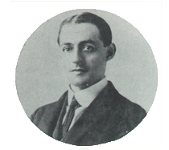
“Here then is the design of prayer: not that God’s will may be altered, but that it may be accomplished in his own good time and way”
-A.W. Pink
The Sovereignty of God: 1918

Slide 35
Prayer is powerful
Prayer is purposeful
Prayer is persistent
Prayer is accountable
Prayer is for the wanderer

